Slide 1
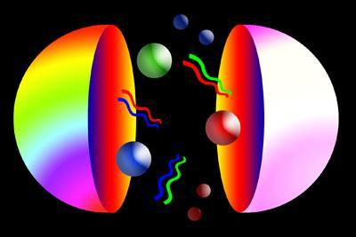
Quarks
By Sarah Newton and Samantha Arkin

Slide 2
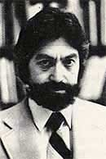
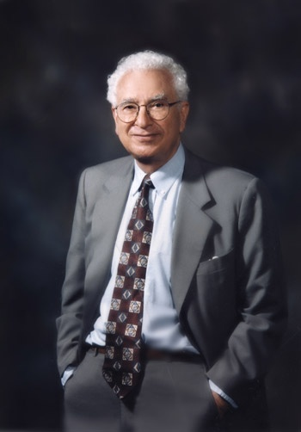
A little background
Murray Gell-Mann and George Zweig discovered that particle are made of 3 base particles
Called elementary particles
Protons and neutrons are made of
Quarks
Quarks are classified into 6
Catagories called “flavors”

Slide 3
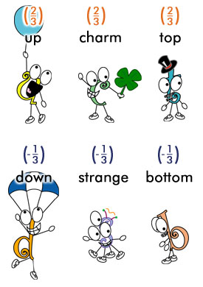
The 6 “Flavors” of quarks
The up quark or u quark is the lightest quark
The down quark or d quark is the second-lightest quark
The strange quark or s quark is the third-lightest quark
The charm quark or c quark is the third heaviest quark
The top quark, also known as the t quark or truth quark is the heaviest of all quarks
The bottom quark or b quark, also known as the beauty quark

Slide 4
Electric Charges
Quark name | Charge
Up Quark | 2/3
Down Quark | -1/3
Top Quark | 2/3
Bottom Quark | -1/3
Strange Quark | -1/3
Charm Quark | 2/3

Slide 5
Antiquarks
Top quark/anti-top
Bottom quark/anti-bottom
Technically there are 12 quarks
Between these 12 quarks you can create almost anything

Slide 6
All Matter
Known Matter
Leptons Hadrons
Baryons Mesons
3 Quarks 1 quark + 1
(or antiquarks) antiquark
Dark Matter
?

Slide 7
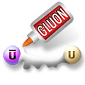
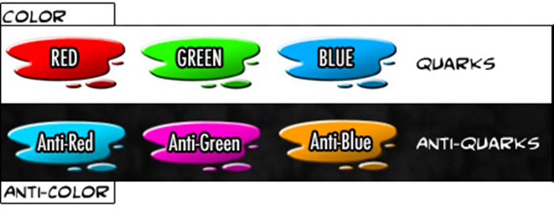
Color Charge
Quarks have a color charge
Gluons are color charge carriers
Quarks communicate through gluons

Slide 8
Spin
Spin: an intrinsic property of elementary particles, and its directions is an important degree of freedom
Can be represented by a vector that is measured in the unit ħ.
Classified as spin -1/2 particles
Example: an up quark with a spin of +1/2 along the z axis is denoted by u

Slide 9
Weak Interactions
Quarks can transform into another flavor but only through weak interaction
Absorbing a W boson can change any up quark into a down quark and vice versa
Beta decay: a neutron “splits” into a proton
Occurs when a down quark decays into an up quark by emitting a W boson

Slide 10
Weak Interactions
Beta decay and Inverse decay are used in medical applications such as PET (positron emission tomography) and neutrino detection
Transformation of flavor happens to every quark but each quark has a preference

Slide 11
Strong Interactions
Quarks posses a color charge
Blue, Green, and Red
Antiblue, Antigreen, and Antired
Every quark carries a color and every antiquark carries an anticolor
System of attraction and repulsion
Different combinations of the three colors are called strong interaction

Slide 12
Mass
Current quark mass
The mass of the quark itself
Constituent quark mass
Current quark mass plus the mass of the gluon field surrounding the quarks
Hadron’s mass is from the gluons that bind the constituent quarks
Gluons are inherently massless, but have energy

Slide 13
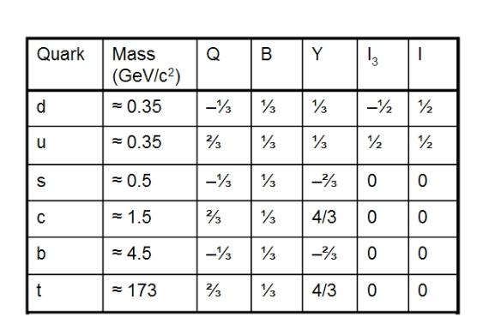
Properties of quarks

Slide 14
Interacting Quarks
When a gluon is transferred to a quark a color changes in both
Gluons are able to emit and absorb other gluons
Causes asympotic freedom
Quarks coming closer to each other, while the chromodynamics binding force between them weakens
As distance increases the binding force strengths

Slide 15
Sea Quarks
Hadrons that contribute to their quantum numbers contain virtual quark-antiquarks called Sea Quarks
Form when a gluon of the hadron’s color field splits
Much less stable than their valence counterparts
Can hadronize into baryonic or mesonic particles

Slide 16
The END
http://youtu.be/xYZkj2FPeoc

