Slide 1
Quarks
By Noah, Jon, Riley, and Nick

Slide 2
Atom
Hadron
Meson/Baryon
Quarks
Flavors
Color Charge

Slide 3
A hadron is made of quarks put together.
In Greek, hadron means thick or stout.
There are two families of hadrons: baryons and mesons.
Baryons are made up of three quarks.
Mesons are a quark and an antiquark pair.
Protons and Neutrons are both baryons.

Slide 4
There are six different “flavors” of quarks.
They aren’t technically flavors, but are a way to classify them.
The six different “flavors” of quarks:
Up
Down
Strange
Charm
Top
Bottom

Slide 5
Up and down quarks have the lowest masses of all the “flavors.”
The other four “flavors” decay through a process called beta decay.
This beta decay reduces the mass, turning them into lower mass quarks (up and down quarks).
The four higher mass quarks can only be created in particle accelerators or cosmic rays in the first place.

Slide 6
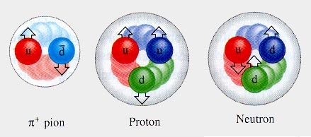
Color Charge
No Quarks don’t actually have color, this refers to their charges that they are constantly exchanging
Quarks are held together by this color charge, which is related to the Strong Nuclear force.
Quarks are constantly changing color, and they use Gluons to change color within the Protons and Neutrons.

Slide 7
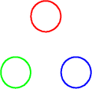
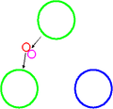
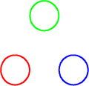
Here is a basic Baryon, it has three quarks and each Quark has there own color
The red Quark decides it wants to change color, and it emits its red charge along with its anti green charge, making the Quark turn green
The bottom Quark absorbs the Anti-red and the Anti-green, making the particle Red. As shown to the right.

Slide 8
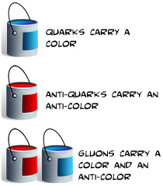
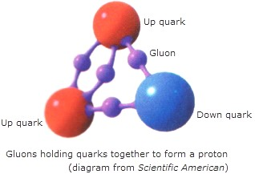
Gluons
Gluons mediate the strong force and the hold the quarks within the proton or neutron together.
Gluons have no mass and no electric charge, this is because they contain all the color charges and all of the anti color charges so it makes it have no charge.
They are 8 different types of Gluons!
Gluons don’t exist independently, they only exist when Quarks interact.
QUARKS EMIT GLUONS , AND GLUONS ALSO EMIT OTHER GLUONS OVER AND OVER AGAIN

Slide 9
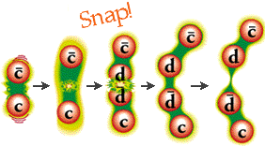
Gluon Interactions
As said before, Gluons can not exist alone and only exist when the Quarks interact, but how do they interact?
One way Gluons interact is when Quarks are exerting too much energy and separate, the Gluons make it easier just to create another Quark using the color charges they carry.
Gluons also interact in color charge, because they carry all types of color charge and different types of Quarks.
When Quarks are trying to separate the Gluon field gets stronger, trying to bring them back. When it gets to strenuous, they just snap and make a new group, which are called hadrons.

Slide 10
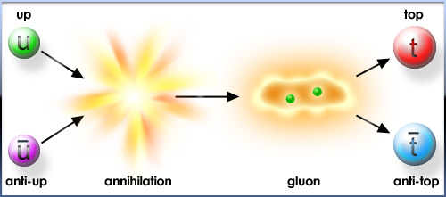

Slide 11
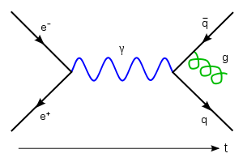

Slide 15
What is Strong Nuclear Force ??
The Strong force holds the nucleus of the atom together but it only works with Quarks
There are four basic forces in “nature” gravity, the electromagnetic force, the weak nuclear force and the strong nuclear force
It is the strongest of all the forces but, its effects are “small” in how it can only effect over a very small range

Slide 16
Its main job is to hold together the subatomic particles of the nucleus (protons, which carry a positive charge, and neutrons, which carry no charge, It doesn’t effect the Electrons )
Its responsible for 98% of the nuclear mass

Slide 17
Weak Nuclear force
Weak Nuclear force also has the ability to change the color of the quarks
Weak interactions are responsible for the decay of massive quarks and leptons into lighter quarks and leptons
Weak nuclear force can make protons in to neutrons and neutrons into protons

Slide 18
The weak interaction is the only process in which a quark can change to another quark, or a lepton to another lepton - the so-called "flavor changes".

Slide 19
History
The quark model was independently proposed by physicists Murray Gell-Mann and George Zweig in 1964.
Came upon the idea by using particle accelerator.
Purpose is to hit the atoms together at extremely high speeds to break them apart.
They then use detector to observe the quarks that are now visible.
Sense quarks are only visible for very small amounts of time (most only last for 10 ⁻⁴² seconds) the detector is very high tech to pick up the video.
The names of the quarks were chosen at random.
The name quarks was undecided after finding the existence of the particles. Gell-Mann names them quarks after reading a book that mentioned a quark.
Three years before the finding of the particles he was working on formula for “eightfold way” which means flavor symmetry.
Flavors are 6 different types of quarks.
After the discovery of the third flavor the last three were discovered by other scientists.

Slide 20
History
The names of the quarks were chosen at random.
The name quarks was undecided after finding the existence of the particles. Gell-Mann names them quarks after reading a book that mentioned a quark.
Three years before the finding of the particles he was working on formula for “eightfold way” which means flavor symmetry.
Flavors are 6 different types of quarks.
After the discovery of the third flavor the last three were discovered by other scientists.

Slide 21
