Slide 1
Plankton
Amphipod
Copepod
Nauplii
Comb jelly
Brittle star larva
Gastropod larva
Zoea larva of crab
Megalops larva of crab
Exoskeleton of Barnicle molt
Ostracod
Small jellyfish
Tintinnid
Fish larva
Diatoms
Dinoflagellates
Caldoceran and caldocran larva

Slide 2
Plankton – General
“plankton” – meaning drifter or wanderer
Zooplankton
“zoo” - of or relating to animals
Heterotrophic
Often have locomotive capability
Phytoplankton
“phyto” – plant
Autotrophic
Sequesters carbon in the ocean

Slide 3
Plankton – General
Holoplankton
Spend entire lifecycle in the water column
Examples: diatom, amphipod, dinoflagellate, krill, copepod
Meroplankton
Spend only part (usually larva stage) in the water column
Examples: sea urchin, sea star, crustacean, worms, fish, macroalgae, jelly fish

Slide 4
Plankton Types
Copy the chart into your notebook
Leave about ½ a page PER type of plankton to add notes to
Read “Plankton Hall of Fame” and write at least 3 notes for each type of plankton you come across
Tomorrow we will fill in any missing parts you might have as well as look at pictures of plankton endemic to the Puget Sound

Slide 5
Plankton Types
Type of Plankton | Notes – at least three points
Phytoplankton
Protozoans | SKIP THIS ONE
Diatoms
Dinoflagellate
Phytoflagellate
Amphipod
Copepod
Rotifer
Coelenterate – Cnidaria
Ctenophore
Chaetognath
Mollusk
Chordate
Larvae

Slide 6
Phytoplankton
Oldest life forms and suited to their environment
Single cell
Cell membrane
Cytoplasm
Armored in some
Photosynthesize
Limiting nutrient – nitrogen
Binary fission

Slide 7
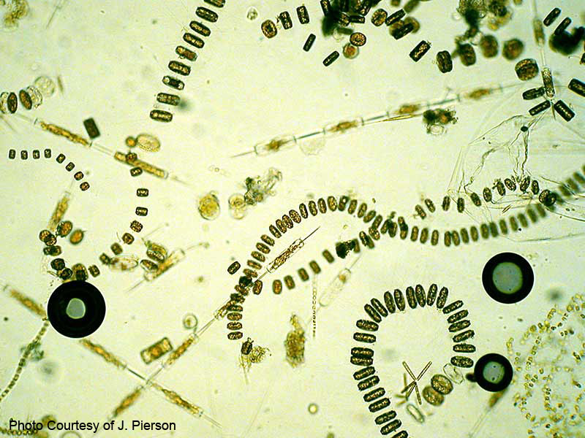
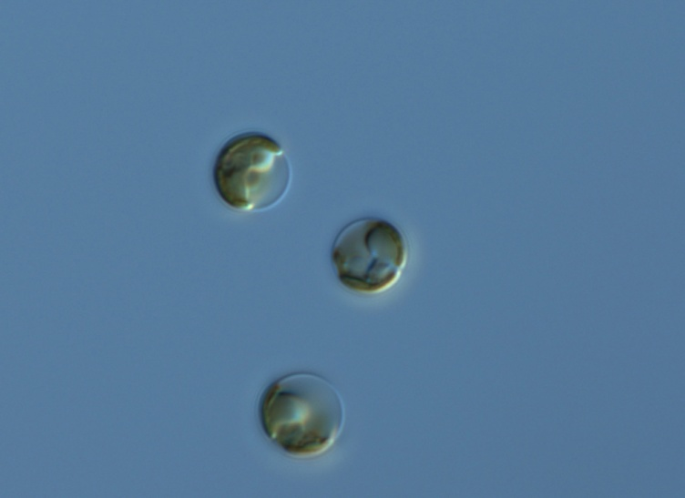
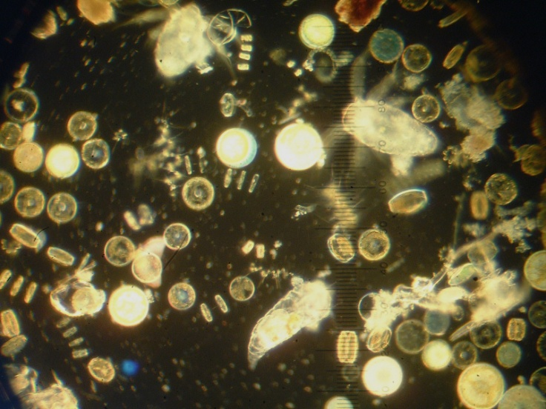
Phytoplankton
Sexual reproduction
Most likely when under stress
Lifecycle varied
Spore/cysts
Years at a time

Slide 8
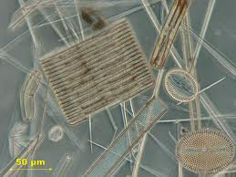
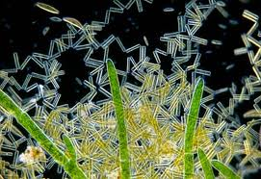
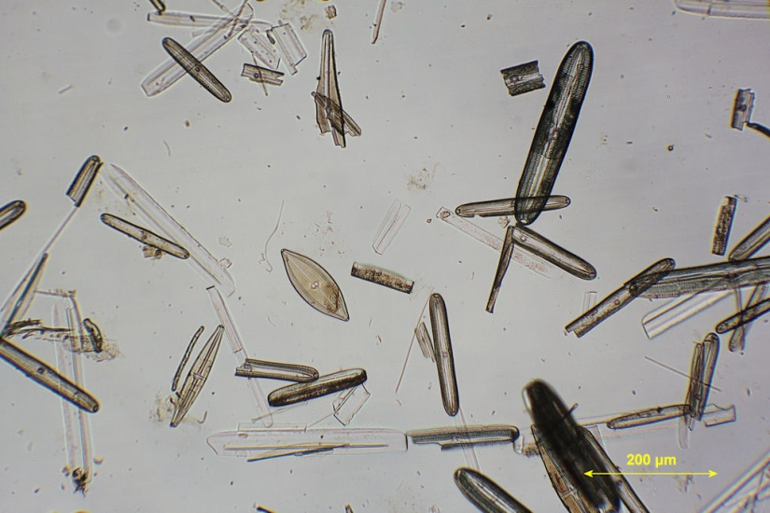
Diatoms - Heterokontophyta
Photosynthetic
Body made of silica (heavy)
Active transport of ions to regulate density
Spiny to increase surface area – increase float
Frustules – Petri dish shape
pseudo-nitzschia can cause PSP through Domoic Acid
Identifying – centric vs. pennate

Slide 9
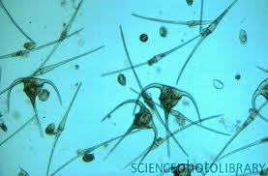
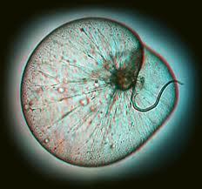
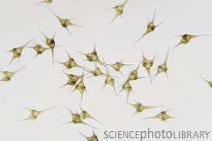
Dinoflagellate- Alveolate
~50% obligate heterotropes
Can be autotrophes or hetertropes
Identifying
Two cones, joined, two flagellum
Migration in water column
Can cause Paralytic Shellfish Poisoning (PSP)
Ex: noctiluca, zooxanthellae, Pfiesteria

Slide 10
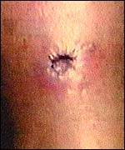
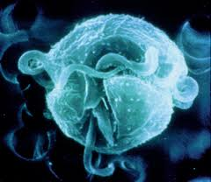
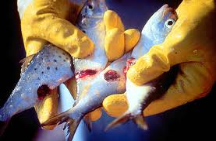
Dinoflagellate- Alveolate
Pfiesteria piscicida
“fish killer”
1993 new culture facility – staff got sick – brain dead
Class 3 biohazard
Changes itself depending on needs

Slide 11
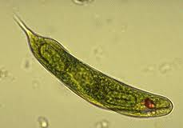
Phytoflagellates
AKA nanoflagellate
Small
Little known
Any photosynthetic organism that has a flagella
Most likely you wont see these

Slide 12
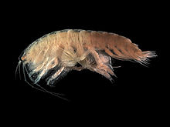
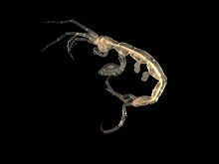
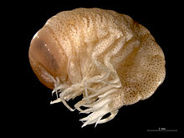
Amphipod - Arthropoda
1-340 mm in size
Has been found at 5,300 m
Largest 28 cm in length
Typically 10 mm

Slide 13
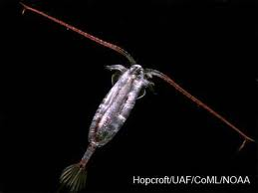
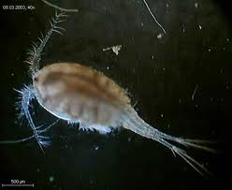
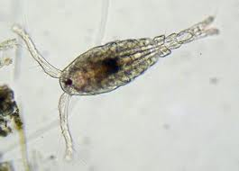
Copepod - Arthropoda
Three types – based on antenna length
Calanoida, harpactiocida, cyclopodia
Travel by “fling and clap”
Eat up to 370,000 cells/day
1-5 mm length
Migrate in the water column

Slide 14
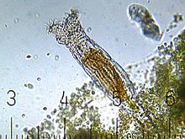
Rotifers
Pseudocoelomate
0.1–0.5 mm
Mostly freshwater
Multicellular
Reproduce sexually

Slide 15
Coelenterate - Cnidaria
Corals and anemone
Part of the life in the plankton
Medusa
Hydra – produces the medusa stage
Hunt with cnidoblasts
Poison dart to embed in the prey

Slide 16
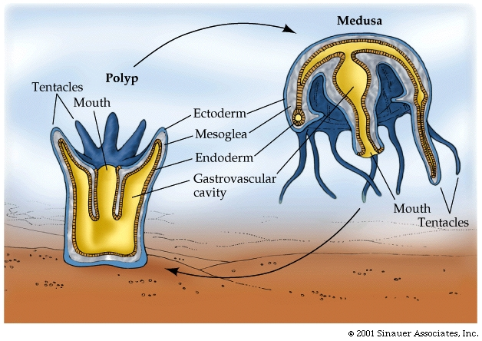

Slide 17
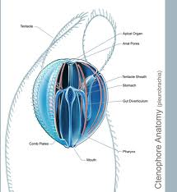
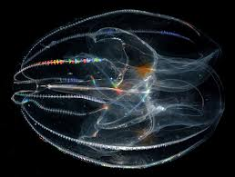
Ctenophore
Comb jelly
Do not have singers
Do have “sticky” tentacles that catch prey
Can eat up to 10X body mass/day

Slide 18
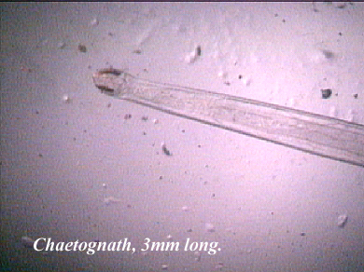
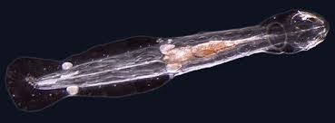
Chaetognaths
Sagitta
“arrow worm”
Predator
Most likely will not see

Slide 19
Mollusks
Mostly not planktonic
Squid octopi, clams, mussels, snails, slugs, nudibranch
Sea butterfly – only planktonic mollusk known

Slide 21
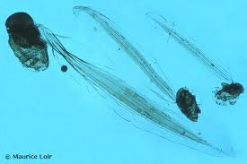
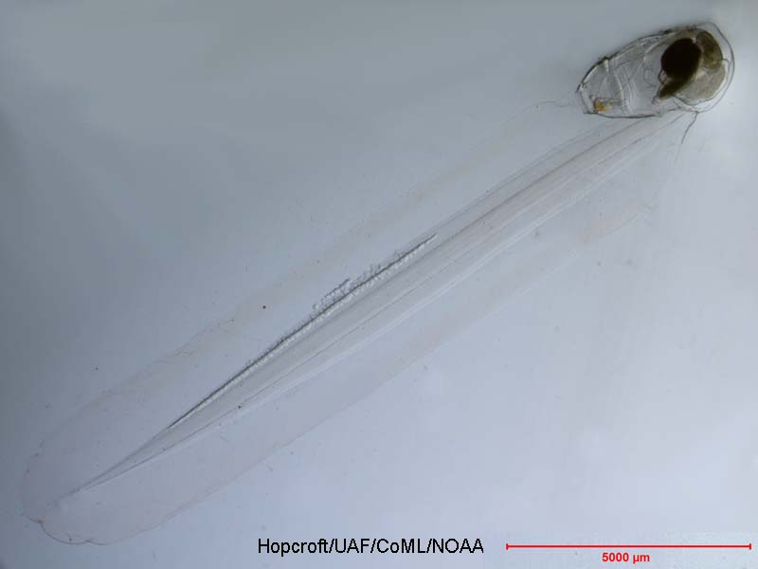
Chordate
Most are nektonic
Oikopleura
Secrete mucus to capture prey
Makes a house
Hermaphrodite

Slide 22
Larvae
Meroplanktonic larvae
Most ciliated
Include
Shipworms, barnacles, mussels, bryozoans, sponges, sea urchins, starfish, sand dollars, sea cucumbers, some fish

Slide 23
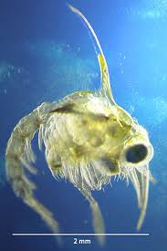
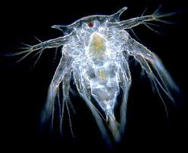
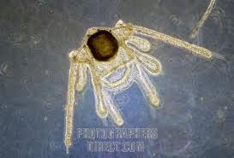
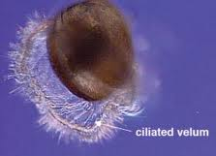
Larvae
Crabs
Brittle Stars
Fish
Barnacles
Mussels
Jellyfish

