Slide 1
Leptons
lepton comes from the Greek language and stands for “fine, small, thin”
leptons are basically electrons, first discovered in 1897
around that time physicists created new categories for all the discovered particles like the electron, muon, and neutrino
in 1948, Leon Rosenfeld coined the term “lepton” for those particles

Slide 2
Categories/Types
2 categories: -charged leptons, also known as electrons
-neutral leptons, also known as
neutrinos
6 types: -electron (e−)
-electron neutrino (Ve)
-muon (μ−)
-muon neutrino (Vμ)
-tau (τ−)
-tau neutrino (Vτ)

Slide 3
Properties 1
elementary, spin-¹⁄₂ particle that does not undergo strong interactions
charged leptons can combine with other particles to form various composite particles such as atoms and positronium
the heavier muons and taus will rapidly change into electrons through a process of particle decay (transformation from a higher mass state to a lower mass state)

Slide 4
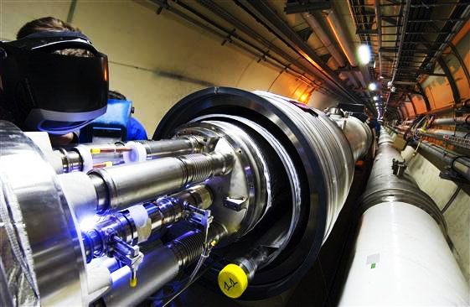
Properties 2
electrons have the least mass of all the charged leptons, and are therefore stable
not subject to strong interactions; but to fundamental interactions (gravitation, electromagnetism, weak interactions)
particle accelerator
for muons and taus (also cosmic rays)

Slide 5
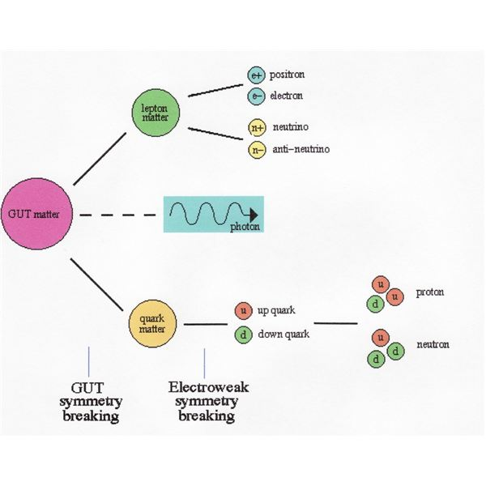
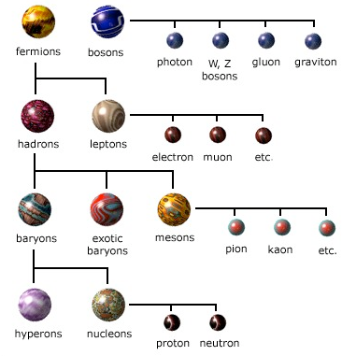

Slide 6
Works cited
Wikipedia, the free encyclopedia. N.p., n.d.
Physics. N.p., n.d.

