Slide 1
Cell Cycle Regulation and Cancer

Slide 2
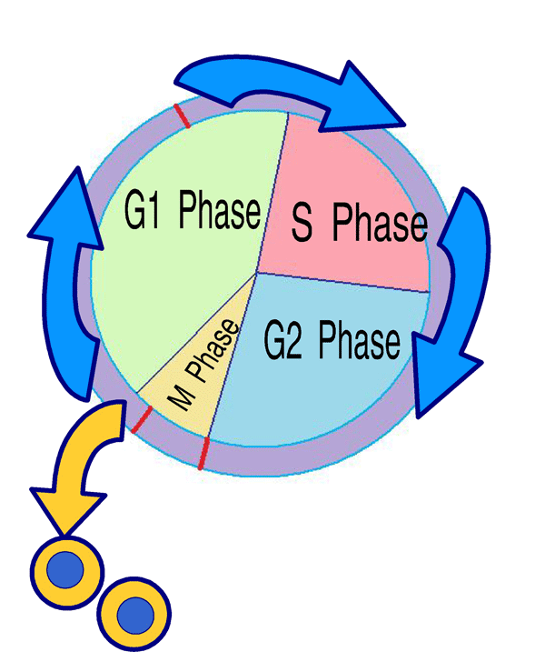
3 Checkpoints
Control the cell cycle (inspection points)
Make sure the cell is ready to move into the next phase.
Mitosis “out of control” leads to cancer

Slide 3
What is Cancer?
Abnormal cell growth (neoplasia)
Benign: slow growth, non-invasive, no metastasis (spread of cancer)
Malignant: rapid growth, invasive, potential for metastasis

Slide 4
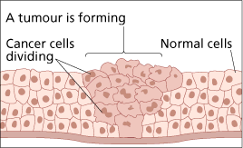
Cancer cells
Cancer cells have escaped internal and/or external control
  Lose contact inhibition
  divide indefinitely if have continual supply of nutrients
  Cancer cells may be “immortal” – can replace telomeres
Usually immune system recognizes (by surface proteins) and destroys transformed cells
Cells that evade destruction multiply to form a tumor, a mass of abnormal cells

Slide 5
Cancer cells
Benign tumors
  Abnormal cells remain at originating site as a lump
  Do not invade other tissues but may push them aside
  Most do not cause serious problems and can be removed by surgery
Malignant tumors
  Grow into and invade other tissues
  Cells lose attachment to nearby cells & are carried by the blood & lymph system to other tissue - metastasize

Slide 6
Cancer cells
Treatments:
Chemotherapy:
  targets rapidly dividing cells
  Interferes with enzyme production in control of cell cycle or DNA replication
Surgery:
  removes tumor
Radiation:
  Kills cells in tumor
Prevention:
  modify behavior to eliminate risk factors
  Known carcinogens, smoking, sunburn, diet and exercise

Slide 7
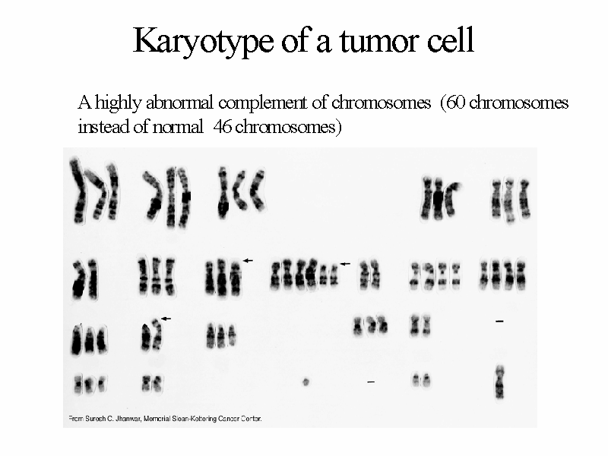

Slide 8
US Mortality, 2003
No. of deaths
% of all deaths
Rank
Cause of Death
1. Heart Diseases 685,089 28.0
2. Cancer 556,902 22.7
3. Cerebrovascular diseases 157,689 6.4
4. Chronic lower respiratory diseases 126,382 5.2
5. Accidents (Unintentional injuries) 109,277 4.5
6. Diabetes mellitus 74,219 3.0
7. Influenza and pneumonia 65,163 2.7
8. Alzheimer disease 63,457 2.6
9. Nephritis 42,453 1.7
10. Septicemia 34,069 1.4

Slide 9
2006 Estimated US Cancer Cases*
Men
720,280
Women
679,510
Prostate 33%
Lung & bronchus 13%
Colon & rectum 10%
Urinary bladder 6%
Melanoma of skin 5%
Non-Hodgkin 4% lymphoma
Kidney 3%
Oral cavity 3%
Leukemia 3%
Pancreas 2%
All Other Sites 18%
31% Breast
12% Lung & bronchus
11% Colon & rectum
6% Uterine corpus
4% Non-Hodgkin
lymphoma
4% Melanoma of skin
3% Thyroid
3% Ovary
2% Urinary bladder
2% Pancreas
22% All Other Sites
*Excludes basal and squamous cell skin cancers and in situ carcinomas except urinary bladder.
Source: American Cancer Society, 2006.

Slide 10
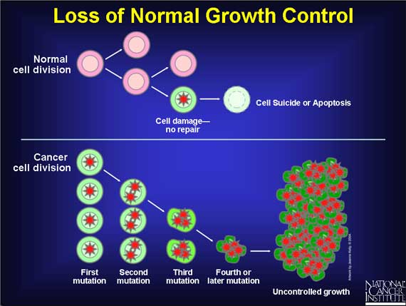
Cancer Cells

Slide 11
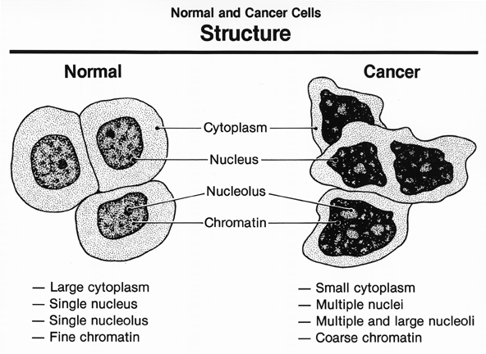
What do cancer cells look like?

Slide 12

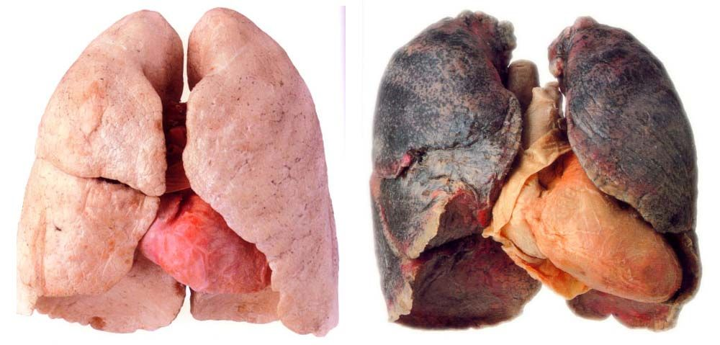
Causes of Cancer
Carcinogenic chemicals
tobacco, asbestos, dioxins, UV rays

Slide 13
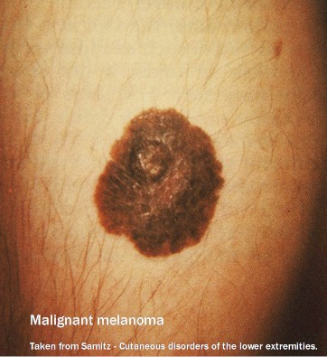
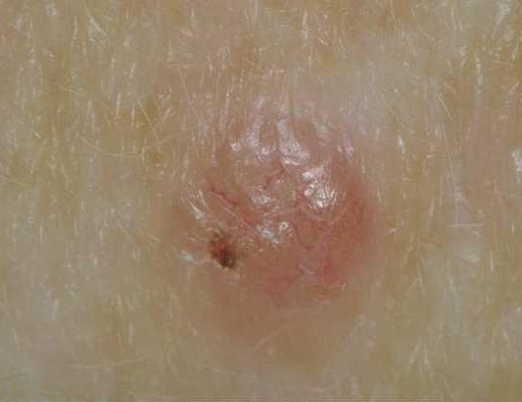
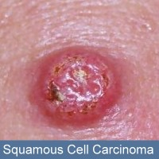
3 Types of Skin Cancer
Melanoma: Dear 16 year-old me
U.S. Estimated Skin Cancer Cases (2007)
Melanoma
60,000
Basal Cell Carcinoma
250,000
Squamous Cell Carcinoma
850,000
From ACS Facts and Figures 2007
Notes:
(7) American Cancer Society Cancer Facts and Figures, 2007. American Cancer Society Publication. Atlanta, GA. 2007.

Slide 14
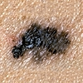
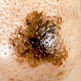
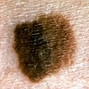
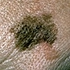
Detection of Skin Cancer
Border
Color
Asymmetry
Diameter
Images Courtesy of: The Skin Cancer Foundation, www.skincancer.org

Slide 15
Skin Cancer Deaths
U.S. Estimated Skin Cancer Deaths (2007)
Basal and Squamous
Cell Carcinoma
2,000
Melanoma
8,110
From ACS Facts and Figures 2007
Notes:
(7) American Cancer Society Cancer Facts and Figures, 2007. American Cancer Society Publication. Atlanta, GA. 2007.

Slide 16



The Sun and You
Benefits of the SUN
  The sun triggers Vitamin D synthesis, which is good for the body
  Only SMALL amounts of sunlight are needed (10-15 minutes; NOT a suntan)
  Vitamin D is found in foods such as eggs, fish, and cheese
Vitamin D
Vitamin D

Slide 17
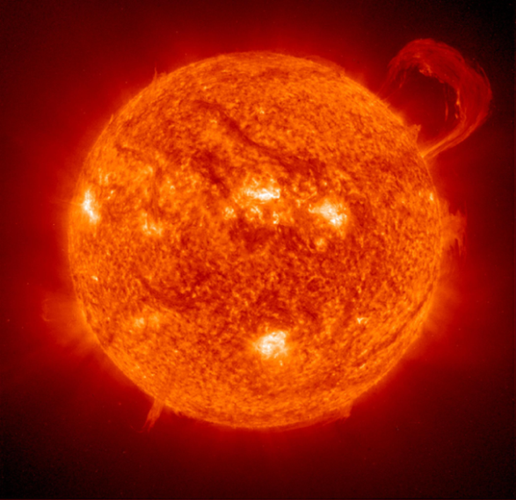



Prevention
American Cancer Society Recommendation
“Slip! Slop! Slap! Wrap!”
Slip on a shirt,
Slop on 15 SPF (or higher) sunscreen,
Slap on a hat, Wrap on sunglasses
before any exposure to the sun.
* From ACS Skin Cancer Fact Sheet 2006

