Slide 1
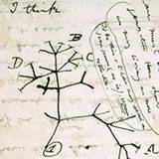
Evolution NOTES: Darwin’s 2 Main Points

Slide 2
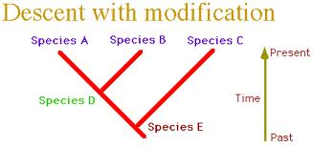
1. Decent with Modification
Change over time within one species.
Relationships and similarities between different species found today because they had a common ancestor in the past.

Slide 3
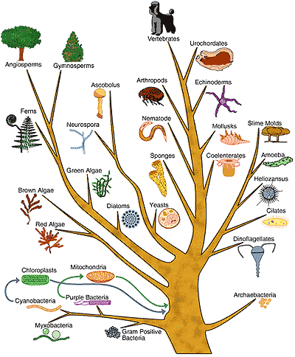
Tree of Life

Slide 4
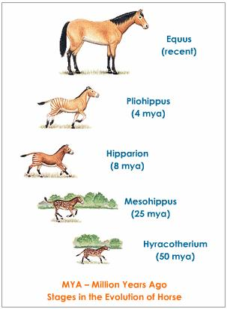
Example:

Slide 5
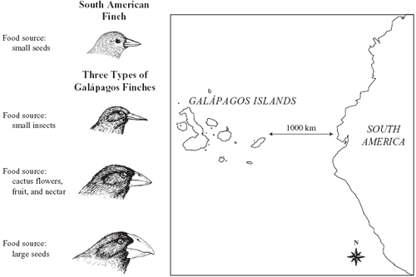
Darwin’s Finches
Finch ancestors came from SA to the Galapagos
Different islands, different environments
Today – each island has own species – 13 species total!

Slide 6
2. Natural Selection 4 Factors:
1. Genetic Variation
2. Overproduction of Offspring
3. Struggle to Survive
4. Successful Reproduction

Slide 7
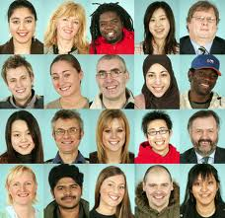
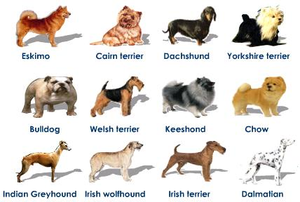
1. Genetic Variation
Each individual is different
Variations caused by random mutations, sexual selection

Slide 8
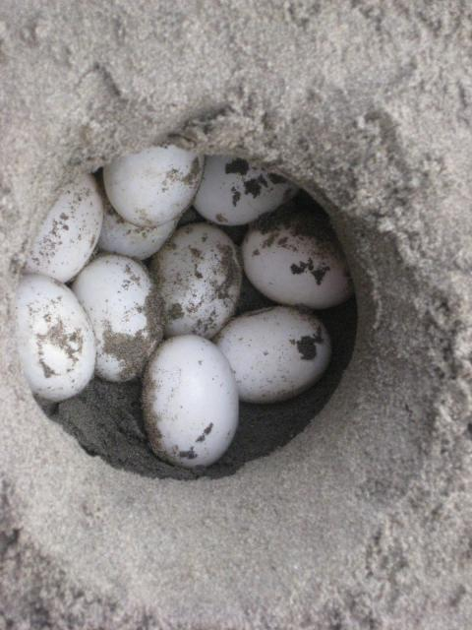
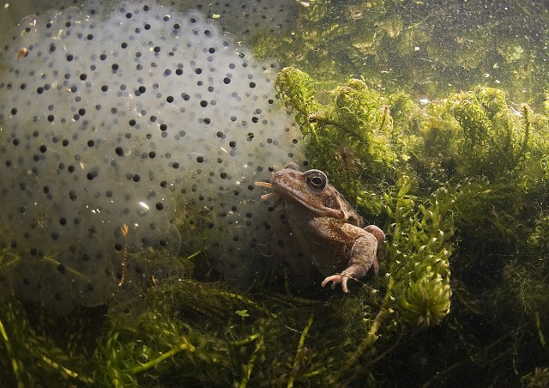
2. Overproduction of offspring
More organisms are born than can survive

Slide 9
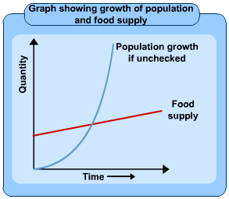
3. Struggle to survive
Environmental pressures
disease, war, famine, competition

Slide 10
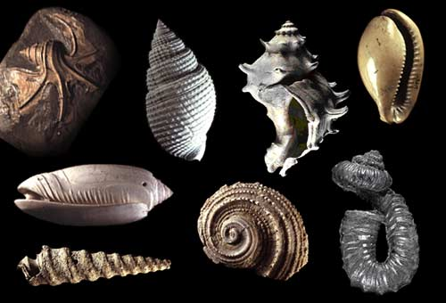
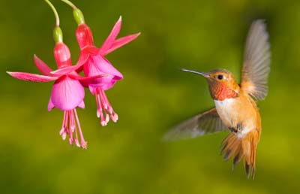
4. Successful reproduction
“survival of the fittest”
Individuals with favorable variations (adaptations) are more likely to survive and reproduce
Natural Selection
NS and Insects

Slide 11
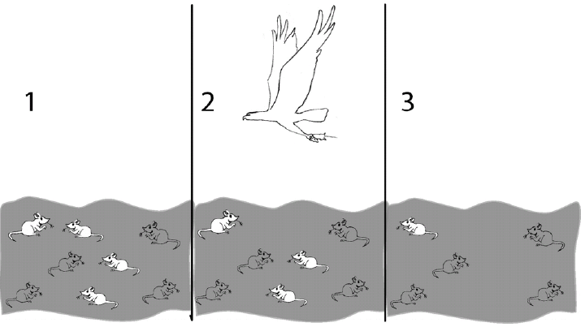

Slide 12
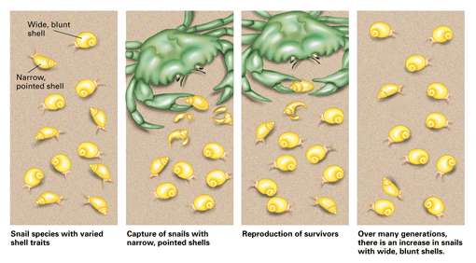
Change through Natural Selection
In this hypothetical population of snails, inherited shell variations make some snails less likely than others to be attacked by predators. Wide, blunt shells increase the chances for snails to survive and pass their traits to the next generation by reproducing. Over time, what happened to the frequency of snails with narrow, pointed shells?

Slide 13
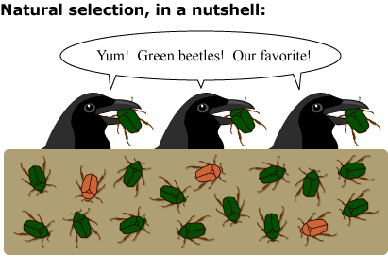
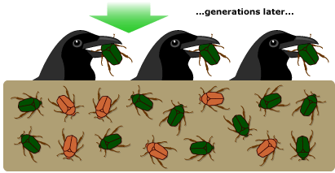
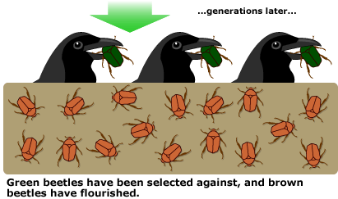

Slide 14
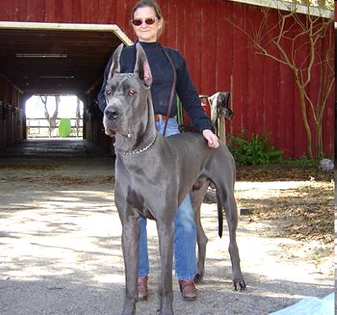
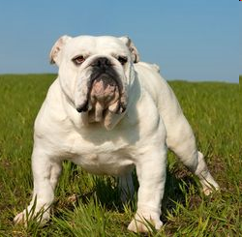
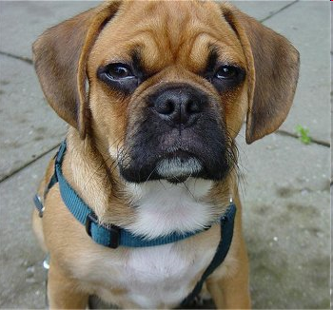
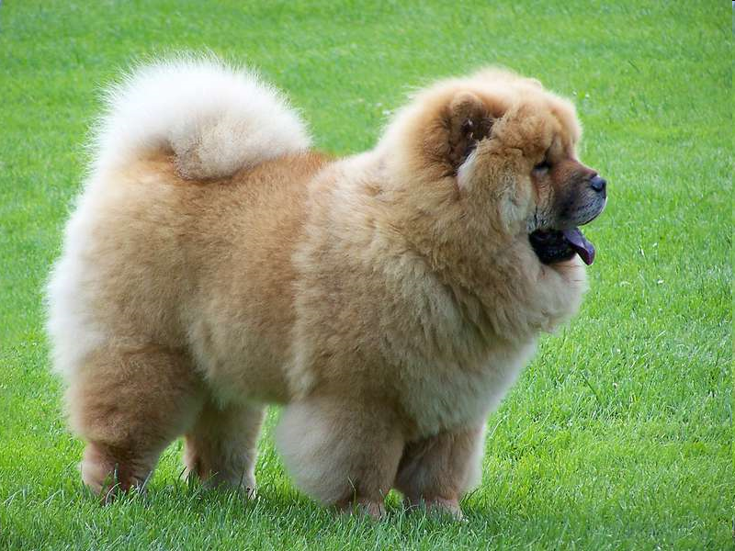
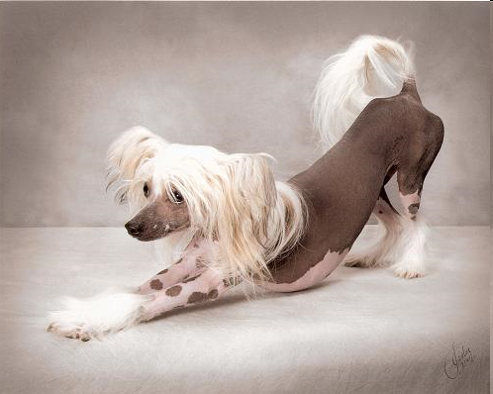
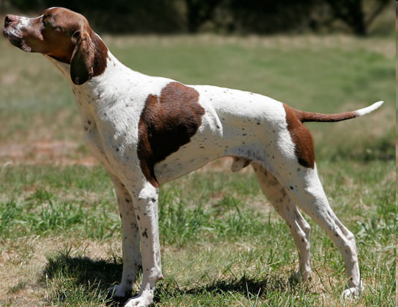
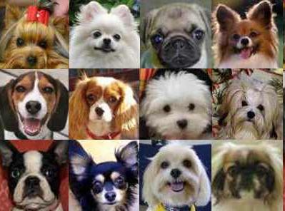
Artificial Selection
Human pressure: Humans select which individuals will mate to produce offspring with desired traits.

Slide 15
The Making of the Fittest
Natural Selection in Humans – Sickle cell
Rock Pocket mouse

