Slide 1
Cancer Activity

Slide 2
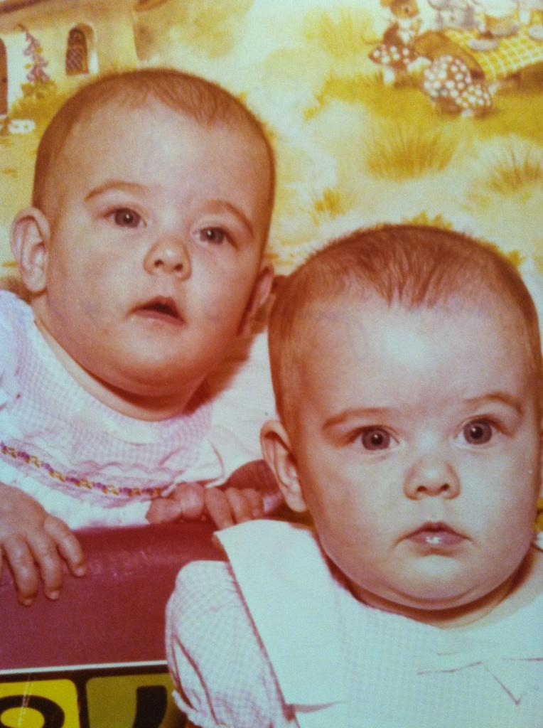
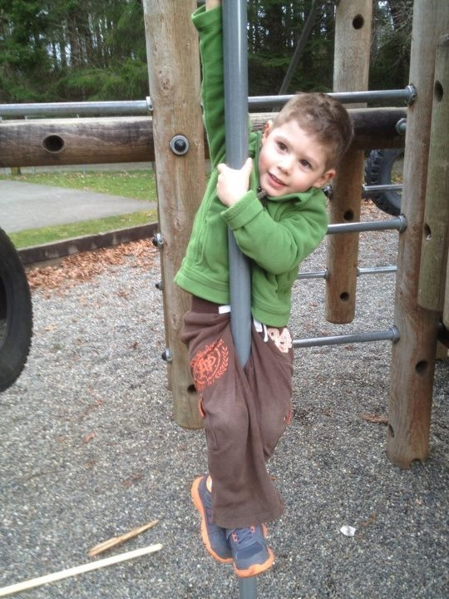
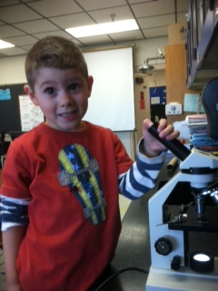
Statistics - Count off in sets of 6
2s, 3s, 5s, and 6s STAND
you will all have children
LeRoy
Munkres

Slide 3
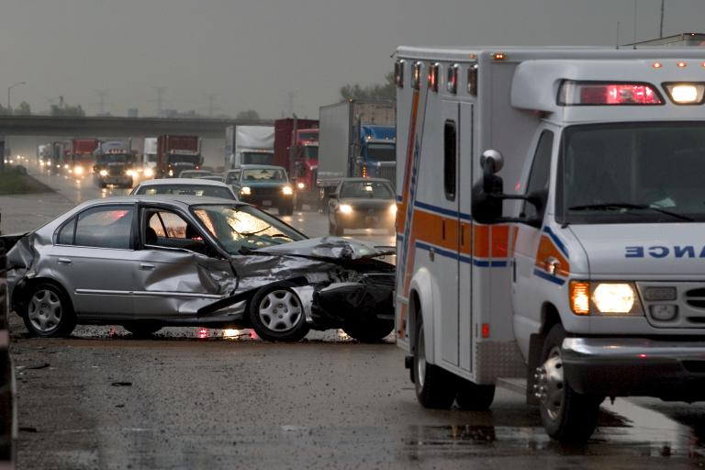
Statistics cont…
3s and 6s STAND
- you will be involved in an alcohol related automobile accident sometime in your lifetime

Slide 4
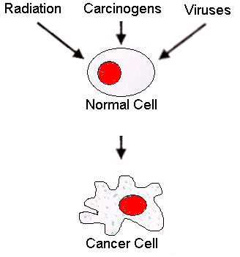
Statistics cont…
1s and 4s STAND
- you will develop cancer sometime in your lifetime
- Does this surprise you?
Cancer and The Cell Cycle

Slide 5
Statistics cont…
3 students sit down
- you will die of cancer ☹
Is there any way to know who will develop cancer and when?

Slide 6
More Statistics…
Men 1 in 2 will develop cancer
Women 1 in 3 will develop cancer
smokers have a 10-fold higher risk of developing lung cancer compared with nonsmokers
women who have a mother, sister, or daughter who has had breast cancer have about a 2-fold higher chance of developing breast cancer compared with women who do not have such a family history.
The National Cancer Institute estimates that appr. 8 million Americans today have a history of cancer.
In 1998, more than 1 million new cases were diagnosed.

Slide 7
Activity
You will learn more about who develops cancer, when, and why, but assuming the identities of 30 fictitious people who develop cancer.

Slide 8
Step 1 – Obtain identity
DO NOT open envelope yet.
Form groups of 3 or 4
Share who you are with other members in your group (front of envelope)
Complete Section 1: Family History

Slide 9
Step 2 – Team Summary
Open envelope – inside contains four cards that provide additional information about each person’s life.
Organize 4 cards by age and place face down
Read cards to each other (0-19 first) in group one at a time by age
Complete Section 2: Cancer History

Slide 10
Step 3 -
After everyone has read their life history – fill out Section 3: Possible Risk Factors

