Slide 1
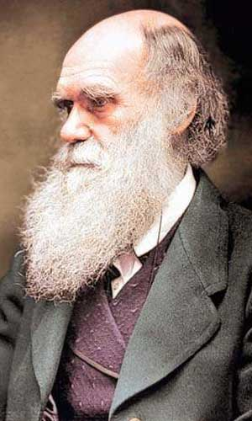
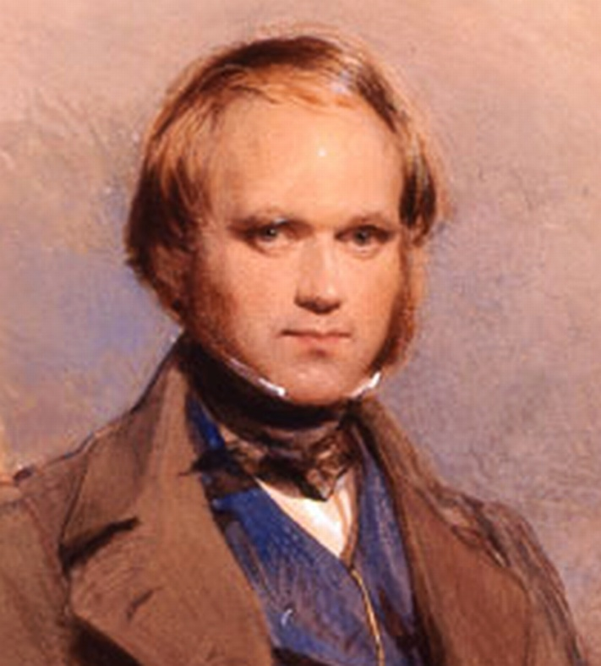
Theory of Evolution
Charles Darwin
1809-1882
Who was Charles Darwin

Slide 2
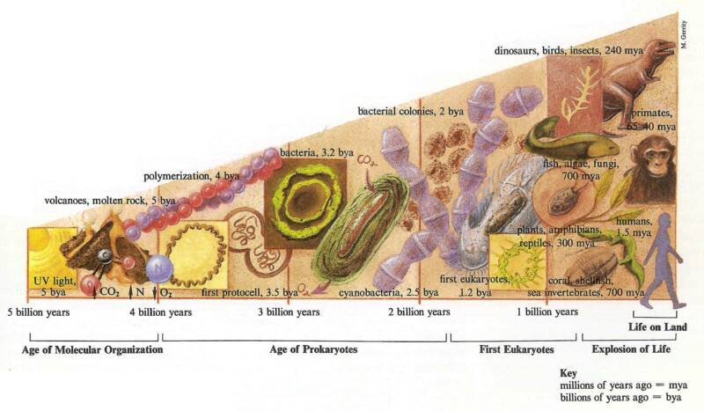
What does the term evolution mean?

Slide 3
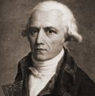
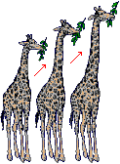
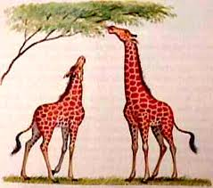
Lamarck – Theory of Aquired Characteristics (rejected)
Organisms change by use or disuse of certain body part
these enhanced characteristics would be passed on to the offspring.
Jean-Baptiste Lamarck 1744-1829

Slide 4
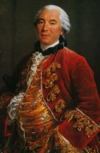
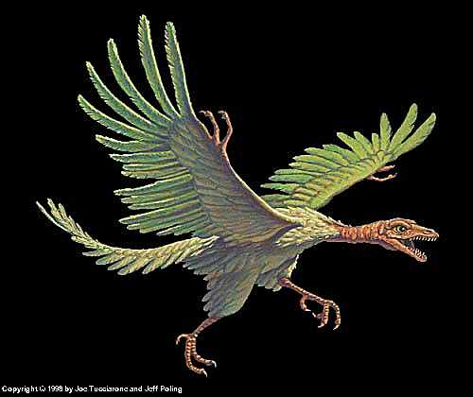
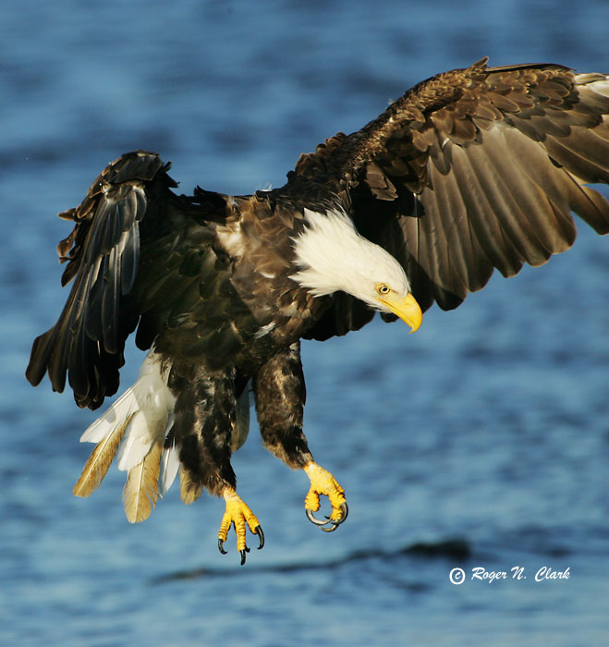
George Buffon
the earth might be older than 10,000 years
living things do change over time
observed that specific fossils and certain living animals were similar but not exactly alike.
Comte de Buffon 1707-1788

Slide 5
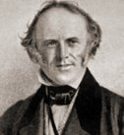
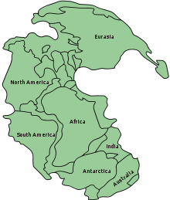
Lyell’s Contribution (geologist):
proposed that geologic processes over a long period of time, such as erosion could explain the physical features of today’s Earth.
This led Darwin to think that organisms must also have changed gradually over time in response to the changing Earth.
Charles Lyell 1797-1875

Slide 6
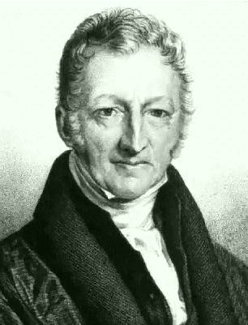
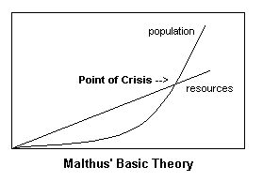
Malthus’ Contribution (economist):
Populations grow exponentially but limited resources (food supply) will force competition
Malthus helped inspire Darwin’s thinking about the “struggle for existence”
Darwin developed the idea of Natural Selection

Slide 7
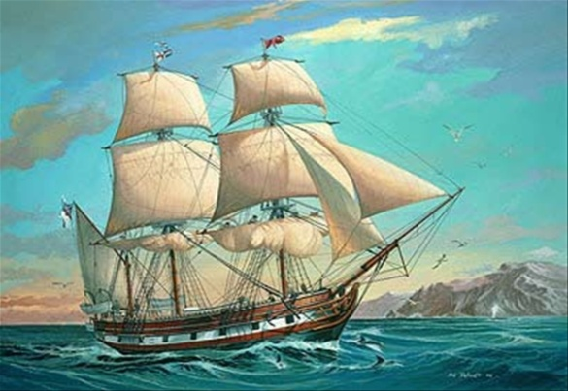
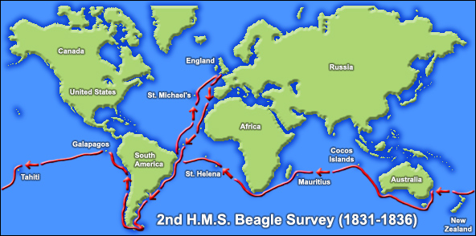
Darwin’s Voyage HMS Beagle – 1831-1836
Purpose: to sail around world and survey little known costal areas

Slide 8
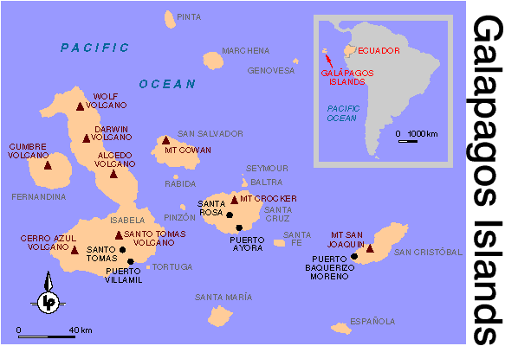

Slide 9
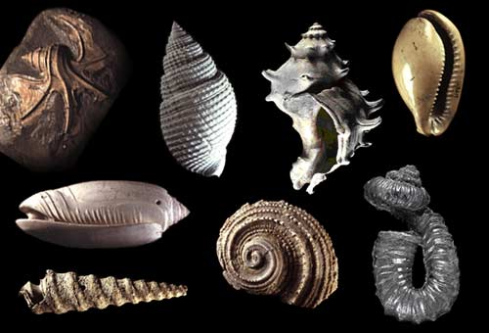
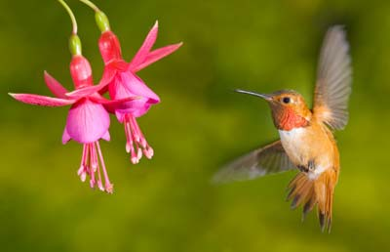
Natural Selection -“survival of the fittest”
Individuals with favorable variations (adaptations) are more likely to survive and reproduce
How does Evolution Really Work?

