Slide 1
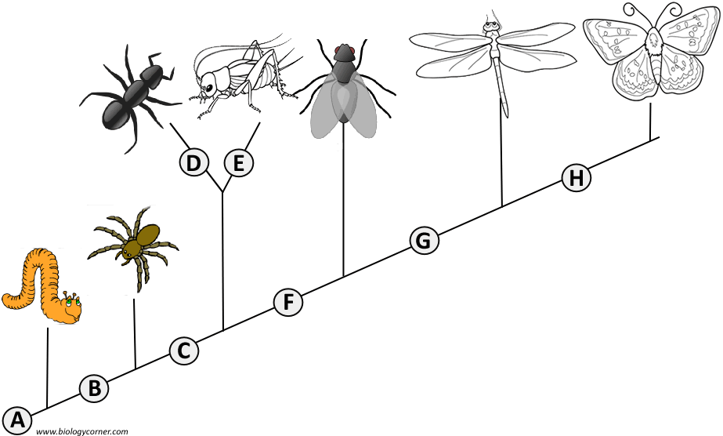
Cladograms – How to draw one

Slide 2
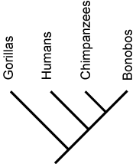
Look at the Cladogram at the right.
What conclusions can be drawn about the relationship between humans and chimps?

Slide 3
What is a Cladogram?
Branching diagram that shows the relationships between organisms
They reconstruct evolutionary history (phylogeny)
Can also be called “phylogenies” or “trees”

Slide 4
How to read a Cladogram
This diagram shows a relationship between 4 relatives who share a common ancestor at the root of the tree.
The diagram is also a timeline - the older organism is at the bottom of the tree.
The four descendents at the top of the tree are DIFFERENT species. This is called SPECIATION.

Slide 5
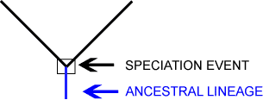
Speciation
Branches on the tree represent speciation
The event that causes the speciation is shown as the fork of the “V”.

Slide 6
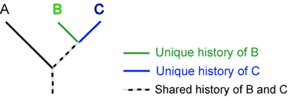
Species B and C each have characteristics that are unique only to them (derived character)
But they also share some part of their history with species A. This shared history is the common ancestor (ancestral character)

Slide 7
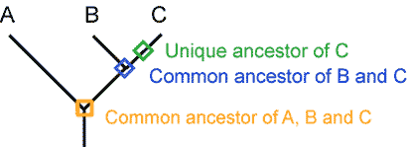
Talk to your neighbor…
What is the relationship between A and B? Between B and C?
What is the only thing A and B have in common?

Slide 8
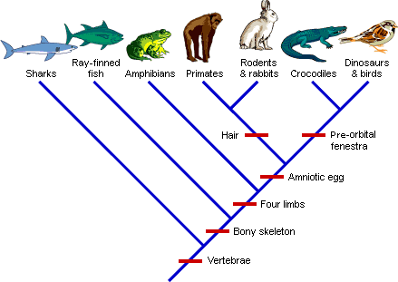
Cladograms show shared derived characteristics
Derived characteristics are unique to the species
they evolve in one group but not the other

Slide 9
Let’s go back to this diagram.
Something to Ponder…
Did humans evolve from chimps?
NO
What familial relationship is a good description of the relationship between chimps and humans?
DISTANT COUSINS
Are humans more highly evolved than chimps?
NO- since the lineage is split, each species has evolved unique traits.
Look at your original description of this picture. Has your understanding of this diagram changed? How?

