Slide 1
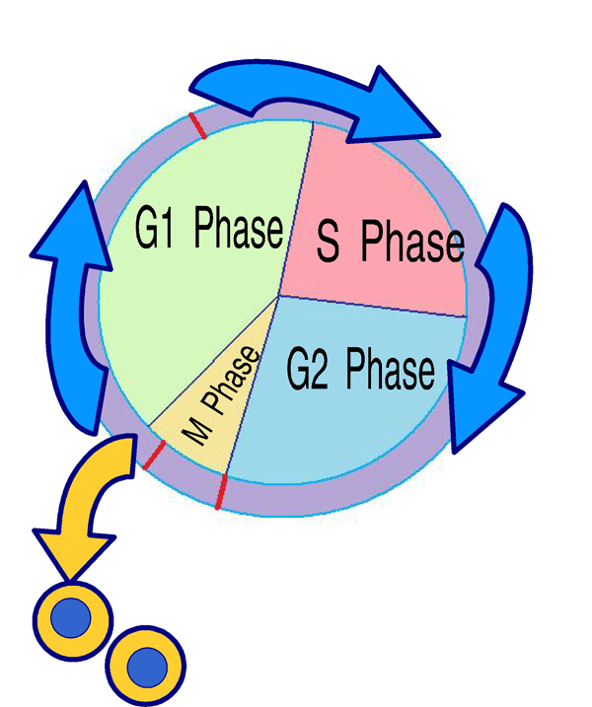
Cell Cycle NOTES

Slide 2
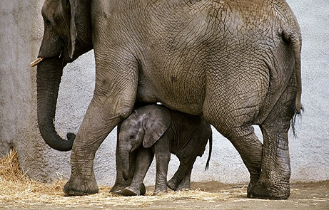
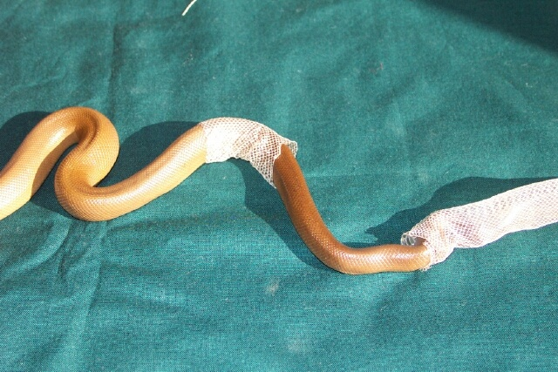
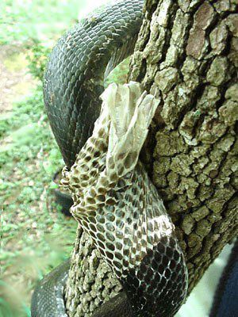
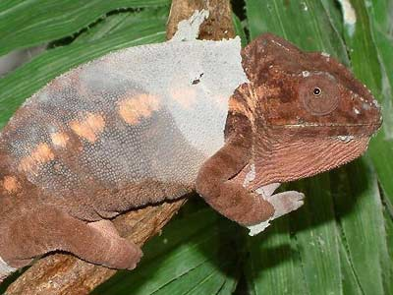
How do little elephants grow up to be BIG elephants?
Why do animals shed their skin?

Slide 3
Why do cells divide?
To make new cells to replace those damaged or worn out.
Size limitations
Growth and change

Slide 4
Cell division is controlled
Chemical signals:
Internal:
Cell division can be stopped at any point
Cell can recognize damaged DNA and cell will not divide
External:
Chemical signals produced by the body or other cells that stimulate the cell to divide or not
Telomeres: structures at the end of each chromosome that protect the chromosome
Erode with each cell division
In humans, most cells can divide about 50 times

Slide 5
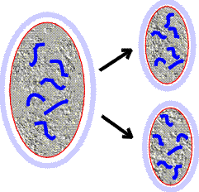
Cell Cycle
The series of events that take place in a cell leading to its division (5 events)
New cells are created from existing cells
Cells genetically identical to the original cell (Asexual reproduction)

Slide 6
5 Events of the Cell Cycle

Slide 7
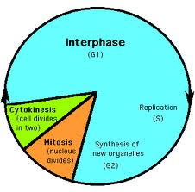
The Cell Cycle – 5 parts
During G1 – growth, normal life processes, preparation for division
During S – synthesis (replication) of DNA Replication
During G2 – The cell finishes growing and preparing to divide.
Mitosis – Division of the nucleus (4 stages)
Cytokinesis – Division of the cytoplasm (occurs during mitosis)
How the Cell Cycle Works
Cell Division and the Cell Cycle

Slide 8
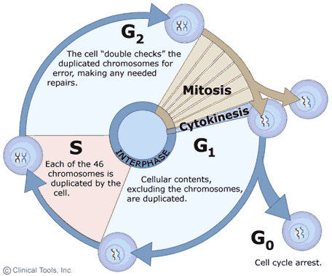

Slide 9
Cell Cycle CHART – glue in NB
Complete the Mitosis HW
Use pages 130-131 to fill out chart (we will do interphase and cytokinesis together)
Include labels and color

Slide 10
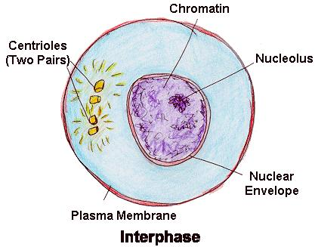
Interphase

