Slide 1
Pedigrees
Review of Traits

Slide 2
Molecular Genealogy

Slide 3
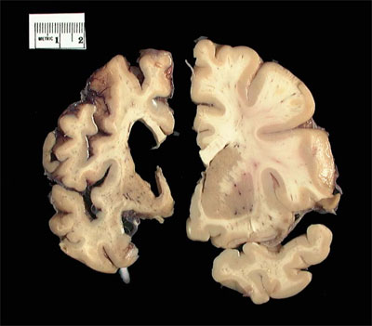
Huntington’s Disease
Huntington's disease (HD) is an inherited, degenerative brain disorder which results in an eventual loss of both mental and physical control.

