Slide 1
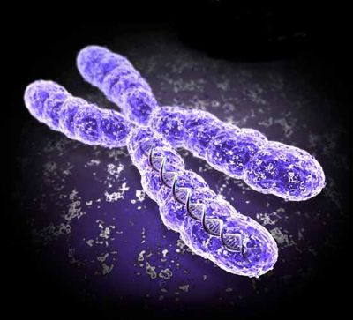
Chromosomes

Slide 2
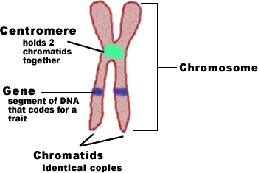
Chromosome = coiled DNA and proteins Chromatin = mass of genetic material

Slide 3
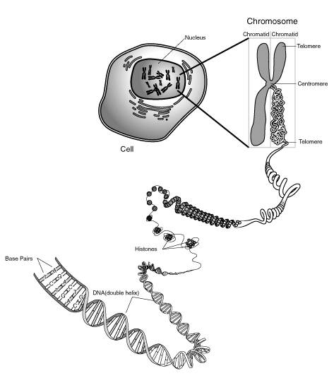
How DNA is Packaged
Videoclip
Diagram

Slide 4
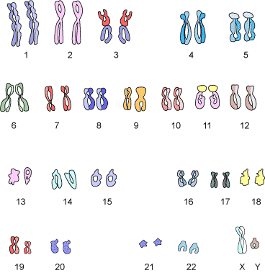
Chromosome Arrangement = Karyotype

Slide 5
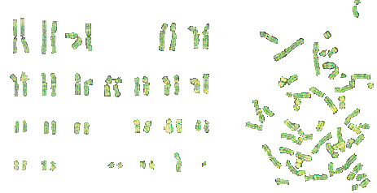

Slide 6
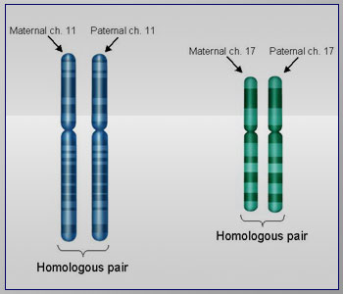
Homologous chromosomes = similar in size, shape, and genetic content - one from mom, one from dad

Slide 7
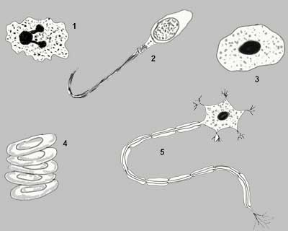
Somatic cells
any cell but egg or sperm
Diploid (2n = 46)
Sex cells
gametes – eggs and sperm
Haploid (n = 23)
Discuss cells #1-5 with your lab partner.
Which ones are somatic cells? What about sex cells?

Slide 8
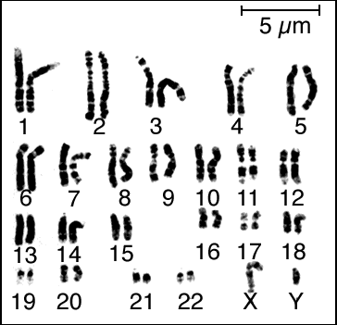
2 Types of Chromosomes
1. Autosomes – don’t determine sex
44 total
2. Sex Chromosomes – determine gender
2 (X or Y)

Slide 9
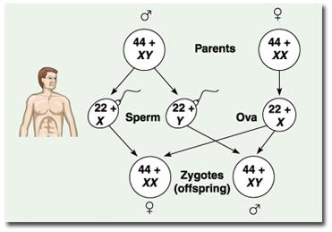
Review Videoclip

Slide 10
PRACTICE ☺ There are 12 chromosomes in a housefly.
1. How many sex chromosomes? ________
2. How many chromosomes in a gamete? ______
3. How many autosomes are present in a gamete? ___
4. How many sex chromosomes are present in the fly ovum (egg)? _______
5. How many autosomes in a somatic cell?__________
6. How many chromosomes are present in a fly wing cell? ___________

