Slide 1
Classification and Cladograms Overview

Slide 2
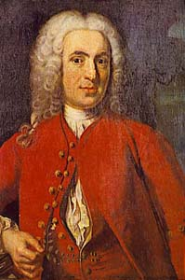
Carl Linnaeus
1707-1778
Father of Biological
Classification!
Classification: grouping items according to similar characteristics
Taxonomy - the science of naming
Carl Linnaeus developed a system using a two-word Latin name for each species
Called binomial nomenclature - uses the genus and species names to identify organisms

Slide 3
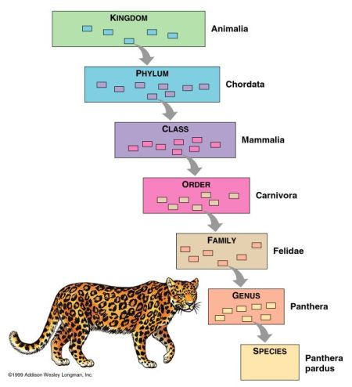
7 levels of taxa
Kingdom
Phylum
Class
Order
Family
Genus
Species

Slide 4
Why scientific names?
not everyone attaches the same common names to the same organism = confusing
ie → same common name used for different species (ie. maple tree might be a sugar maple, a silver maple, or a red maple)
Common names may not also describe organisms accurately (ie. jellyfish)

Slide 5
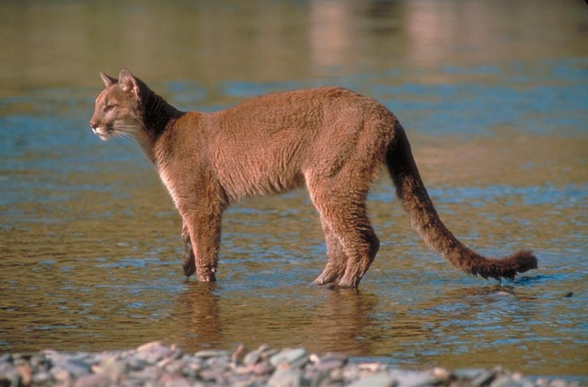
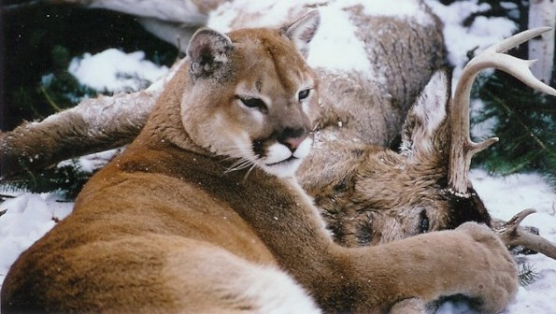
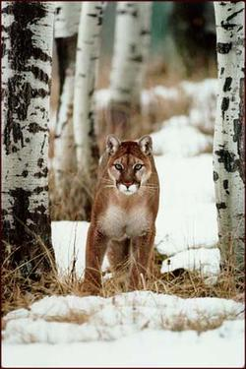
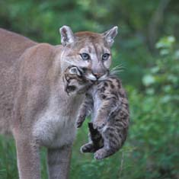
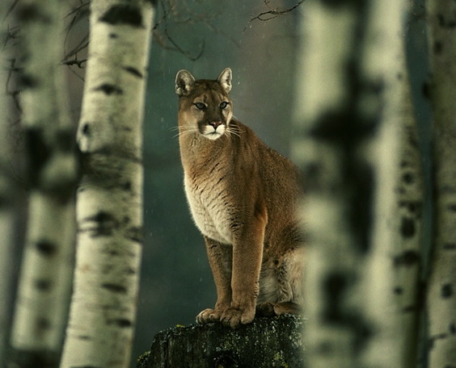
What animal is this?
Mountain Cat
Cougar
Puma concolor
Mountain Lion
Panther
Puma

Slide 6
Scientific Names
Genus first - Capitalized
Species second - not capitalized
Both italicized
Examples:
Canis familiaris - dog
Felis domesticus - cat
Canis lupus - wolf
Homo sapien - man

Slide 7
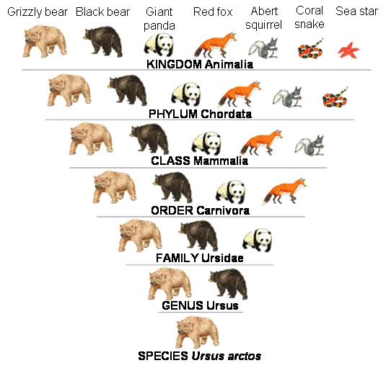

Slide 8
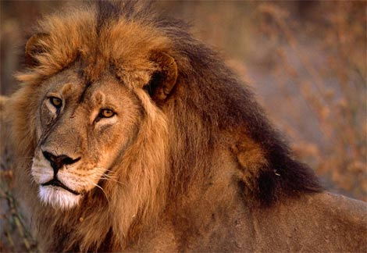
Let’s classify. . .
Kingdom: Animalia
Phylum: Chordata
Class: Mammalia
Order: Carnivora
Family: Felidae
Genus: Panthera
Species: leo

Slide 9
Domain | Bacteria | Archaea | Eukarya | Eukarya |  | Eukarya |  | Eukarya
Kingdom | Eu- bacteria | Archae- bacteria | Protists | Fungi |  | Plants |  | Animals
# Species | 4,000 | < 100 | 43,000 | 77,000 |  | 280,000 |  | 1 million
Cell Type (pro or eu) | Prokaryotic |  | Eukaryotic
Cell structure | CW Peptidoglycan | CW –NO Peptidoglycan | Mixed | CW – Chitin |  | CW – Cellulose | NO CW
Body Type | Unicellular |  | Mixed | Multicellular
Nutrition | autotroph heterotroph | autotroph heterotroph chemoauto | autotroph heterotroph | hetero –troph | autotroph |  | hetero –troph
Reproduction | Asexual – Binary Fission |  | Mixed | Mixed | Mixed |  | Sexual
Movement | Flagella / Pili |  | Flagella Cilia | NO | NO |  | Varies
Examples

Slide 10
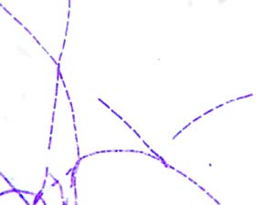
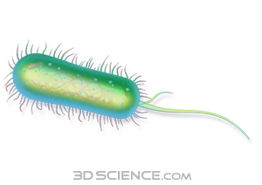
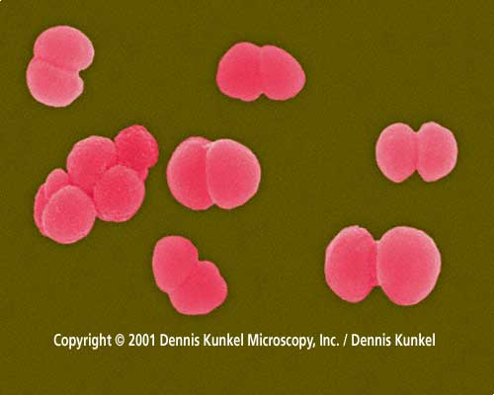
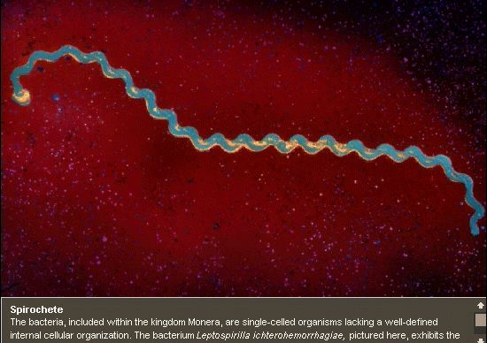
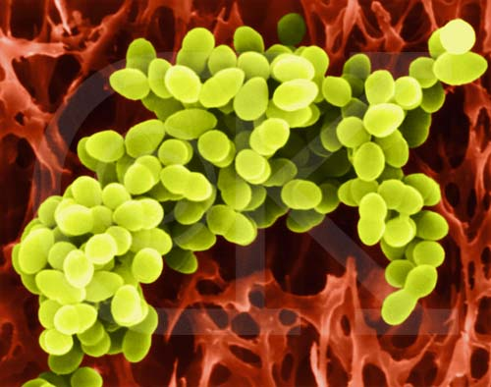
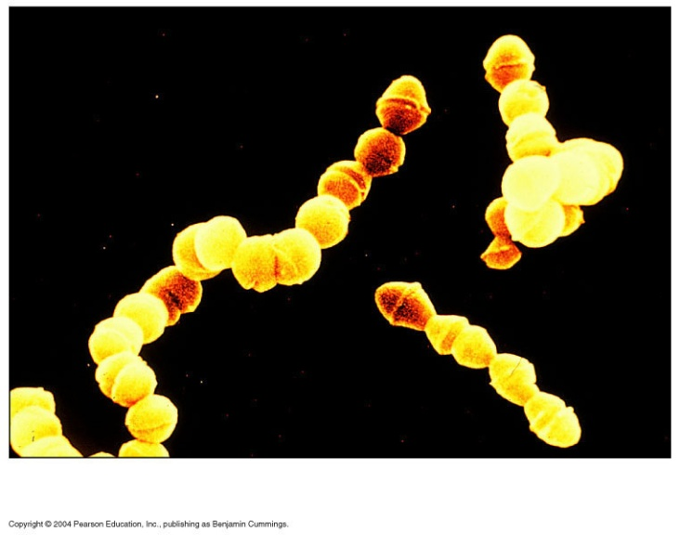
3 Types of Bacteria

Slide 11
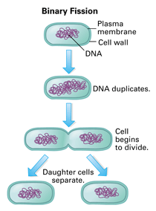
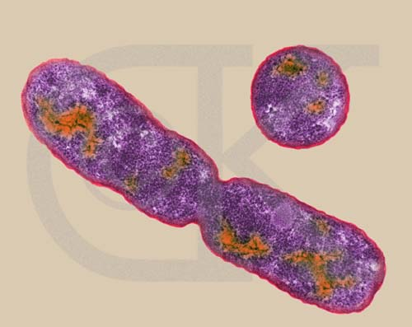
Reproduction

Slide 12
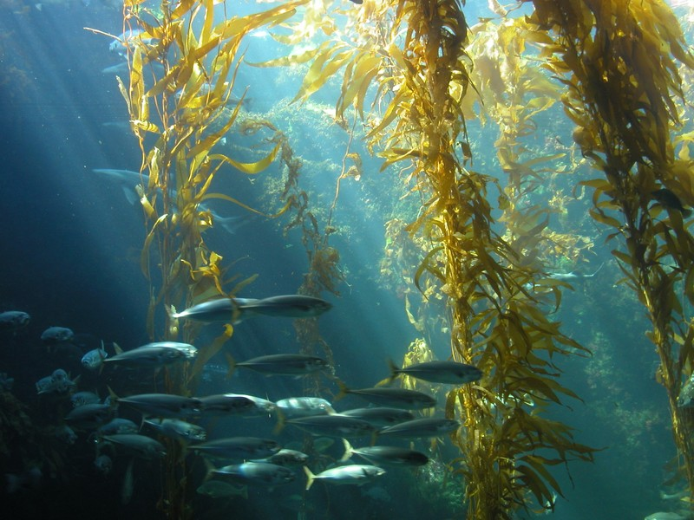
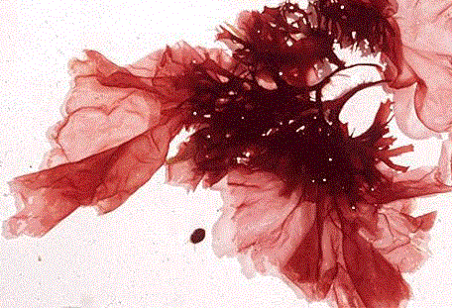
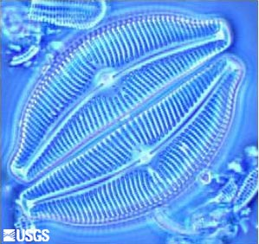
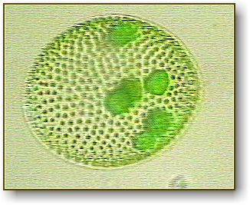
Photosynthetic Protists – Algae

Slide 13
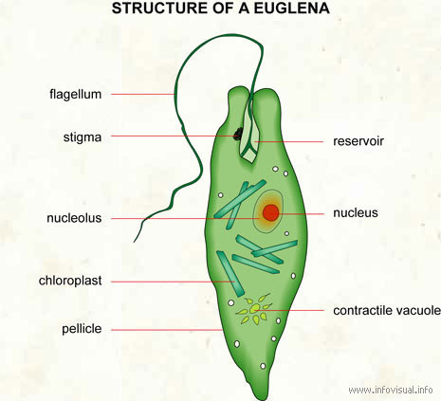
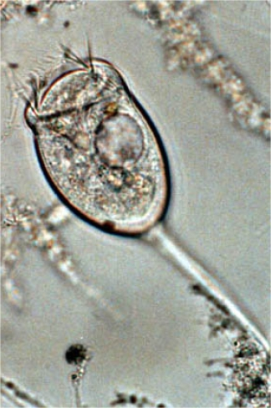
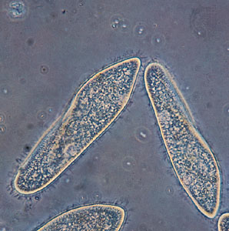
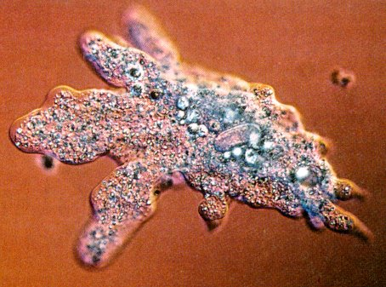
Heterotrophic Protists - Protozoa - classified by their movement.

Slide 14
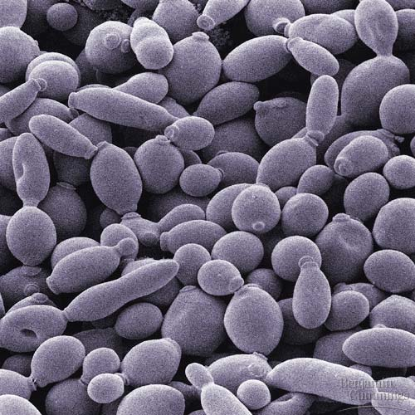
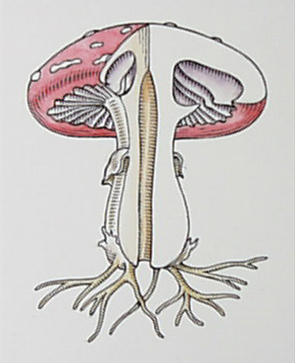
A Fungus Among us
Fungi
Ant - Parasitic Fungus
Cow Pie Fungus

