Slide 1
Review – Geological Time Scale

Slide 2
Refer to pink sheet in NB:
2 Questions:
1. Put the following organisms in order from those that appeared first on Earth to those that appeared the closet to present day: dinosaurs, mammals, fish, bacteria, land plants, amphibians, reptiles, insects
2. Why do you think the periods vary in length?

Slide 3
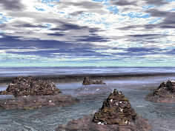
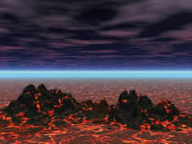
Hadeon Eon
4.5-3.8 billion years ago
No known life. The Earth’s crust cools and solidifies. The moon forms.

Slide 4
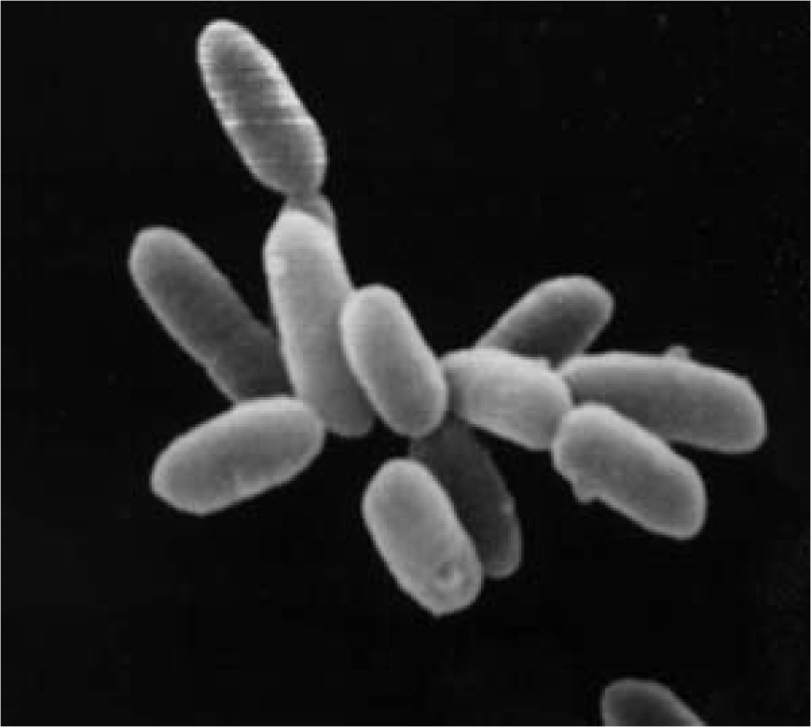
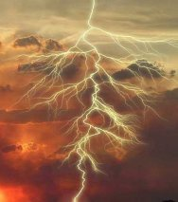
Archean Eon
3.8-2.5 billion years ago
Earliest life on Earth are bacteria
The atmosphere is mostly methane and ammonia.
Continents beginning to form

Slide 5
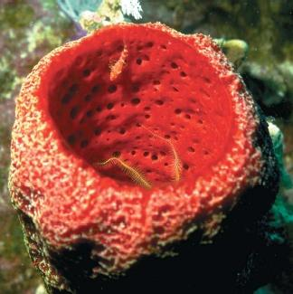
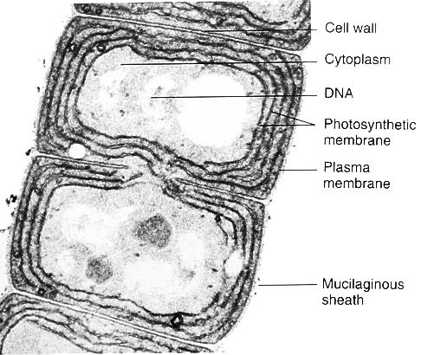
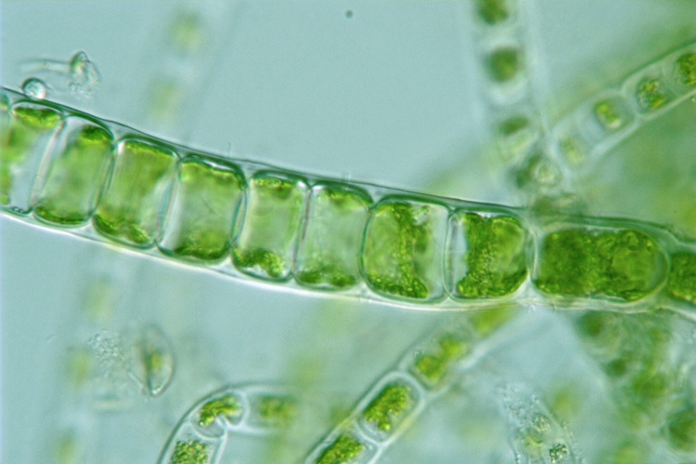
Proterozoic Eon
2.5 billion to .54 billion (540 million) years ago.
First multi-celled organisms like sponges appear.
Algae also arises1.4 bya – more complex
Oxygen begins to accumulate in the atmosphere.
Oxygen (O₂)

Slide 6
Phanerozoic Eon
543 million - present

Slide 7
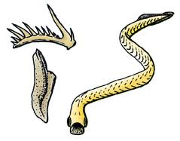
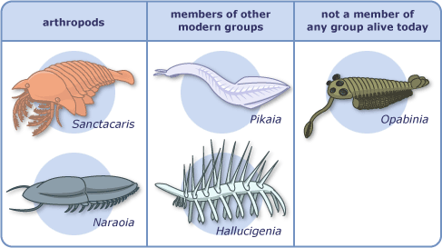
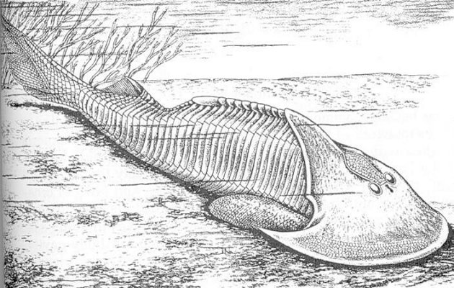
Paleozoic era – Cambrian Period
488 – 543 million years ago
A large number of new animal species appear in a relatively short time (The Cambrian Explosion!)
First fish appear – they are JAWLESS.
No known life on land yet.
Conodonts (extinct)
Ostracoderms (extinct)

Slide 8
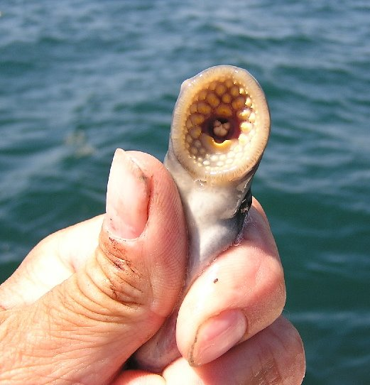
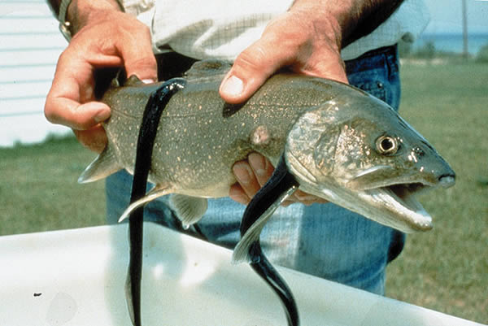
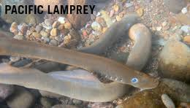
Modern Jawless Fish – Lamprey

Slide 9
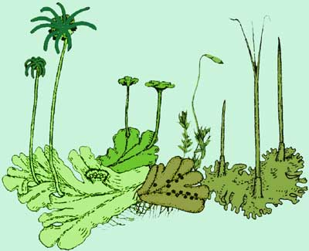
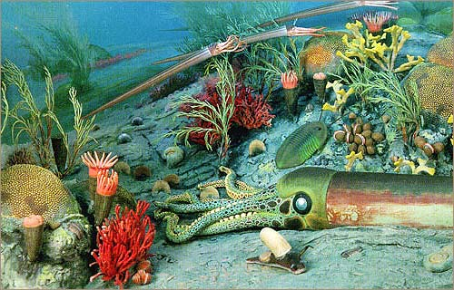
Ordovician period
443 – 488 mya
First land plants appear.
Primitive fungi and sea weed appears.
The oceans are full of corals, mollusks, worms, primitive fish, and echinoderms like starfish.
Marine life flourishes!

Slide 10
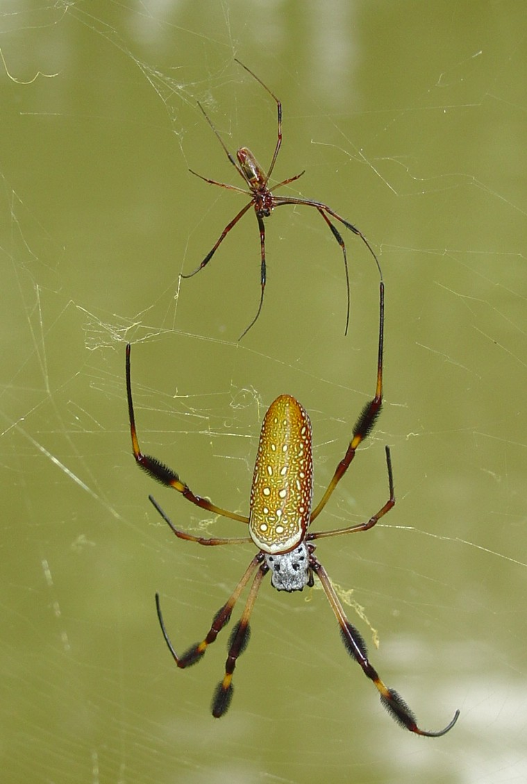
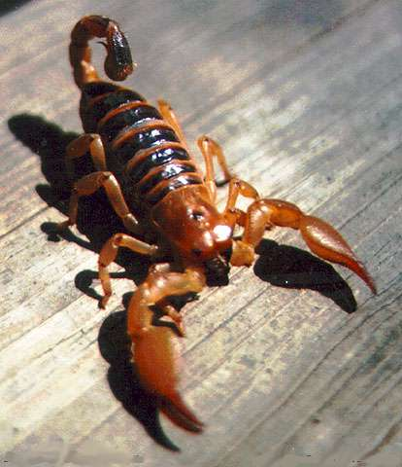
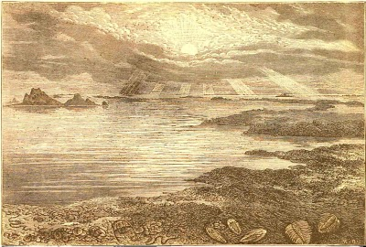
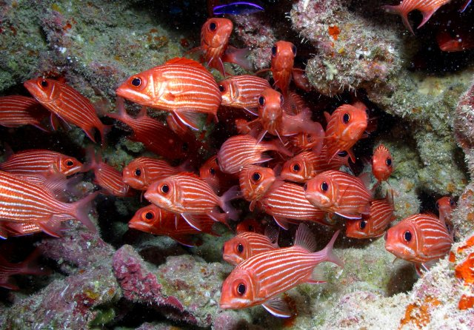
Silurian period 417 – 443 mya
Ends with Extinction
Spiders, scorpions, insects, complex plants, and fish with bony jaws appear.
Fish adapt to living in rivers and fresh water for the first time.

Slide 11
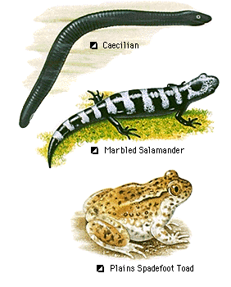
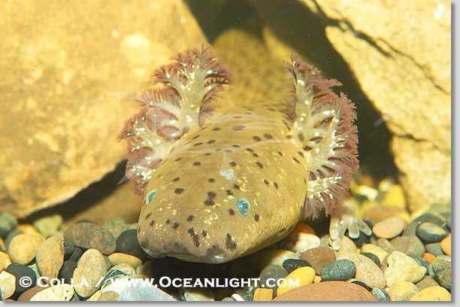
Devonian period 354 – 417 mya
Ends with Extinction
Fish spread across the oceans.
Amphibians appear.
The first trees and other plants spread across the land creating the first forests.

Slide 12
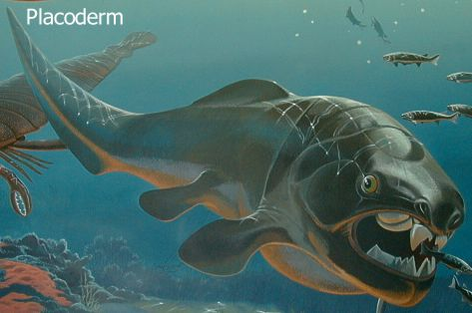
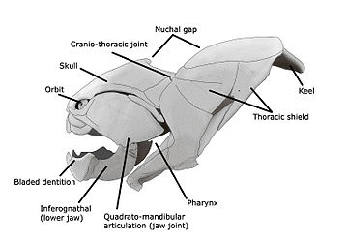
First Jawed fish – Placoderms

Slide 13
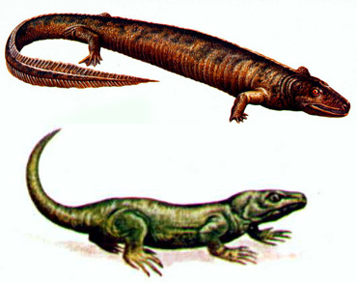
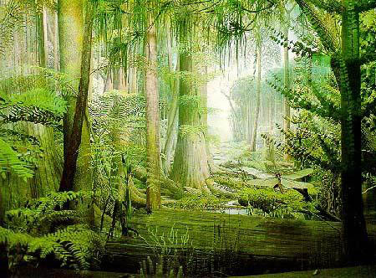
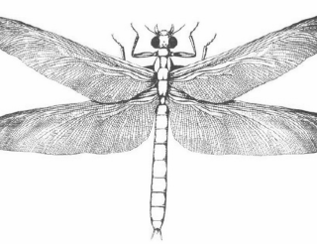
Carboniferous period 299 – 359 mya
Many swamps on land and sponge reefs in the oceans.
Reptiles appear.
Early winged insects and cockroaches appear.

Slide 14
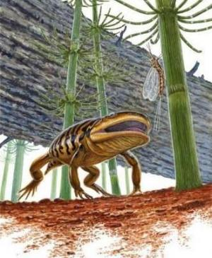
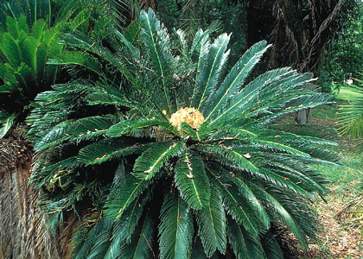
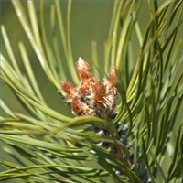
Permian period 251 – 299 mya
Ends with Extinction
Amphibians dominate the land.
Early cone-bearing plants like pine trees appear.
Period ends with the largest mass extinction known with 95% of all marine species and 50% of all animals going extinct.

Slide 15
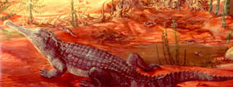
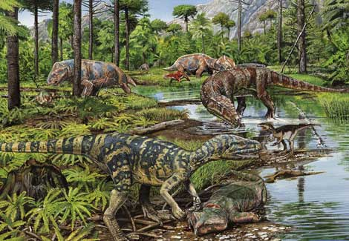
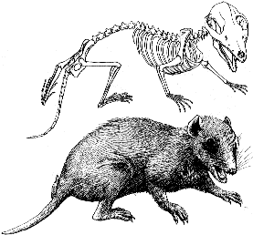
Mesozoic era – Triassic period 200 – 251 mya
Ends with Extinction
The few survivors of the Permian extinction go on to populate the land and oceans.
New species like mammals, dinosaurs and crocodiles appear.

Slide 16
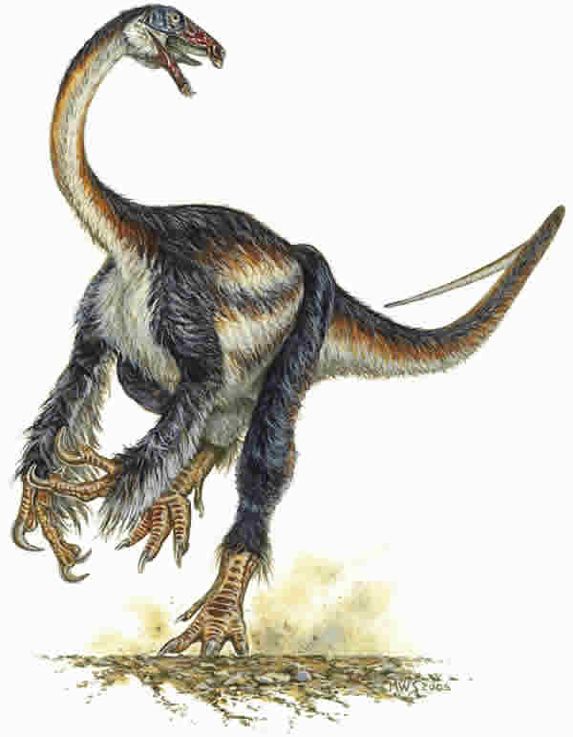
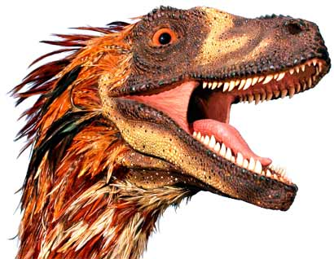
Jurassic period 145 – 200 mya
Dinosaurs dominate the land. Mammals are common but small.
Feathered dinosaurs and birds appear.
The most common land plants are ferns, palm-like trees called cycads, and grasses.

Slide 17
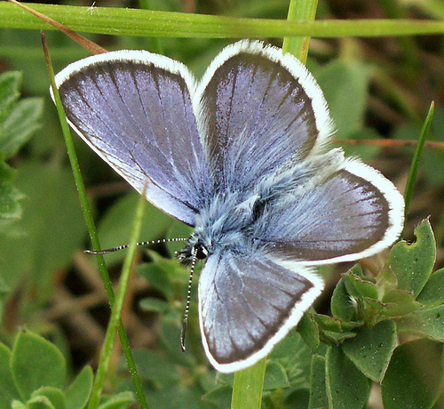
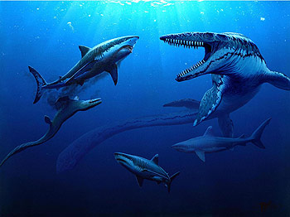
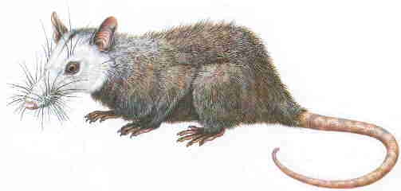
Cretaceous period 65 – 145 mya
Ends with Extinction
Dinosaurs continue to dominate the land.
Marsupials, modern sharks, bees and butterflies appear.
Flowering plants appear.
Period ends with the mass extinction of the dinosaurs and many plants.

Slide 18
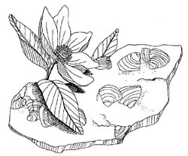
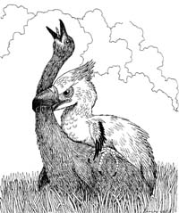
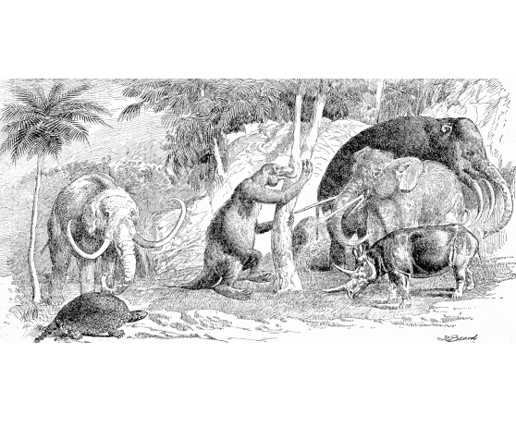
Cenozoic Era – Paleogene period 23-65 mya
Rise of the mammals and birds.
Rodents, primates, pigs, cats, dogs, bears and whales appear.
Flowering plants spread across the globe.

Slide 19
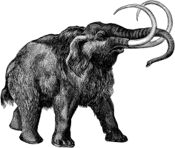
Neogene period Today – 23 mya
Firt homind - Australopithicus afarensis “Lucy”
Modern humans appeared and developed civilization by the end of this period.
Mammoths, sabre-toothed cats, and giant camels dominated until 10,000 years ago when many large mammals went extinct.

