Slide 1
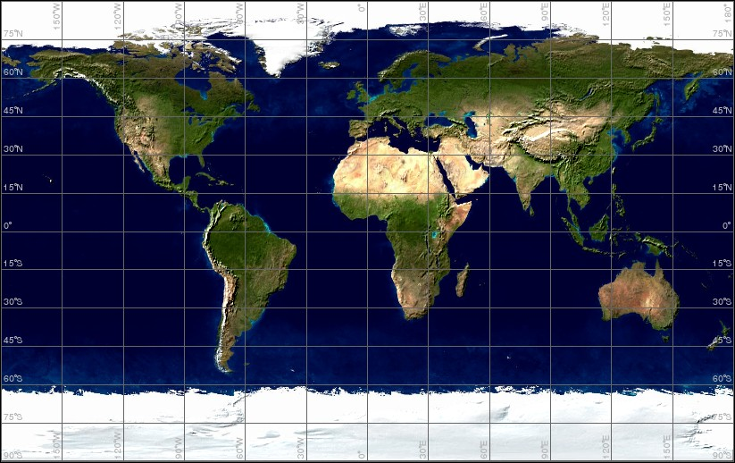
Biomes of the World

Slide 2
What is a Biome?
An ecosystem that occurs over a large area of land.
Includes plants and animals that are adapted to the climate and other abiotic factors.

Slide 3
What is an Adaptation?
List examples of adaptations
Camouflage

Slide 4
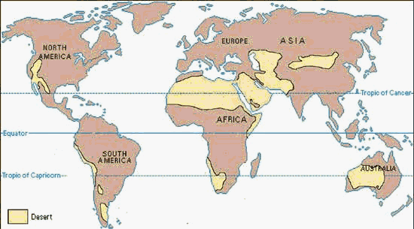
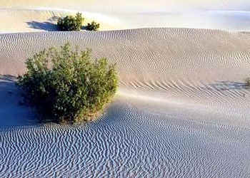
Desert
Location: varies, but often interiors of continents
Climate: 1 inch of rain per year; hot days, cold nights.
Average temp over 64° F

Slide 5
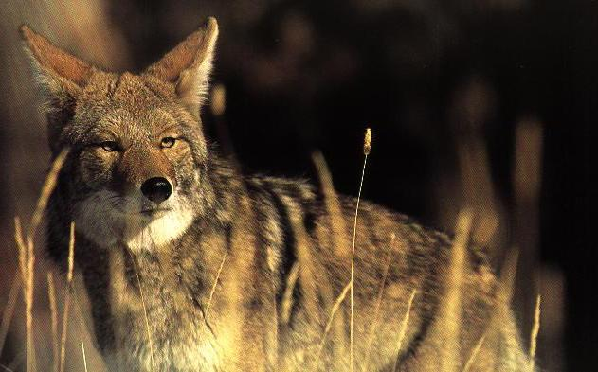
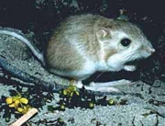
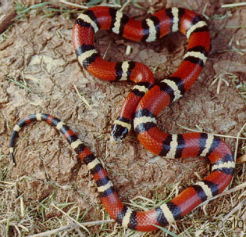
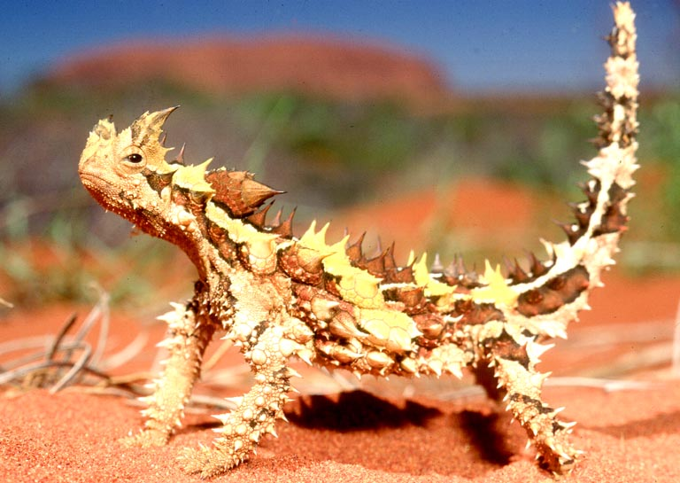
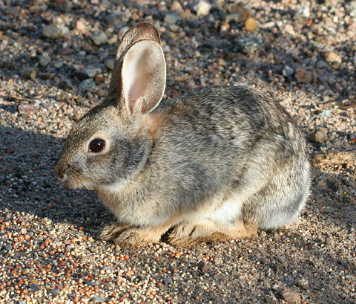
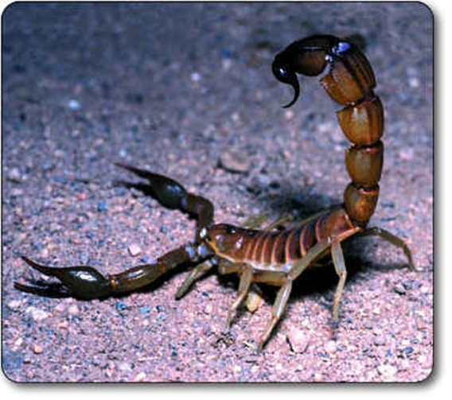
Desert Animals
ants, birds, rodents, reptiles and snakes.
Coyote
Thorny Lizard
Scorpion

Slide 6
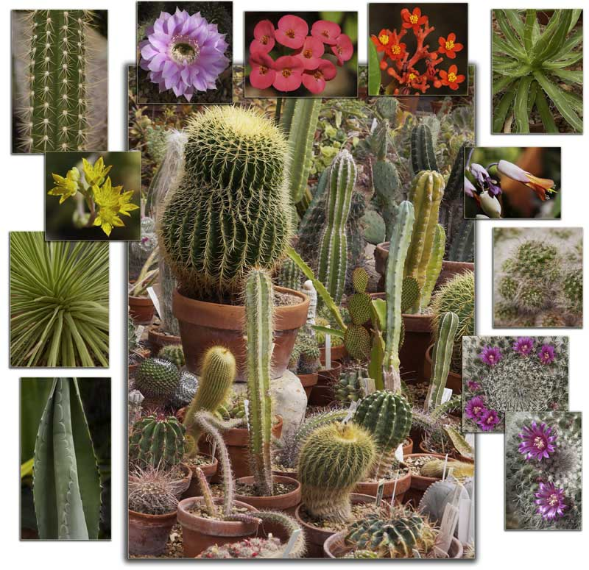
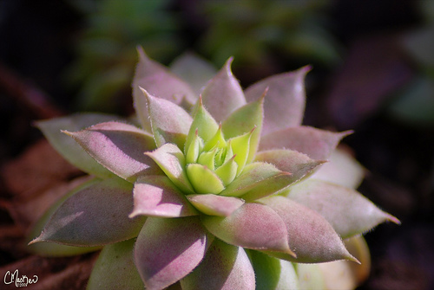
Desert Plants
some grasses, shrubs, cacti, and rosette plants.

Slide 7
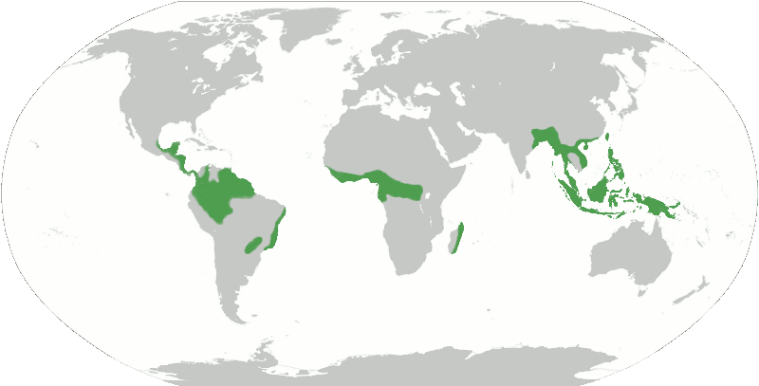
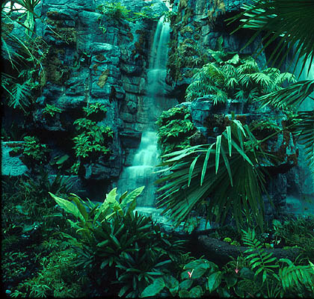
Tropical Rainforest
Location: near the equator
Climate: 68-93ºF, Average Humidity 77-88%, often more than 100 inches of rain per year!

Slide 8
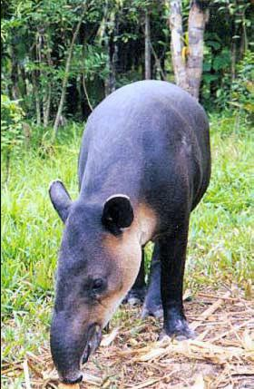
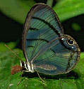
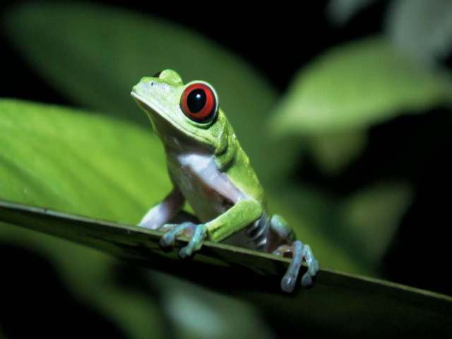
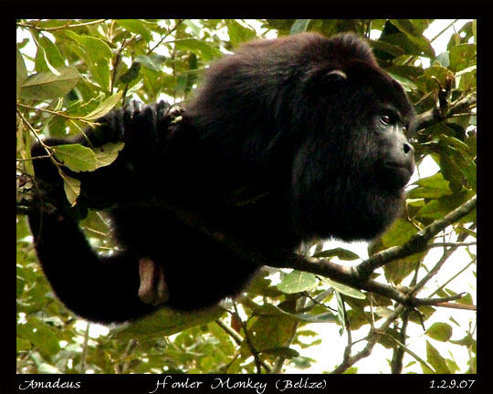
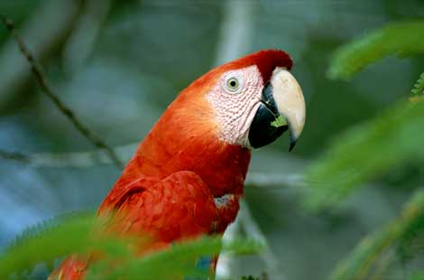
Rainforest Animals
more than ½ the world’s plants and animals live here (greatest biodiversity!)
Monkeys, apes, parrots, toucans, sloths, brightly colored butterflies, mosquitoes, huge colonies of ants
Tapir
“mountain cow”

Slide 9
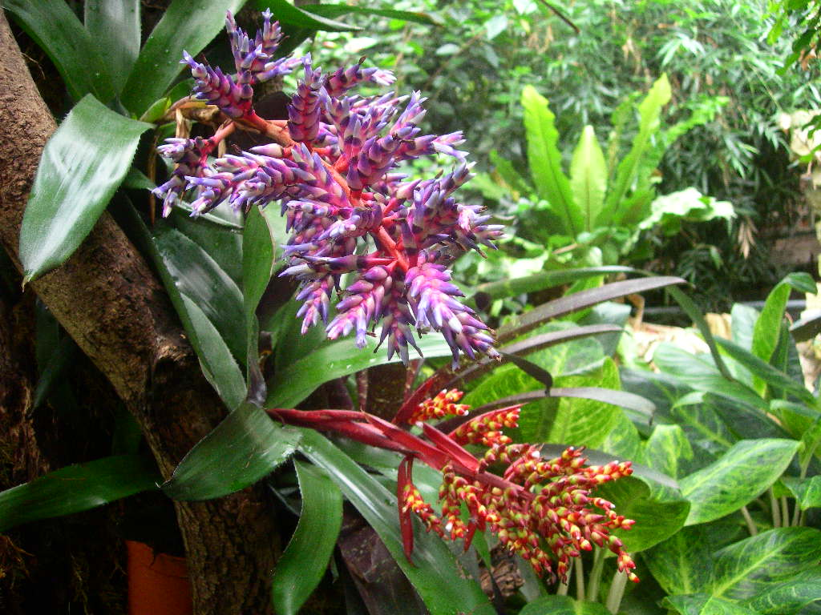
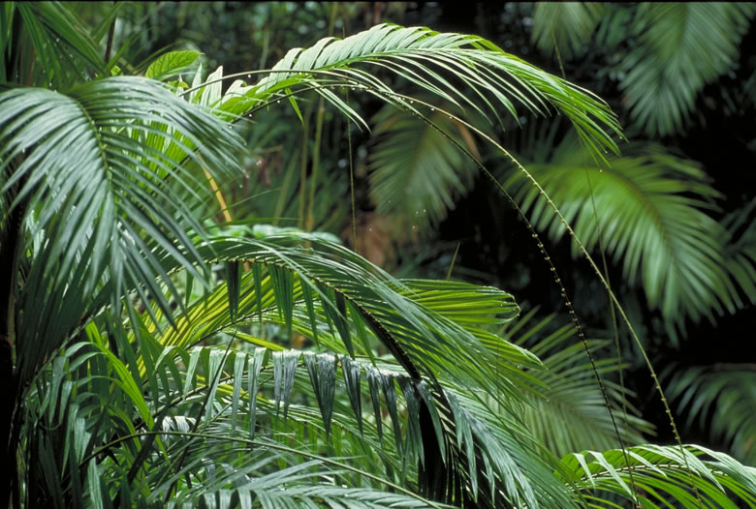
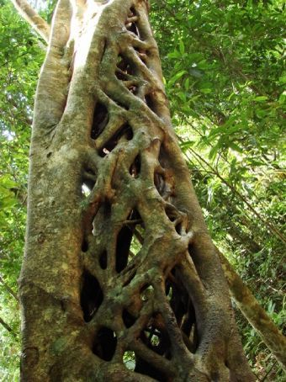
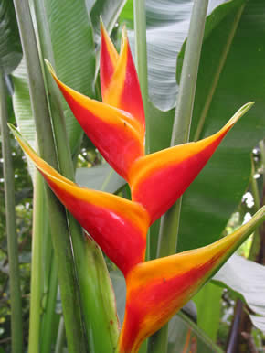
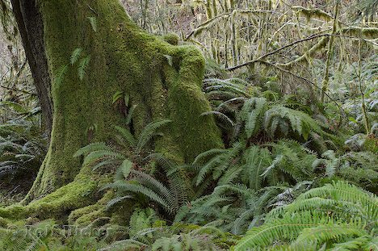
Rainforest Plants
More than 2,500 species of vines, palms, figs, ferns, orchids, etc.

Slide 10
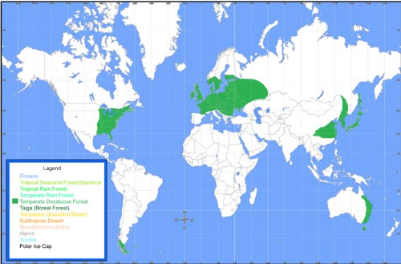
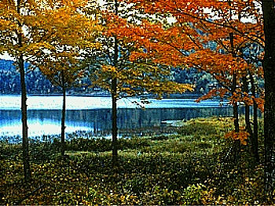
Temperate Deciduous Forest
Location: Eastern half of NA, Europe, Asia, Russia, Japan, South America, and Australia.
Climate: avg. temp. is 50° F. The average rainfall is 30 to 60 inches a year
the soil is very fertile.

Slide 11
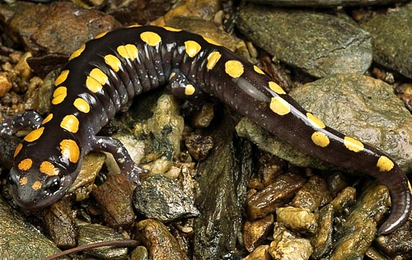
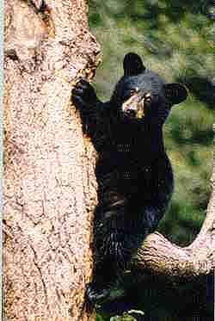
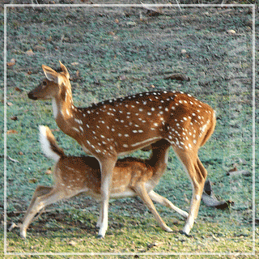
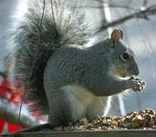
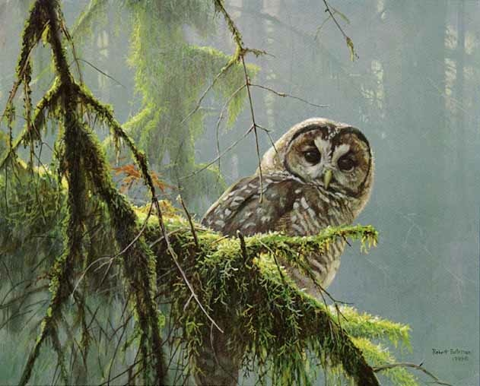
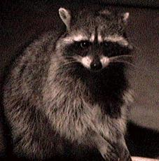
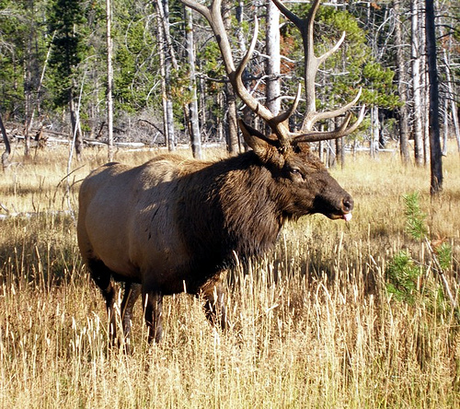
Temperate Deciduous Animals
deer, gray squirrels, mice, raccoons, salamanders, snakes, robins, frogs and many insects.

Slide 12
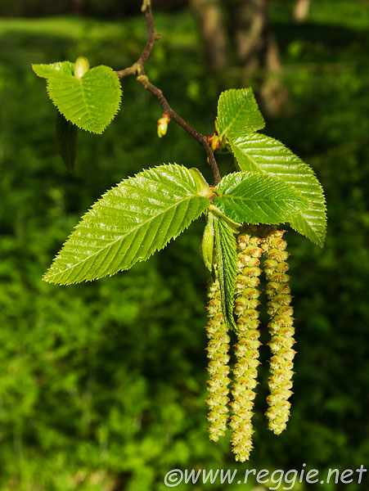
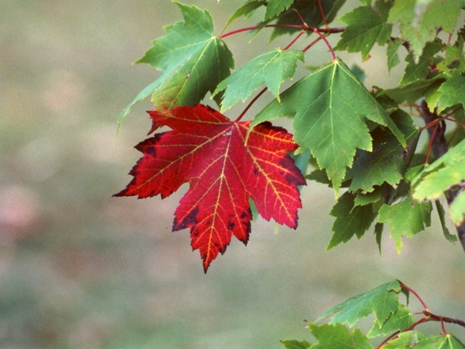
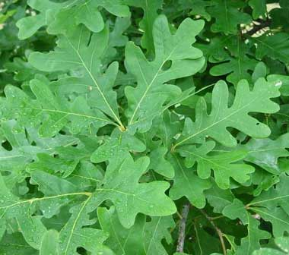
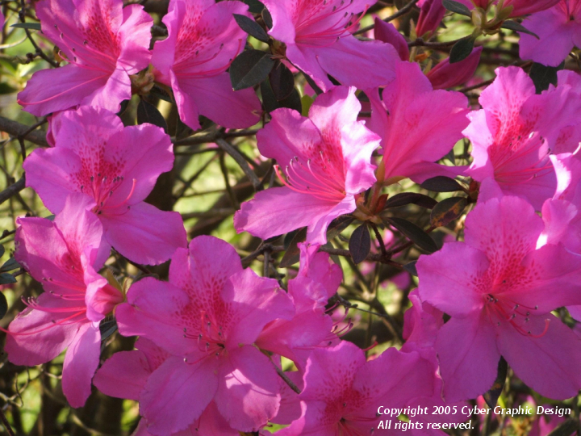
Temperate Deciduous Plants
Oak, maple, hickory, elm, walnut, sweet gum, rhododendrons, azaleas, huckleberries, herbs, and mosses.

Slide 13
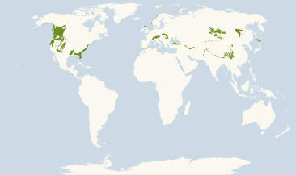
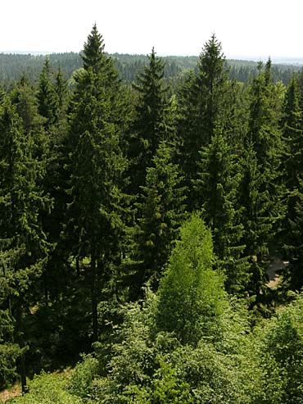
Evergreen Forest (Our Biome! ☺)
Location: southeastern and western United States
Climate: drier weather

Slide 14
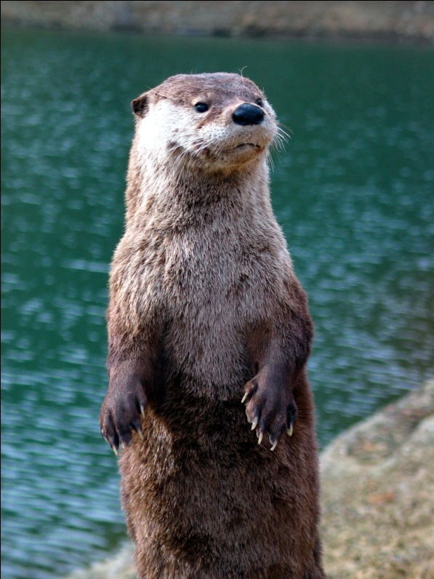
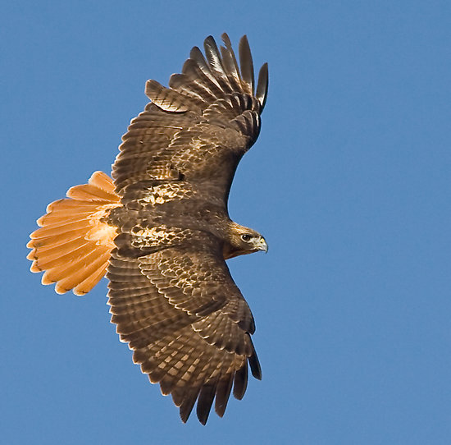
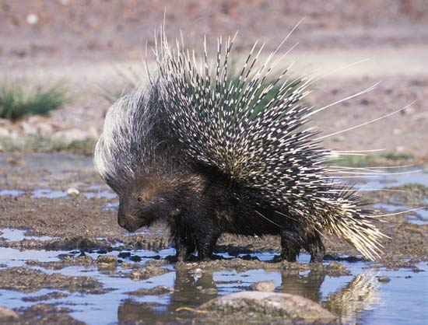
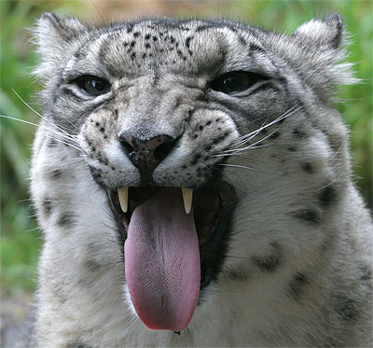
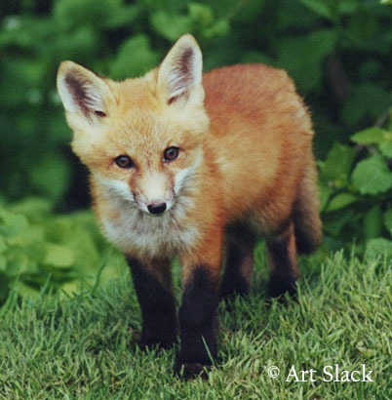
Evergreen Forest Animals
bald eagle, red-tailed hawk, coyote, spotted owl, snow leopard, porcupine, raccoon, beaver, brown bear, red-fox, otter.

Slide 15
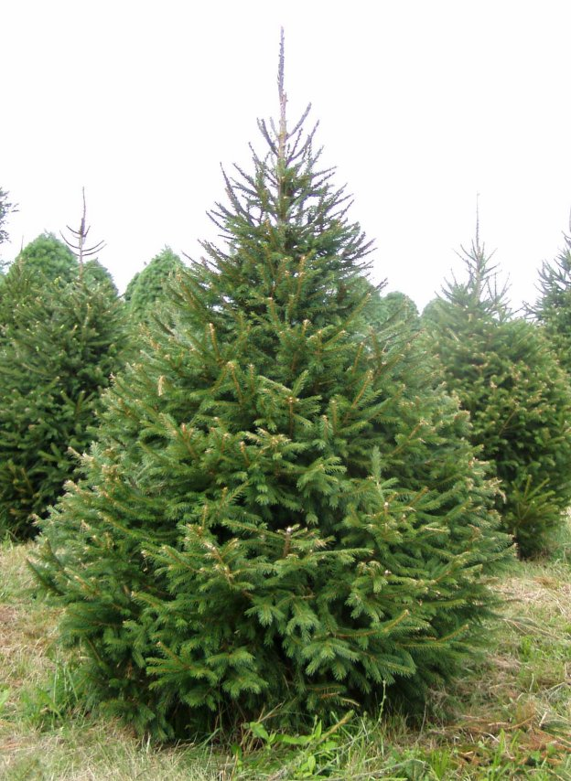
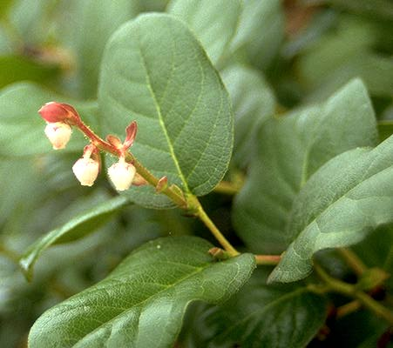
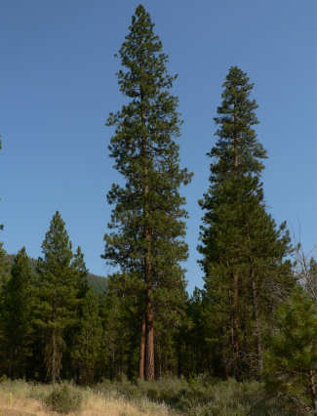
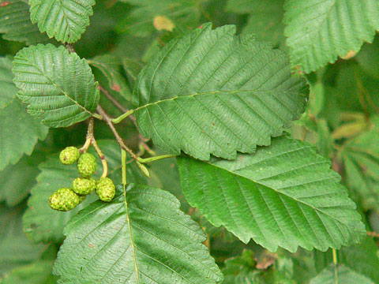
Evergreen Forest Plants
Thimbleberry, salal, hazelnut, nootka rose, ponderosa pine, lodgepole pine, spruce,fir,red alder

Slide 16
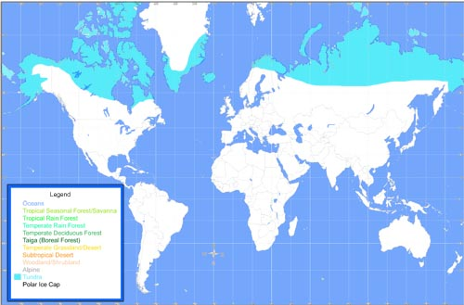
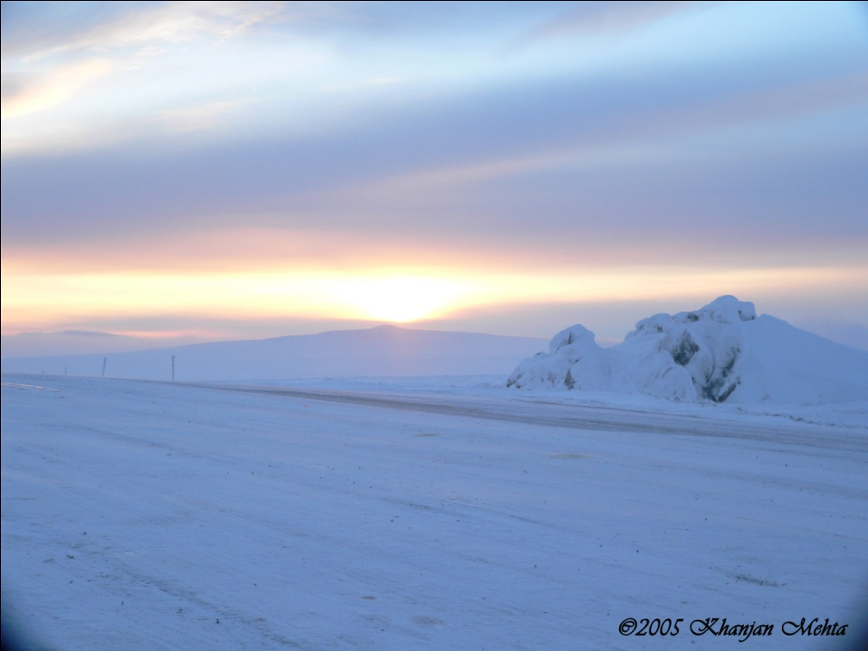
Tundra
Location: near the North pole.
treeless, covers about 20% of the Earth's surface,
Climate: cold most of the time, summer is brief when the sun shines almost 24 hours a day.
6-10 inches of rain per year, temperature less than 5° C

Slide 17
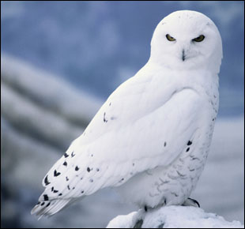
Tundra Animals
Arctic Fox, Caribou, Ermine, Lemming, Musk Ox, Polar Bear, Snowy Owl
Ermine
Lemming

Slide 18
Tundra Plants
Arctic Moss, Arctic Willow, Bearberry, Labrador tea, Yellow Tundra Flower
Bearberry
Labrador tea

Slide 19
Savanna
Location: Africa and South America
Climate: dry season - 68° to 86° F (winter),
rain (35 to 60 in) in the summer months
Most of the animals migrate to find food.

Slide 20
Savanna Animals
Elephant, African Wild Dog, Black Mamba, Caracal, Chacma Baboon, Emu, Zebra, Koala Bear, Lion.
Caracal
Black Mamba

Slide 21
Savanna Plants
Whistling Thorn
Acacia
Jackalberry Trees
Gum Tree Eucalyptus

Slide 22
Temperate Grassland
Location: mostly in interiors of continents.
Climate: 20° F - 70°F, annual precipitation is 10-30 inches.
very fertile soil

Slide 23
Temperate Grassland Animals
Badger
American Bald Eagle, Badger, Bobcat, Coyote, Prairie Dog, Fox
Bobcat
Bison
Prairie Dog

Slide 24
Temperate Grassland Plants
Bluestem Grass, Blue Grama Grass, Milkweed, Purple Coneflower
Milkweed
Blue Grama Grass
Big Bluestem Grass

Slide 25
Taiga (Coniferous Forest)
Largest biome in world!
Location: stretches over North America and Eurasia (top of the world, just below tundra)
Climate: winter – freezing cold.
Summer – hot, little rain (12-33 inches)

Slide 26
Taiga Animals
Black Bear, Bald Eagle, Bobcat, Canadian Lynx, Gray Wolf, Grizzly Bear, Long-Eared Owl, Red Fox, River Otter, Snowshoe Rabbit

Slide 27
Taiga Plants
Balsam Fir, Black Spruce, Douglas-fir, Eastern Red Cedar, Jack Pine, Paper Birch, Siberian Spruce, White Fir, White Poplar, White Spruce.

Slide 28
Biome Summary Questions – on your own paper – you will turn these in.
Why are there different biomes?
2. What might cause a change in a biome?
3. Which biome is most at risk? (your opinion and why)
4. Where is there the greatest biodiversity and why?

