Slide 1
Evolution of Life
Endosymbiosis

Slide 2
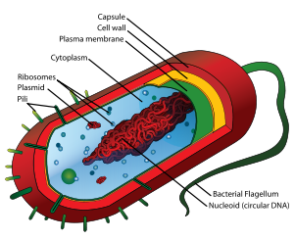
3.5 bya Prokaryotes – 2 Kingdoms
Eubacteria
(true bacteria)
Archaebacteria (ancient bacteria)
E. Coli

Slide 3
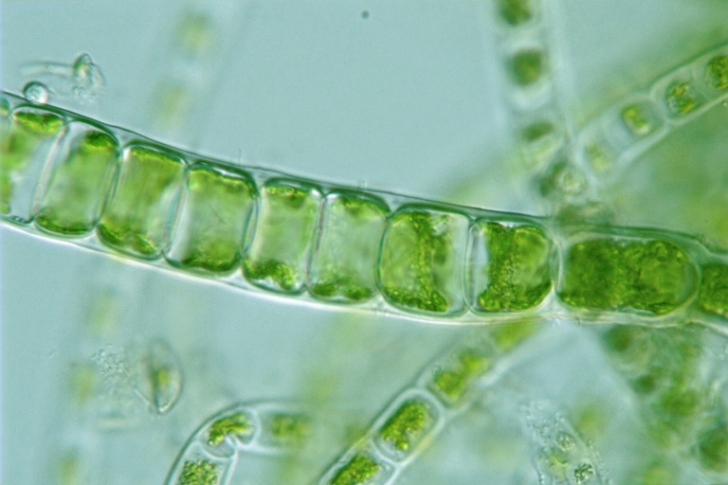
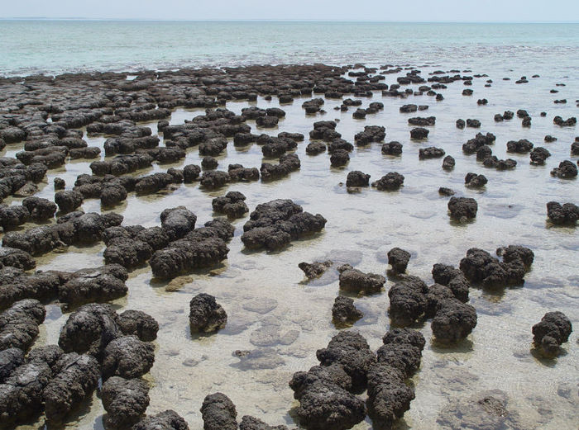
Cyanobacteria
First Photosynthetic Prokaryote
Oxygen is produced in oceans and creates ozone
Cyanobacteria create Stromatolites

Slide 4
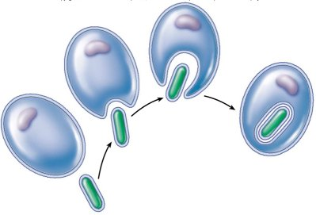
1.5 bya - First Eukaryote
1966 – Margulis - Theory of Endosymbiosis
Proposes how eukaryotes evolved from prokaryotes
Endosymbiosis proposes that mitochondria and chloroplasts were formerly small prokaryotes living within larger host cells

Slide 5
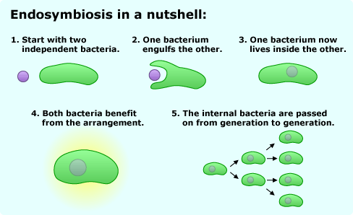
Diagram - Mitochondrion

Slide 6
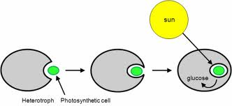
Diagram - Chloroplasts

Slide 7
Evidence
Size and Structure
Mitochondria and chloroplasts are the same size as prokaryotes.
Both have a double membrane
Genetic material
Both have circular DNA
Ribosomes
Contain their own ribosomes
Reproduction
Both reproduce by fission, not during the cell cycle

Slide 8
Video Clip
Plant Biology – Chloroplasts

