Slide 1
Biodiversity -
Review Q#1-5
the variety of living organisms within an ecosystem.

Slide 2
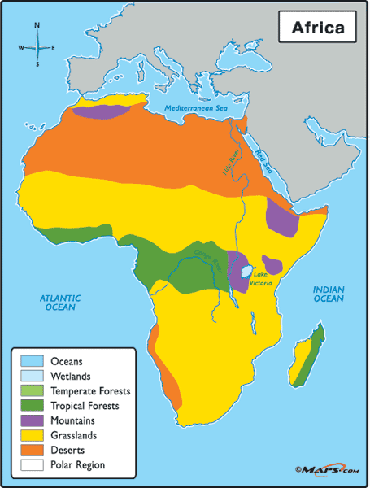
1. What causes the “patchiness” in the Biosphere (Earth)?
The Earth is “patchy” because it is made up of different environments (land, oceans, lakes, ice).
If you look at a single continent it is “patchy” because there is an uneven distribution of ecosystems (deserts, grasslands, forests) due to differences in climate).

Slide 3
2. Name 5 abiotic factors that can affect Biodiversity?
Sunlight
Temperature
Soil
Precipitation
Water
Wind
Mountains
Elevation
Humidity
Severe disruptions

Slide 4
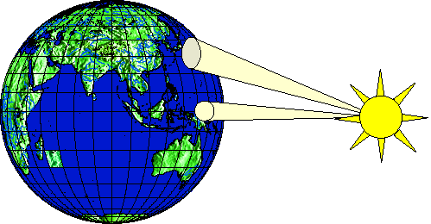
3. The Earth is heated “unevenly,” what does this mean?
The sun’s rays strike different parts of the Earth differently.

Slide 5
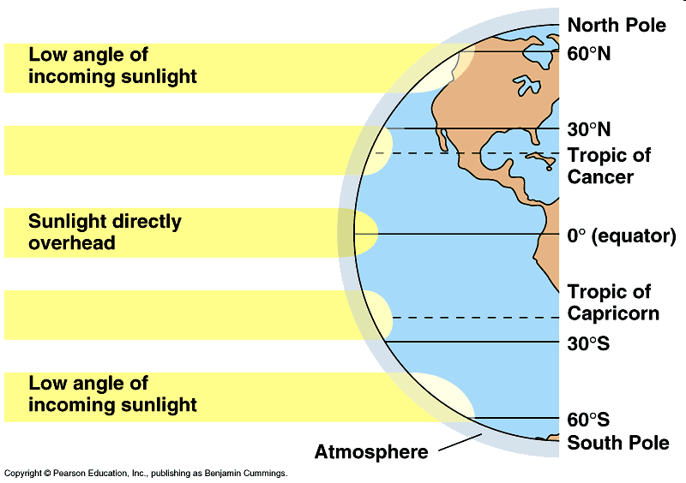
3. How does the uneven “heating” of the Earth impact Ecosystems?
The uneven heating affects the climate of a region
The sun’s rays striking the equator are more direct than the rays striking the polar regions.

Slide 6
4. What 2 abiotic factors have the greatest influence on the ecosystems?
Sunlight
Temperature
Soil
Precipitation
water
Wind
Mountains
Elevation
Humidity
Severe disruptions

Slide 7
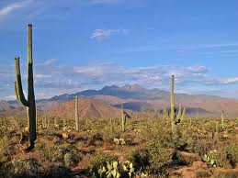
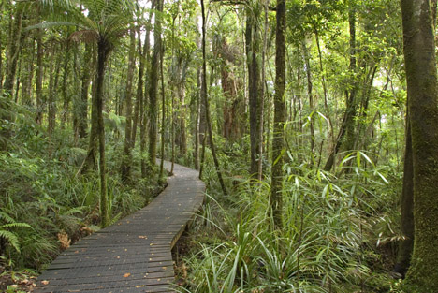
5. What is a Biome ……
A very specialized ecosystem that only exists in a certain area or climate.
They are identified by factors like temperature, rainfall, soil type and altitude.
The organisms are adapted to its specific climate (temperature and precipitation)

Slide 8
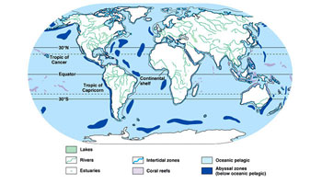
5. Can the term Biome be used for water ecosystems?
Lakes
Rivers
Estuaries
Intertidal zones
Coral reefs
Oceans

Slide 9
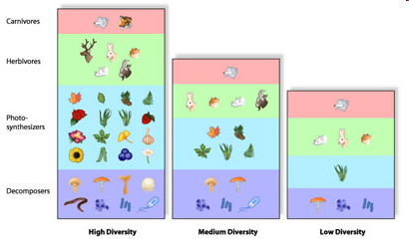
Biodiversity is a measure of the health of ecosystems

Slide 10
Thought Question…
Reflect on the biodiversity of the Tundra and Evergreen Forest biomes. Identify at least two reasons for the differences in biodiversity between these two places.

