Slide 1
History of Life on Earth

Slide 2
How Did Life Begin – 2 Theories

Slide 3
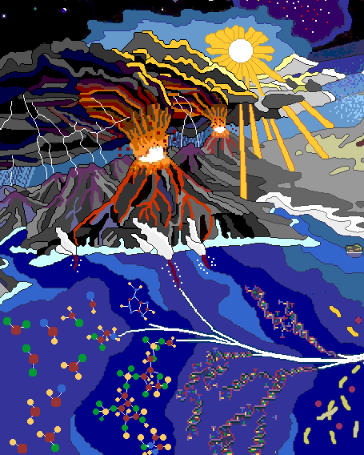
1. Primordial Soup
1929 - Oparin and Haldane
Early atm. contained N₂, H₂, H₂0, NH₃ and CH₄
These molecules underwent chemical reactions (sun, volcanoes, lightning) to create organic molecules

Slide 4
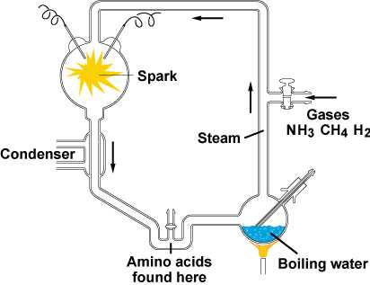
1953 - Primordial Soup – Retested
Miller and Urey
Amino acids and other organic molecules were formed.

Slide 5
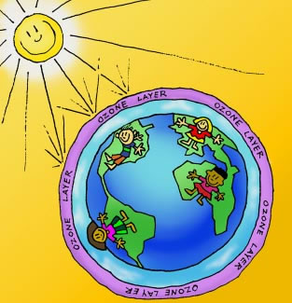
Primordial Soup - Rejected
NH₄ and CH₄ would not have existed without ozone.
Without these gases, organic molecules are not made.

Slide 6
The Bubble Model
1986 – Lerman
Ammonia, methane, from undersea
Inside “bubbles”
Rise to surface, exposed to atm, then get reacted with others
Heavy molecules return to the ocean
Absorbed by the ocean and other reactions occurred

Slide 7
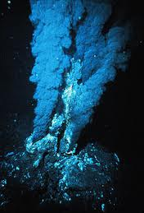
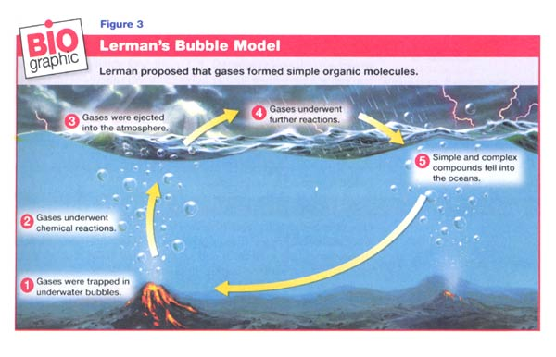
2. Bubble Model (1986)
Hydrothermal Vents

