Slide 1
Meiosis

Slide 2
Review the following terminology with your lab partner:
Homologous chromosomes
Gametes
Gene
Diploid (2n)
Haploid (n)
Somatic cells
Autosomes
Sex chromosomes
Mitosis

Slide 3
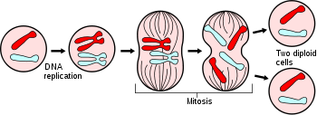
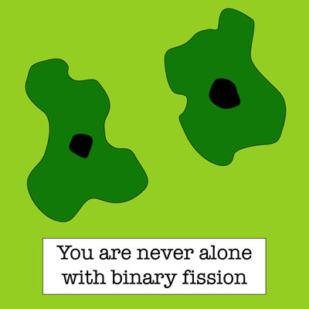
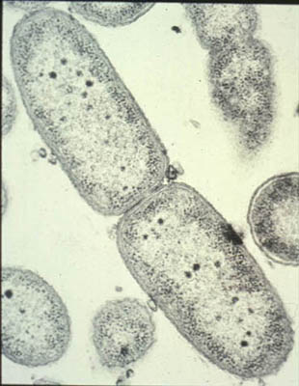
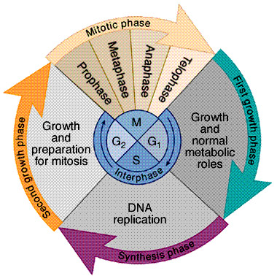
Mitosis (Asexual Reproduction) produces cells that are genetically identical.

Slide 4
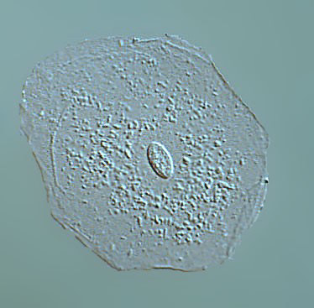
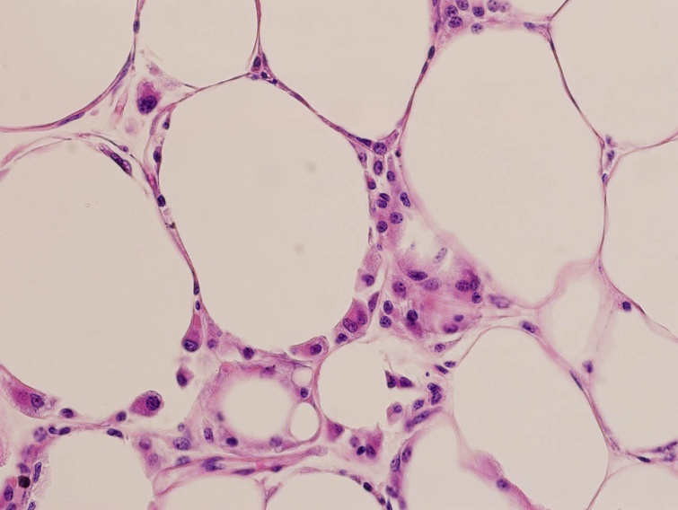
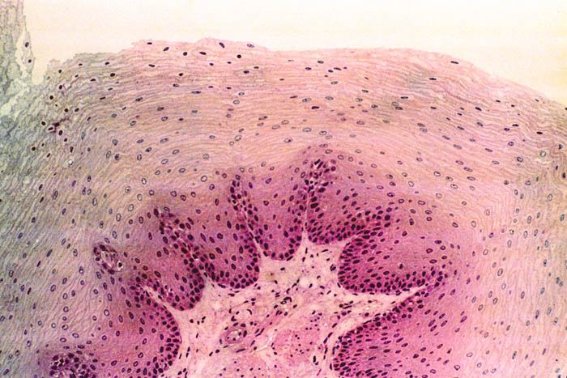
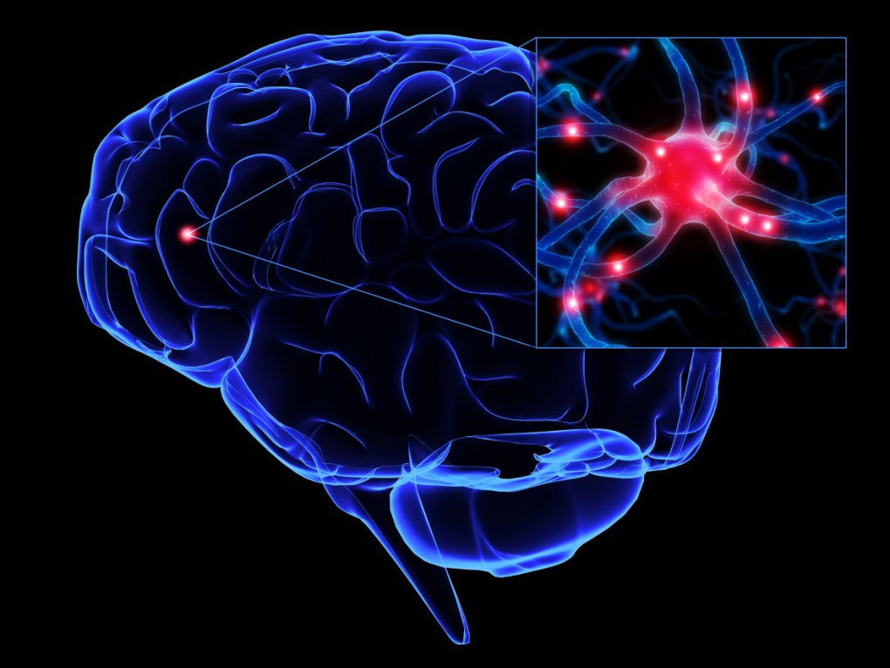
Mitosis produces Somatic Cells

Slide 5
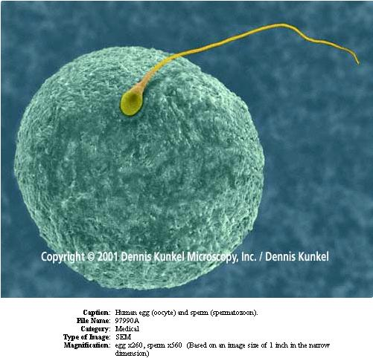
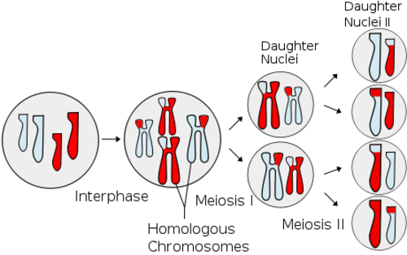
Meiosis –formation of gametes

Slide 6
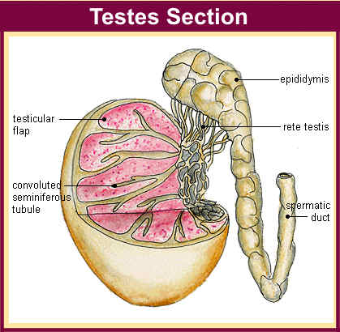
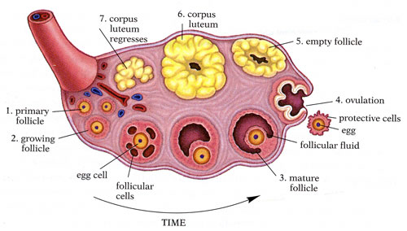
Gametes are produced in…
Testes
Ovaries
Ovary

Slide 7
Meiosis: Males vs. Females
Males:
Meiosis and sperm production begins at puberty
Continuous process that males will always undergo – takes 9 weeks
Females:
Meiosis and egg production begins before birth. Process stops abruptly, and does not begin again until puberty
At puberty, one egg each month resumes meiosis and finishes its development
Process stops when a women reaches menopause (around 50 years of age)
Meiosis of a singe egg could take 50 years to complete!

Slide 8
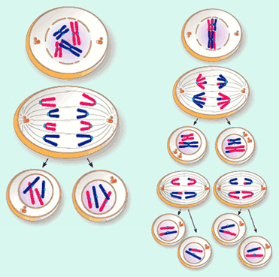
Comparison of mitosis and meiosis
Skin Cells Egg Cells
Somatic Cells or Body Cells
Gametes or sex cells
Diploid
Haploid

Slide 9
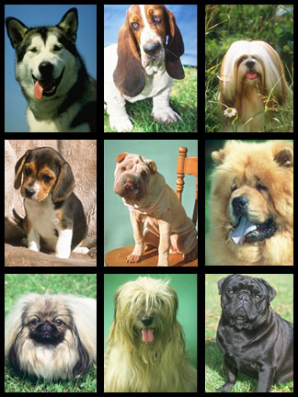
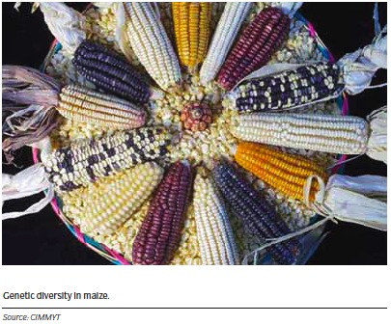
Meiosis (Sexual reproduction) leads to genetic diversity!

Slide 10
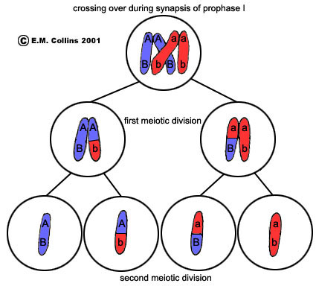
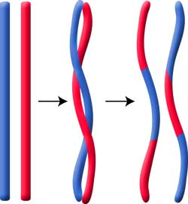
Crossing over of homologous chromosomes leads to diversity

Slide 11
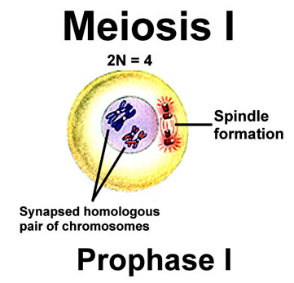

Slide 12
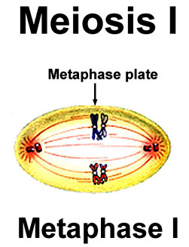

Slide 13
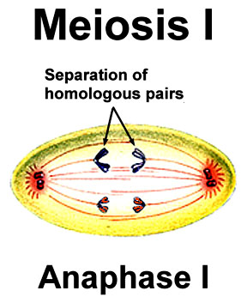

Slide 14
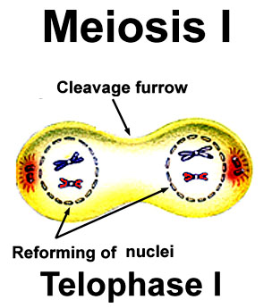

Slide 15
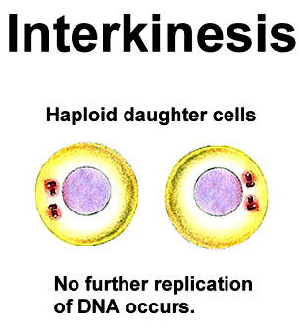

Slide 16
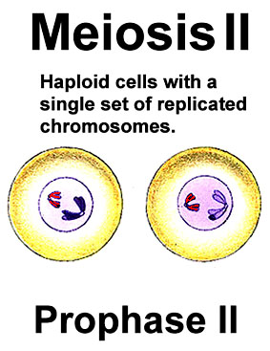

Slide 17
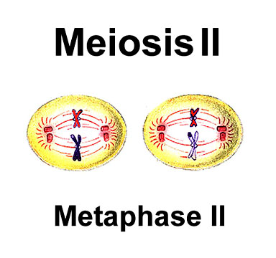

Slide 18
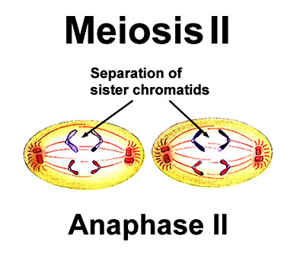

Slide 19
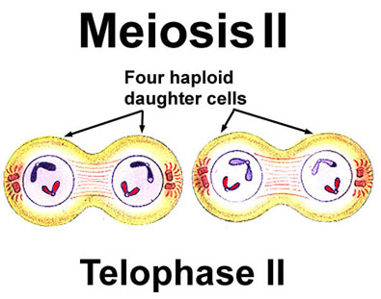

Slide 20
Meiosis Review
The Meiosis Square Dance

