Slide 1
Ecology
As we look at the following pictures – identify any words that “fit” or come to mind.

Slide 2
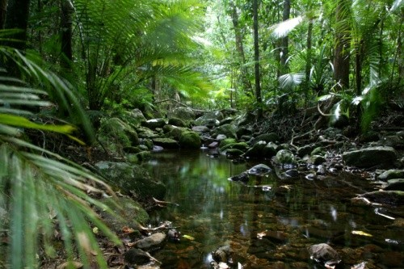

Slide 3
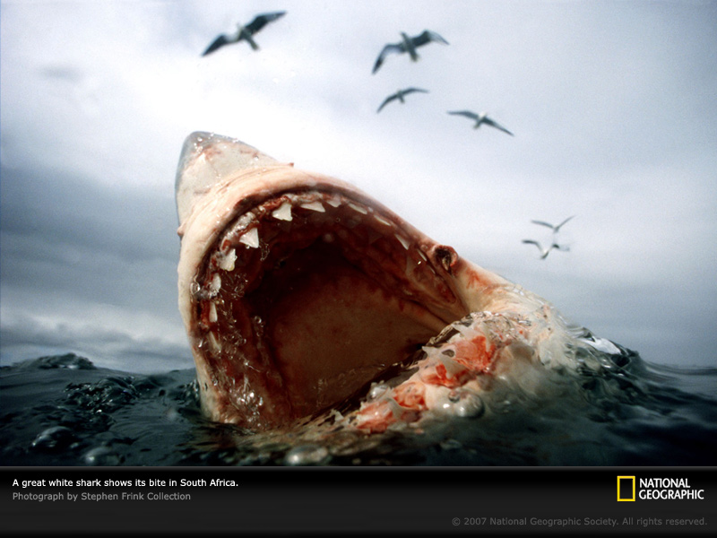

Slide 4
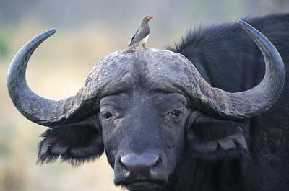

Slide 5
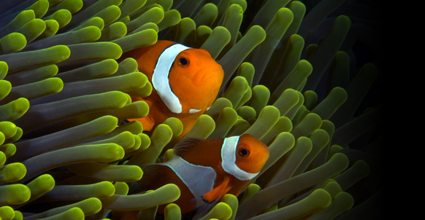

Slide 6
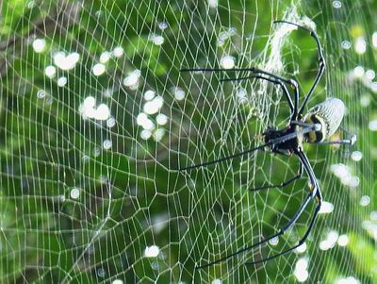

Slide 7
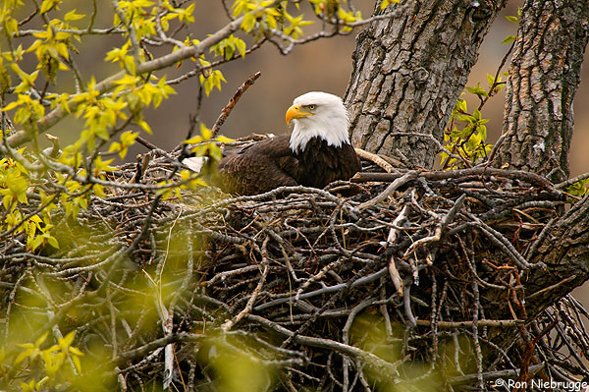

Slide 8
What is Ecology?
“ecos” = home
“ology” = study of
Ecology = the study of organisms and where they live

Slide 9
Define Ecosystem under your chart
Ecosystem = a system formed by the interaction of organisms with the living (biotic) and non-living (abiotic) environment.
Video
Thought Question:
How might an abiotic factor affect a biotic factor in an ecosystem?

Slide 10
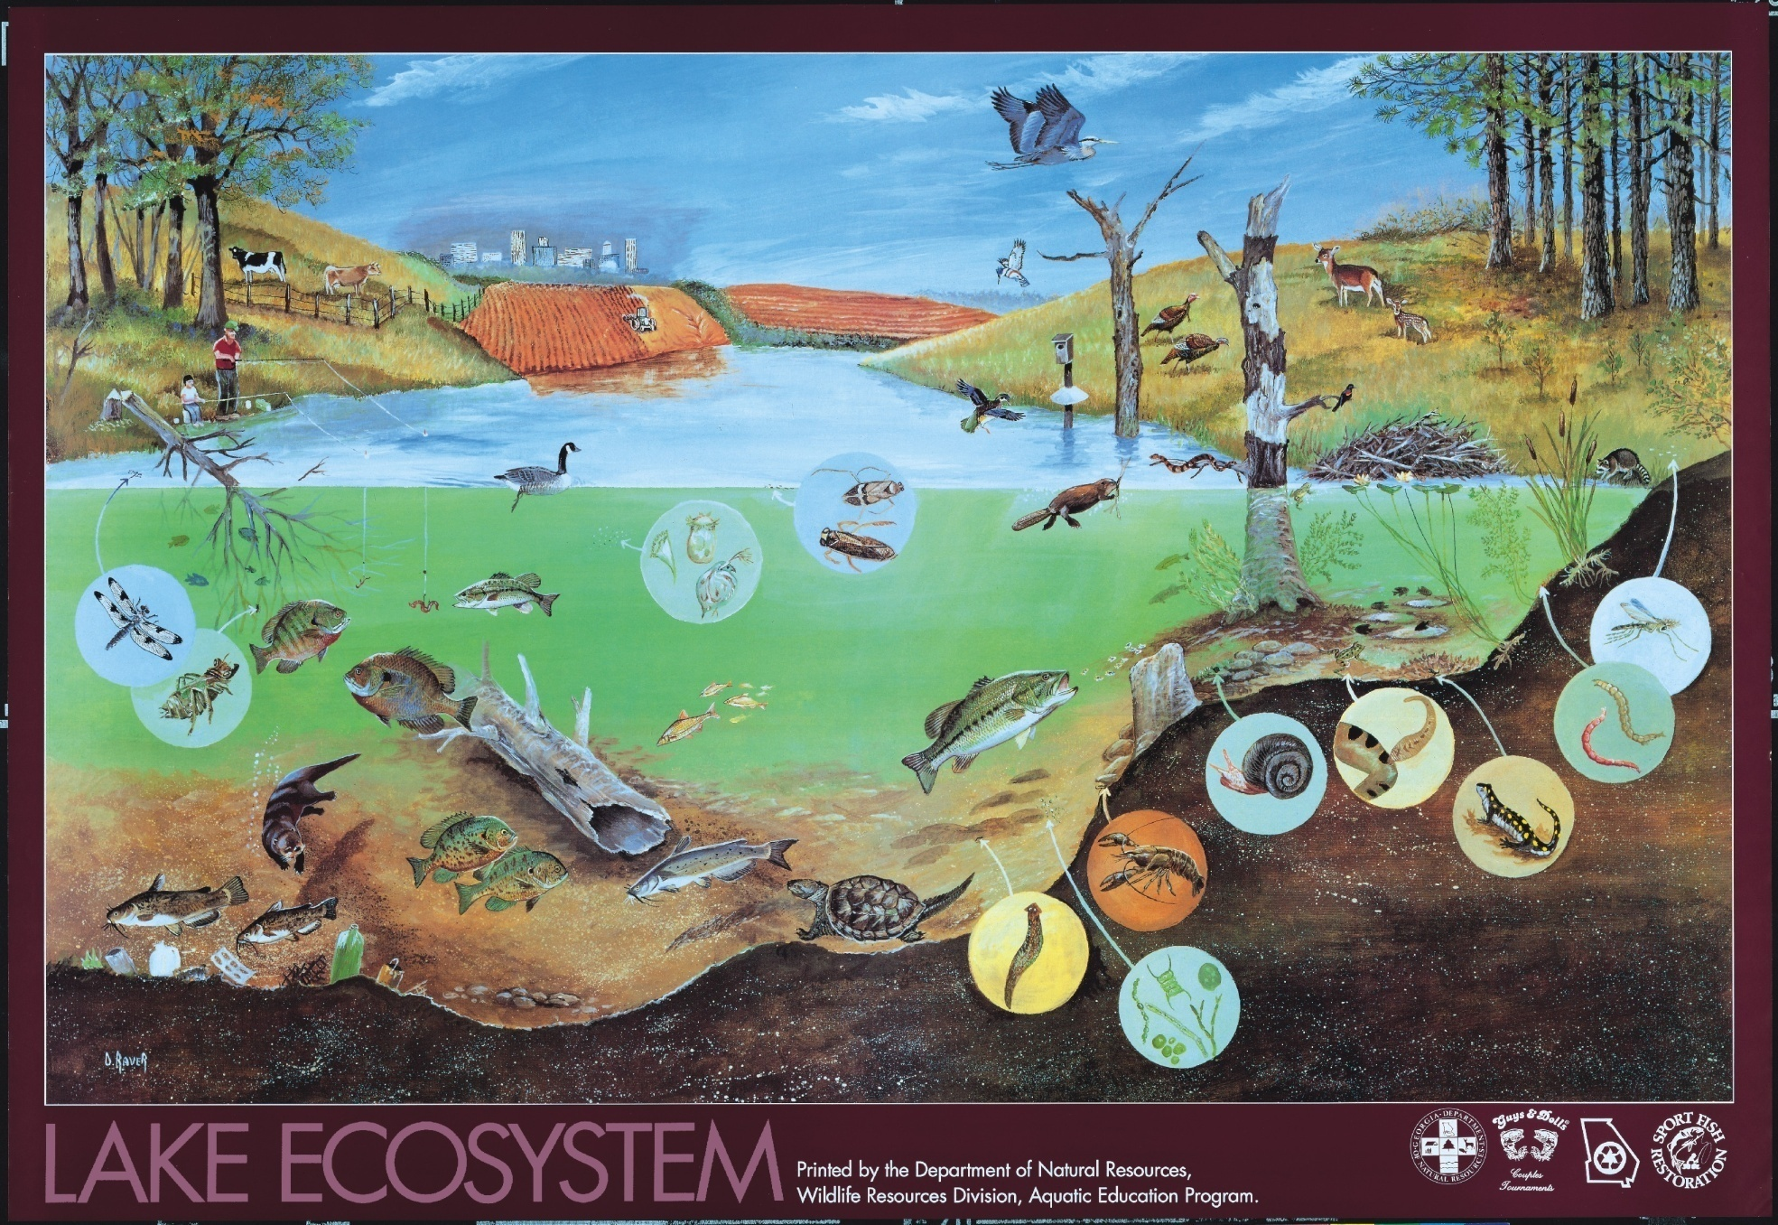
Ecosystem Organization

Slide 11
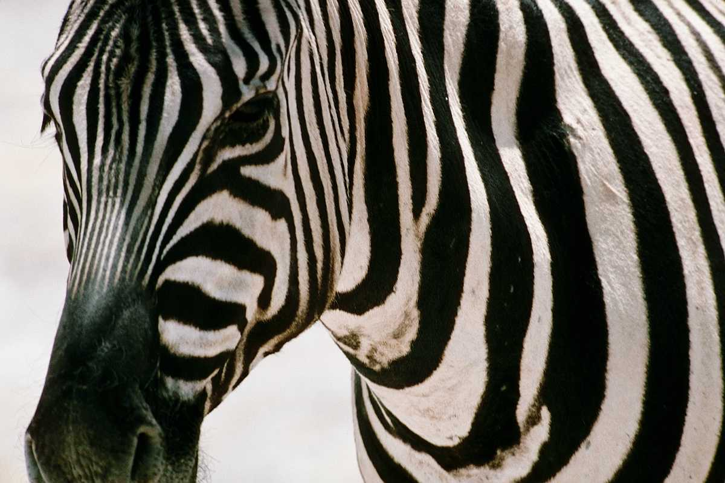
Organism

Slide 12
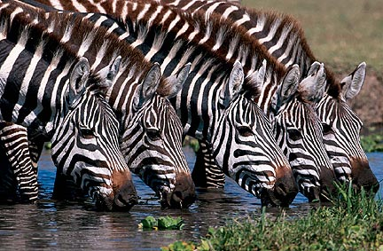
Population

Slide 13
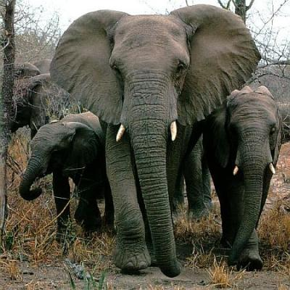
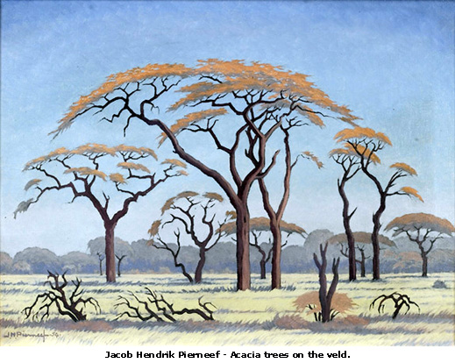
Community

Slide 14
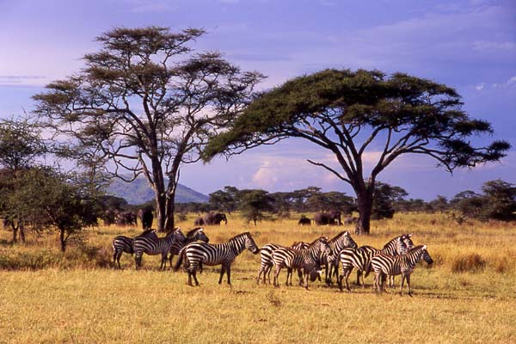
Ecosystem

Slide 15
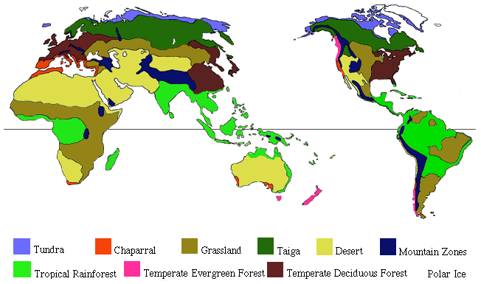
Biomes
We will study 7

Slide 16
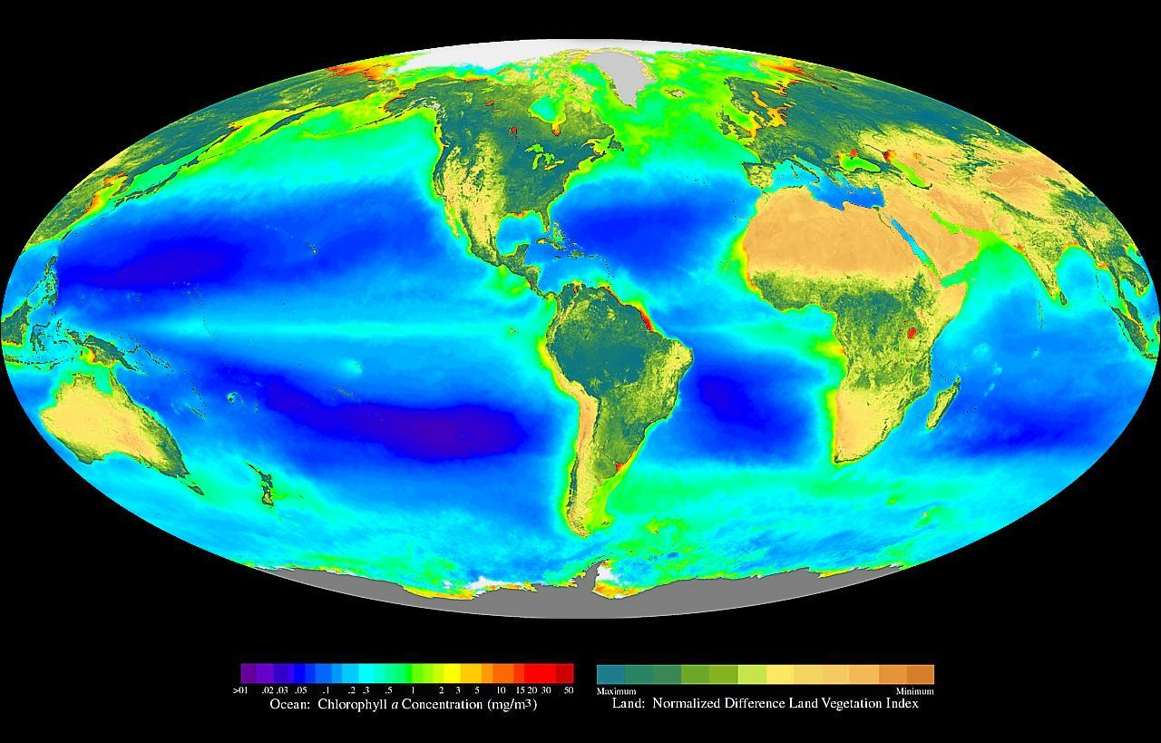
Biosphere (Earth)
3 parts: land, water, air

Slide 17
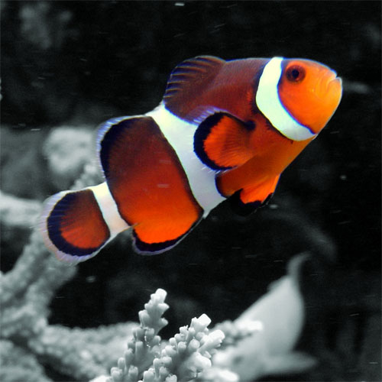

Slide 18
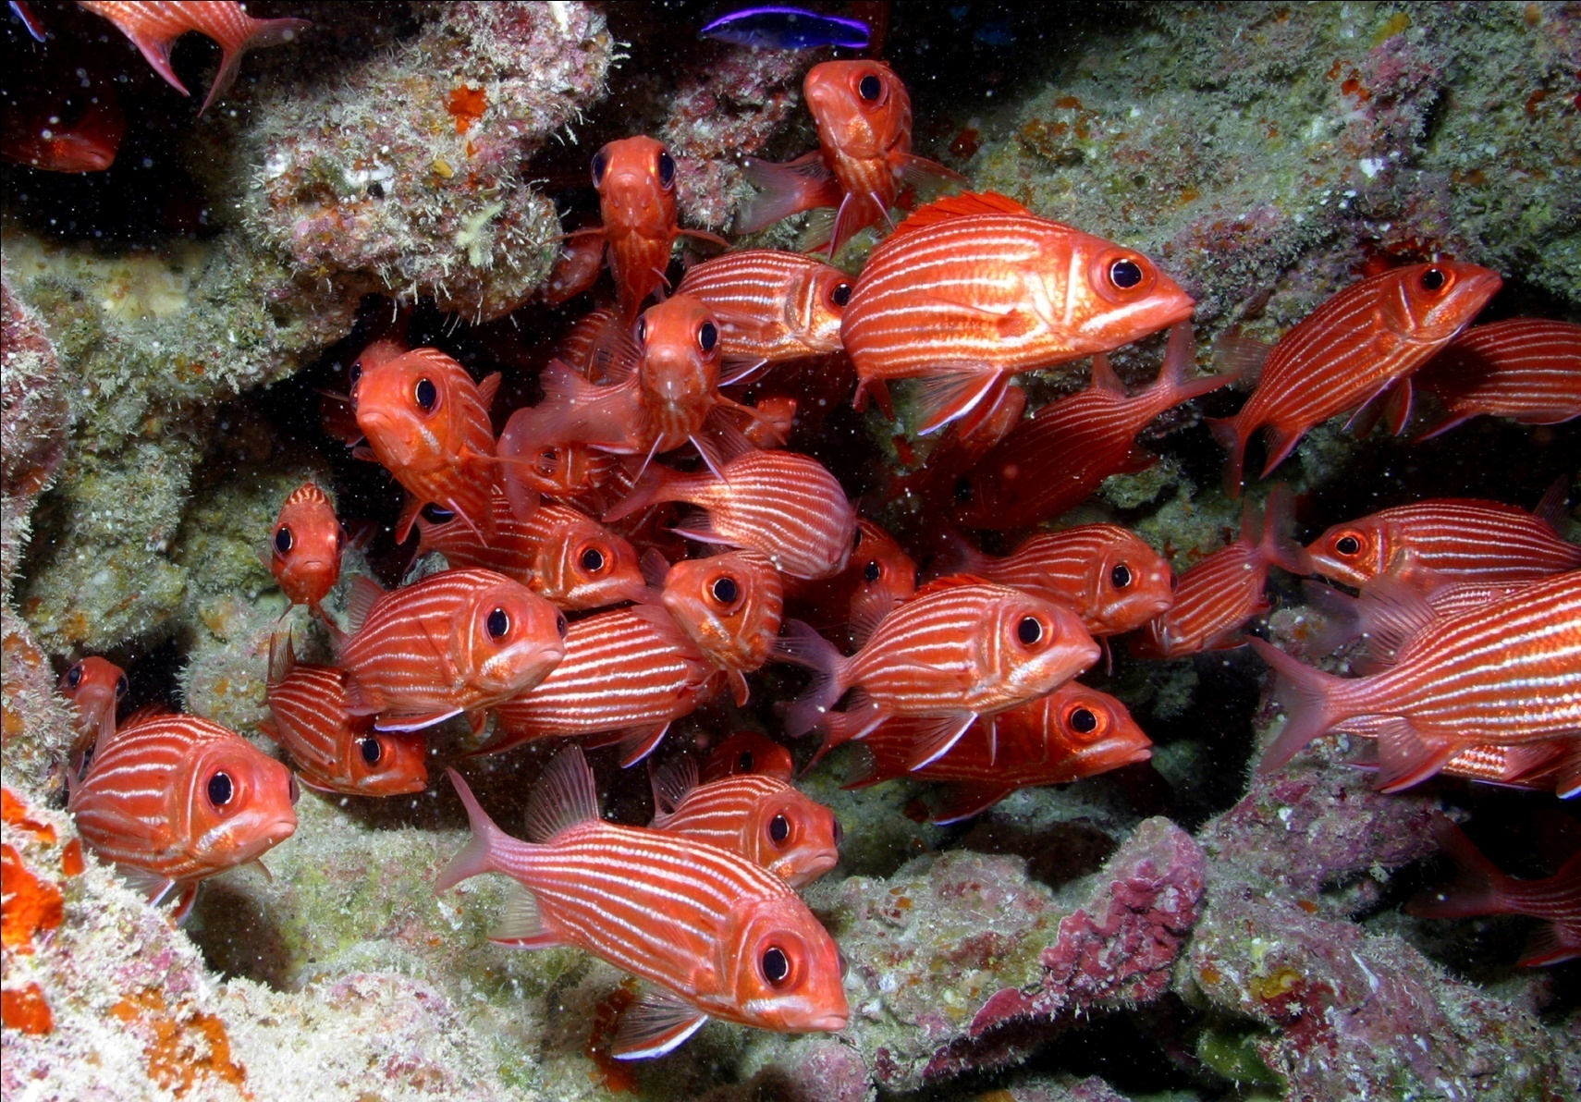

Slide 19
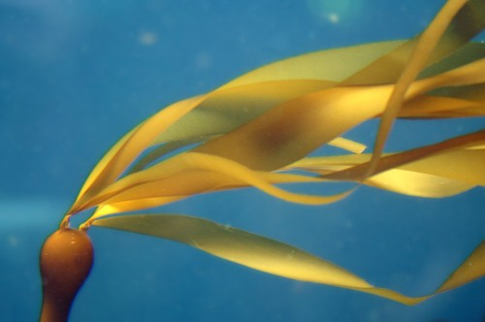
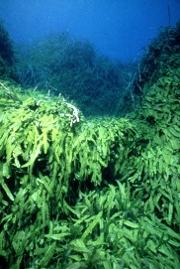
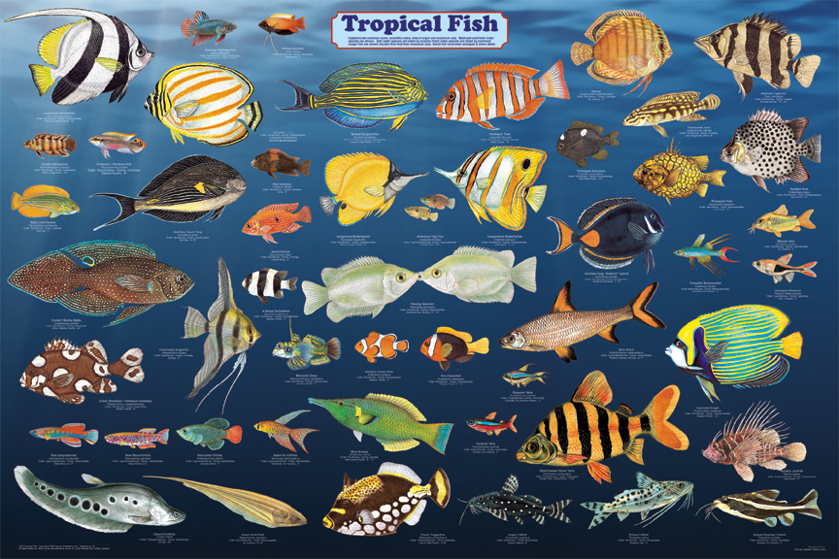
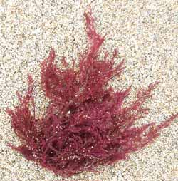

Slide 20
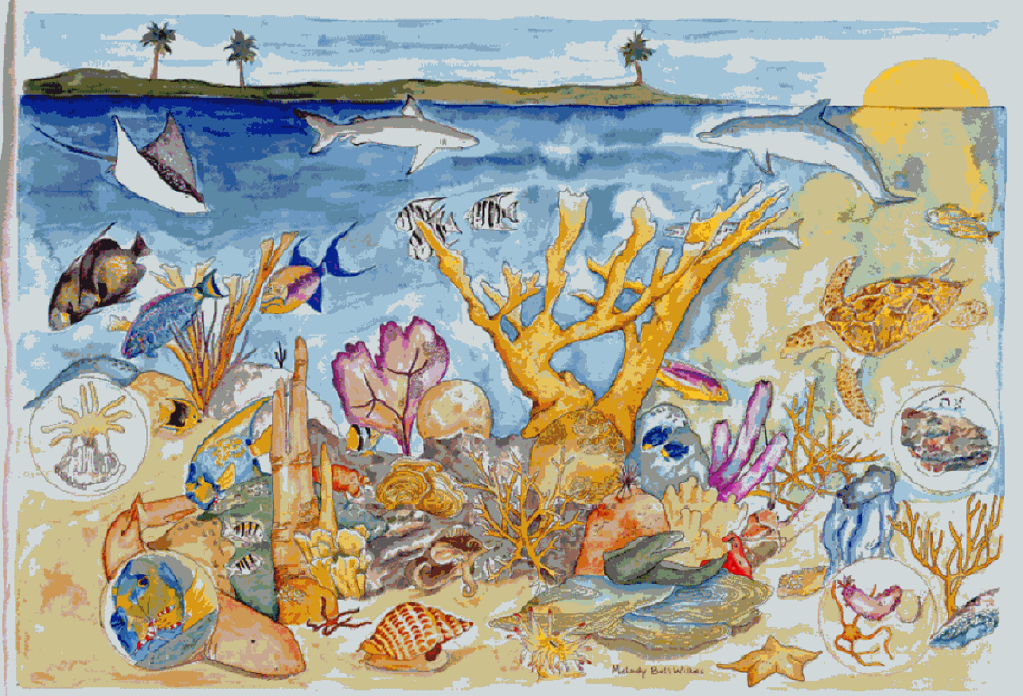
Ecosystem

Slide 21
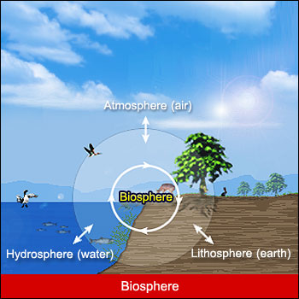

Slide 22
How is an ecosystem organized?
Small -> Large
Organism -> population -> community -> ecosystem -> biome -> biosphere (earth)

Slide 23
Quantify
Biodiversity (pg 341) – the number and variety of organisms in a given area during a specific period of time.
Found by counting the number of different organisms in an area.

Slide 24
Calculate the biodiversity of this slide

Slide 25
Quantify
Biodiversity (pg 341) – the number and variety of organisms in a given area during a specific period of time.
Found by counting the number of different organisms in an area.
Transect – a line overlaid in an area to count specie diversity.

Slide 26
Succession
Pioneer species – the first specie to move into a disturbed area.
Succession – when species replace other species in a given area.
Primary succession – occurs where life has not existed before.
Secondary succession – occurs in areas that have previous growth but currently do not due to a disturbance

Slide 27
Succession Activity

Slide 28
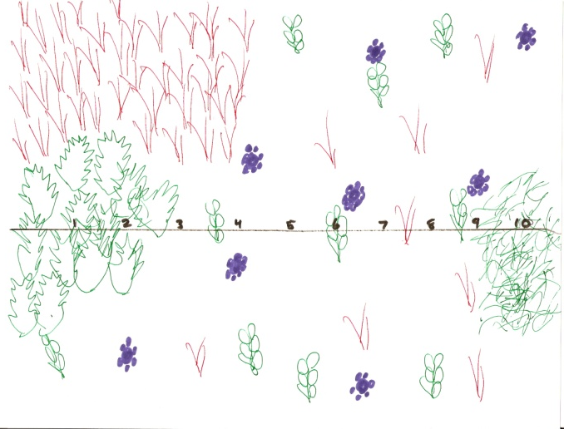
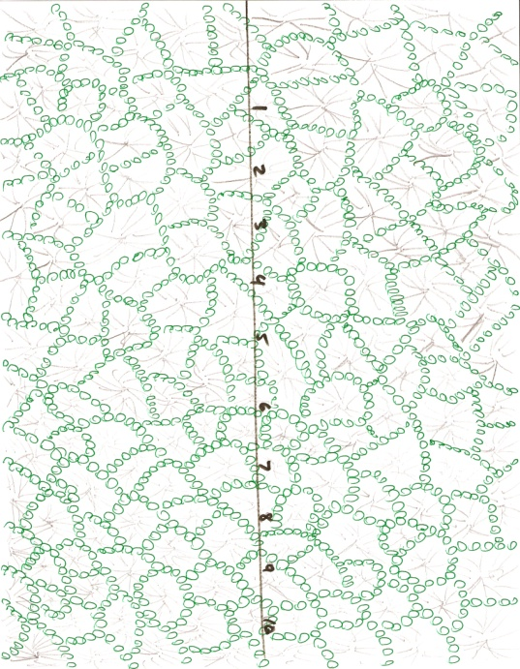
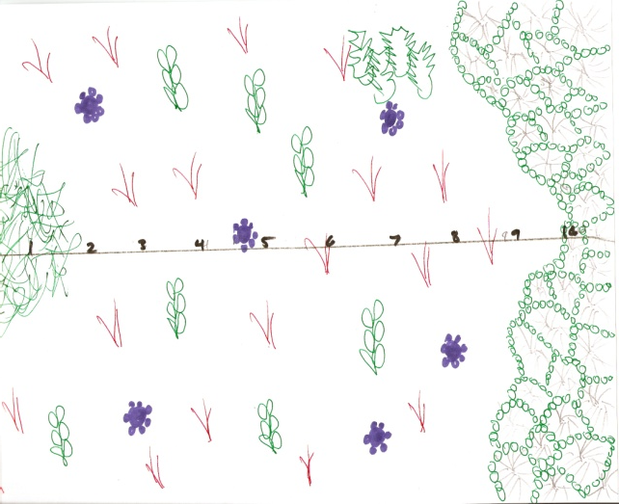
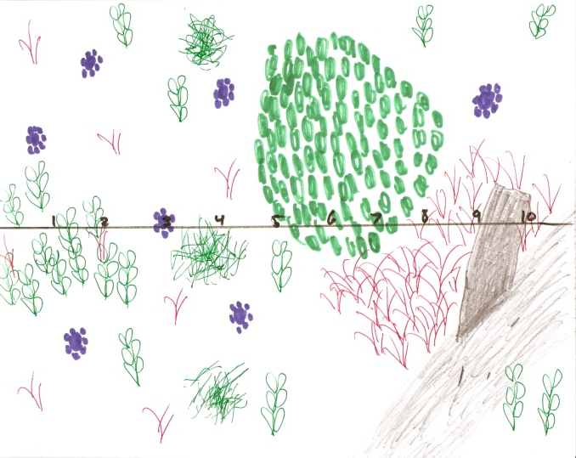
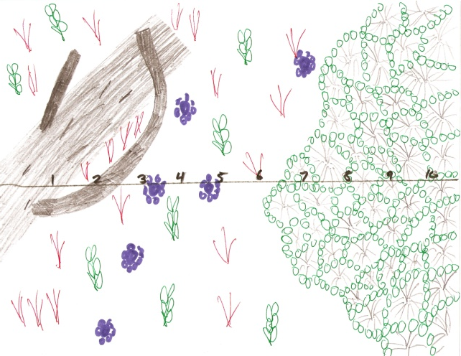
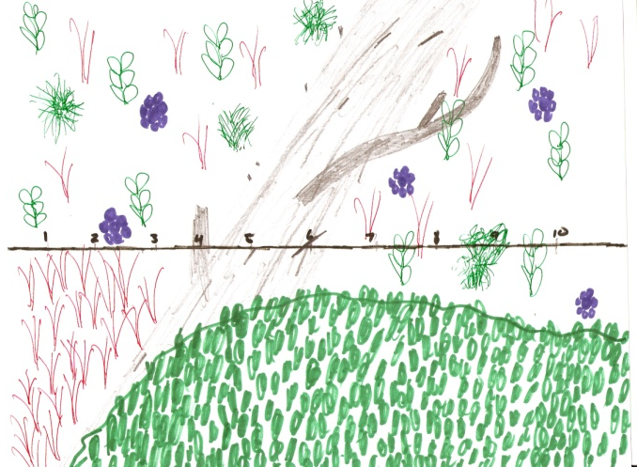
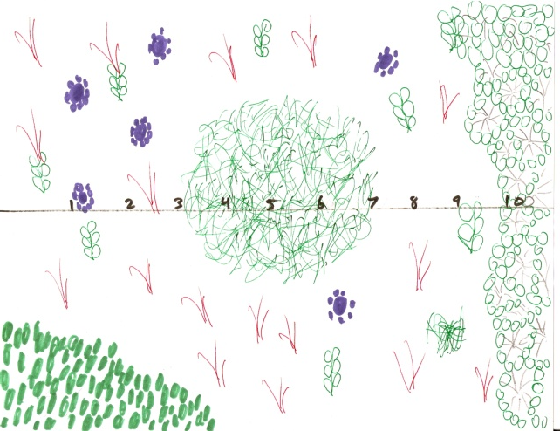

Slide 30
Primary Succession
Secondary Succession

Slide 31
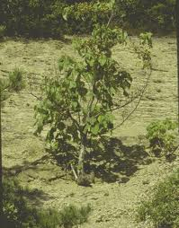
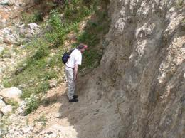
Primary Succession

Slide 32
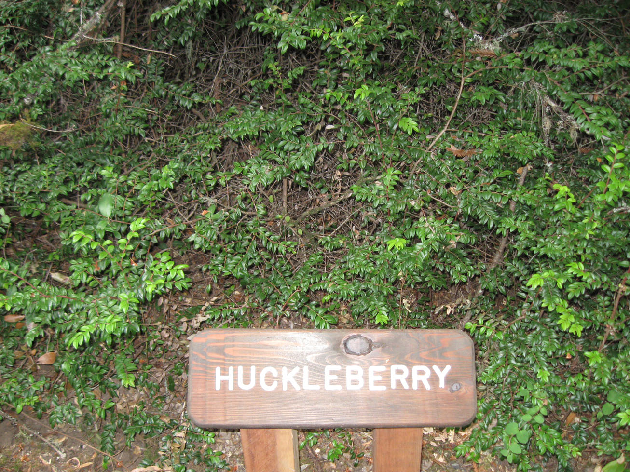
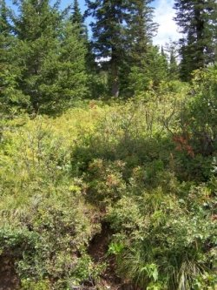
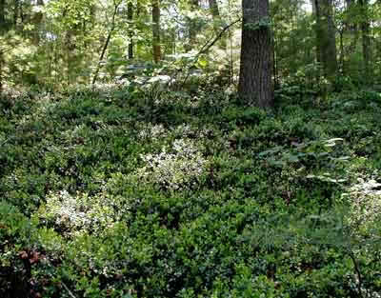
Secondary Succession

Slide 33
Succession Activity - Wrapup
Primary Succession
An area where growth happens on a new substrate. ex: lava, glacial retreat
Secondary Succession
An area where growth happens after an event on previously used soils. ex: hurricane, fire, flood

Slide 34
Succession Activity
Note:
A primary succession area tends to have more plant diversity.
A secondary succession area tends to have more overall diversity.

Slide 35
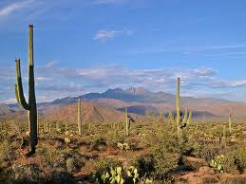
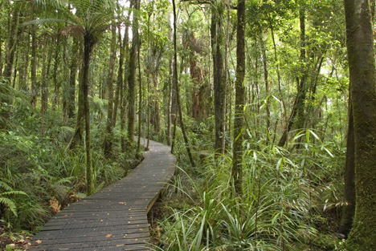
A Biome ……
is a very specialized ecosystem that only exists in a certain area or climate.
They are identified by factors like temperature, rainfall, soil type and altitude.
The organisms are adapted to its specific climate (temperature and precipitation)

Slide 36
Biome Chart
Teams of 3 – Teacher will assign
Each person researches 2 biomes. (one person will have to do 3, there are 7 total)
Your TASK: Complete your research (library or textbook pg 373) . Take time to look more deeply at the ecosystems you were assigned. Add to your research by completing your section of the biome chart – in detail.
Groups share their information tomorrow.

