Slide 1
Photosynthesis

Slide 2
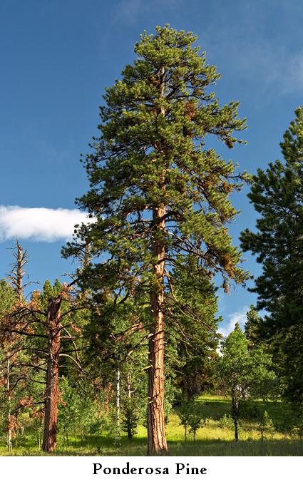
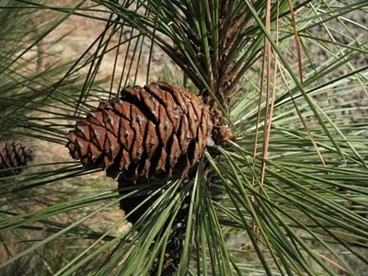
Seeds to Logs
Where did all that “stuff” come from?
VIDEOCLIP - Harvard

Slide 3
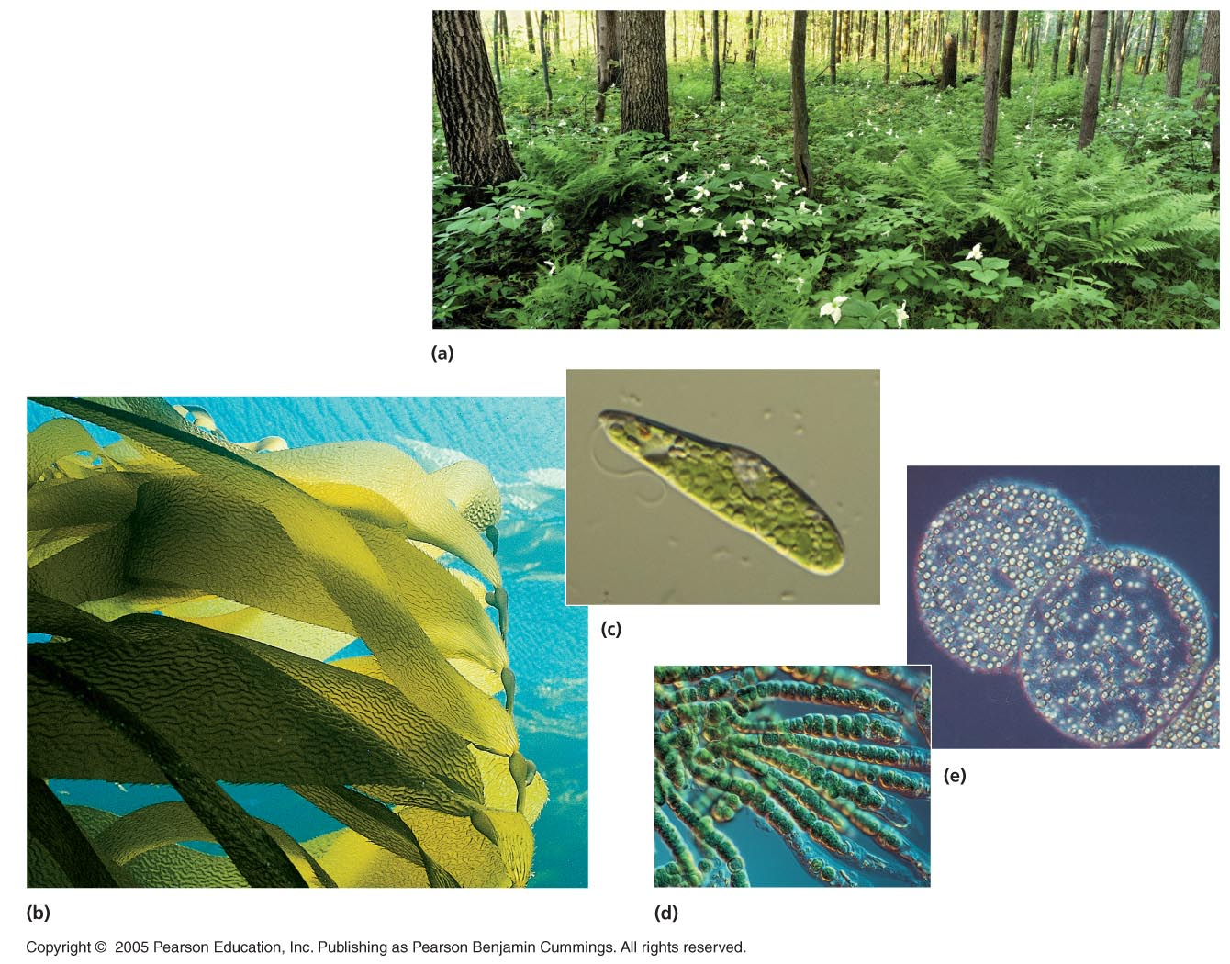
Who can undergo Photosynthesis?

Slide 4
Photosynthesis - Overview
Copy the diagram into your notebook.

Slide 5
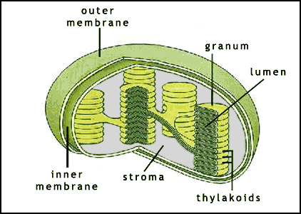
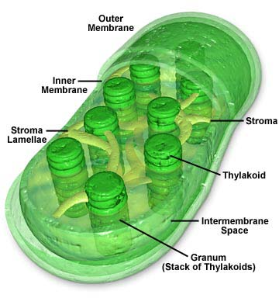
Where does photosynthesis occur?
Chloroplasts

Slide 6
Chemical Equation
6 CO₂ + 6 H₂O + sunlight → C₆H₁₂O₆ + 6 O₂
solar energy (sun) → chemical energy (glucose)
Energy Transformation!

Slide 7
Stage 1: Energy captured from sun
Occurs on the Thylakoid Membrane (TM)
Light strikes thylakoid
Water is split with light (photolysis)

Slide 8
What is released when water is split?
Oxygen gas (O₂)
Hydrogen ions (H+) = protons
Electrons (e-)

Slide 9
Stage 2: Light energy changed to chemical energy (ATP, NADPH)
e- (from stage 1) move through TM - called an electron transport chain (ETC)
ETC powers the movement of H+ into the thylakoid
H+ pass through carrier proteins to make ATP and NADPH

Slide 10
Animations
Stage 1 and 2
Stage 1 and 2
Stage 1 and 2

Slide 11
Stage 3: Stored energy creates organic compounds (sugars)
No light required, occurs in the stroma
Stored energy from stage 2 is used for carbon dioxide fixation
CO₂ is broken and “fixed” into sugar by the Calvin Cycle
Animation

Slide 12
Light vs. Dark Reactions
Light Reactions: “photo” part – light is absorbed by pigments (stage 1 & 2)
Dark Reactions: “synthesis” part – organic molecules are created (stage 3)

Slide 13
Copy Table into Notebook
Light
Water
Pigments
ATP and NADPH
Carbon Dioxide

Slide 14
Summary
Light | Excites electrons (Stage 1)
Water | Provides H+ ions and O₂ (Stage 1)
Pigments | Absorb light (Stage 1)
ATP and NADPH | Store chemical energy (Stage 2)
Carbon Dioxide (Calvin Cycle) | Used to make organic compounds (sugars) (Stage 3)

Slide 15
The Importance of Photosynthesis: A Review
The energy entering chloroplasts as sunlight gets stored as chemical energy in organic compounds
Sugar made in the chloroplasts provides energy for the organism and carbon to make cell parts.
Photosynthesis also produces the oxygen in our atmosphere!

Slide 16
Photosynthesis
Demo
Videoclip #1
Videoclip #2

