Slide 1
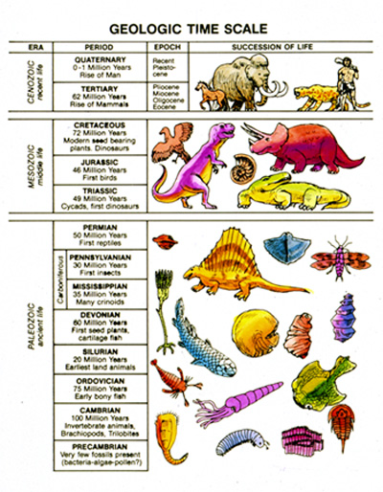
Geological Time

Slide 2
What do you know about the Geological Time Scale?
On the front chalk board, you will see a timeline. The timeline spans the age of the Earth. It starts at 4.5 billion years ago (bya) when the Solar System and Earth were formed. The timeline ends on the right side of the board at present time.
Earth: Making of a Planet – National Geographic

Slide 3
The adding tape on the board represents the entire history of the Earth.
Draw an red line on the timeline where you think the first living organisms (bacteria) appeared
Draw a green line on the timeline where you think dinosaurs roamed the Earth.
Draw a blue line on the timeline where you think humans first appeared.

Slide 4
The adding tape on the board represents the entire history of the Earth.
Draw an red line on the timeline where you think the first living organisms (bacteria) appeared
3.5 billion years ago – bacteria (3.5 m)
Draw a green line on the timeline where you think dinosaurs roamed the Earth.
251-65 million years ago (25.1 cm)
Draw a blue line on the timeline where you think humans first appeared.
200,000 years ago – (.2mm)

Slide 5
In your NB:
1) How close were your predictions to the correct spots on the timeline? Explain.
2) Did you do better on one prediction than another? Explain.
Video clip – Origin of Life on Earth

Slide 6
Geologic time as a calendar year:
Imagine that the geologic time scale is contained in 1 calendar year (each second is around 146 years). January 1 is 4.5 billion years ago.
March - The oldest known rocks are formed in early
Late March - The first forms of life (bacteria and algae) are preserved as fossils
September 3 - The first multi-celled creatures (seaweed) appear
November 11 - Phanerozoic Eon (most recent eon) begins
December 5 - Reptiles appear
December 14 - The first mammals appear
December 26 - Dinosaurs go extinct
5 PM on December 31 - The first hominids (human-like ancestors) appear
11:48 PM on December 31 - The first modern humans (Homo sapiens) appear
11:58:45 p.m. on December 31 - The last glacier receded
11:59:30 on December 31 - Written history begins
11:59:57 on December 31 - Columbus lands in the Americas
11:59:59 on December 31 - You were born 1/10th of a second before midnight

Slide 7
Geologic Time Scale
history of Earth into chunks:
Eons
Eras
Periods
Divisions determined biodiversity (appearances of some fossils and the disappearance of others)
Each era (and eon) ended with a major extinction event (5 mass extinctions).

Slide 8
Look at the Geologic Timeline...
1. What year did the Earth’s crust cool and the moon form?
4.5 bya
2. When did dinosaurs first appear? What Eon, Era, Period?
251 mya. Phanerozoic eon, Mesozoic era, and Triasic period
3. When did early humans appear? Is this a long time or short time in comparison with the whole history of the Earth?
23 mya. This is a short time in comparison with the history of the Earth.

Slide 9
Your Timeline - Phanerozoic Eon.
1 millimeter = 1 million years
Your adding tape is 60 cm long (you should only need 54 cm).
Directions:
Mark off the boundaries Periods using a meter stick.
You will label the Eras and color each one a different color
Label period and major biological events that happened in that period.
Include a picture for each period
Color each era a different color.

Slide 10
Your timeline should look like this. Be sure to include the years and one significant event from each period. You will need to measure and calculate the sizes of each period on your timeline.
Cenozoic Era | Neogene
 | Paleogene
Mesozoic Era | Cretaceous
 | Jurassic
 | Triassic
Paleozoic Era | Permian
 | Carboniferous
 | Devonian
 | Silurian
 | Ordovician
 | Cambrian

Slide 11
What does your timeline look like?
1 mm = 1 million years
Cambrian 543-488 = 55 million years (55 mm)
Ordovician 488-443 = 45 million years (45 mm)
Silurian 443-417 = 26 million years (26 mm)
Devonian 417-359 = 58 million years (58 mm)
Carboniferous 359-299 = 60 million years (60 mm)
Permian 299-251 = 48 million years (48 mm)
Triassic 251 – 200 = 51 million years (51 mm)
Jurassic 200-145 = 55 million years (55 mm)
Cretaceous 145-65 = 80 million years (80 mm)
Paleogene 65-23 = 42 million years (42 mm)
Neogene 23 – 0 (Present time)= 23 million years (23 mm)

