Slide 1
Welcome to Biology A Mr. Lonsdale

Slide 2
Blue
An entry task ~ 5-10 minutes
Review from the previous day.
Gets your head into biology.
Lets Mr. Lonsdale take attendance and get the class started.

Slide 3
Respect
Please work quietly
Be thoughtful and thorough, this is your first graded assignment
When finished, please put pencil down and wait for further instruction from me

Slide 4
Seating Chart
Meet your new lab partner for the month of December
New lab partners every month

Slide 5
Introduction
Have taught for 5 years – 4 at North Mason one in Tacoma
Attended University of Puget Sounds
4 years with a Bachelors in Science emphasis in marine ecology
1 year Masters in Arts in Teaching

Slide 6
Biology A Syllabus
Units:
1A Ecology (Biodiversity)
1B Ecology (Matter and Energy)
2. Chemistry of Cells
3. Cell Structure and Function
4. Cell Energy

Slide 7
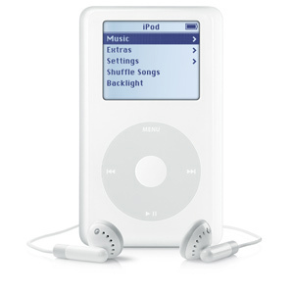
Classroom Rules
2
1
3
4

Slide 8
If You Break a Rule
1. Verbal Warning
2. Parent Contact
3. Detention
4. Administrative Referral
5. Severe Disruptions

Slide 9
Grading
70% Assessment of Learning
Final Assessments
Tests / lab reports / projects /quizzes= 70%
30% Assessment for Learning
The Learning Process –
Science Notebook, EOC Booklet = 10%
Homework, Daily Work, Quizzes = 10%

Slide 10
Grading Scale
A = 93-100% B = 83-86% C = 73-76% D = 66-60%
A-= 90-92% B-=80-82% C-=70-72% F = 59% -0
B+=87-89% C+=77-79% D+=67-69%

Slide 11
Policies and Procedures
1. Class Signal
2. Entry tasks
3. Absences
4. Make-up Work
5. Class Dismissal
6. Late Work
7. Mr. Lonsdale’s Desk
8. Going to the Restroom
9. Pencil Sharpeners
10. Student Movement
11. Participation
12. Tardy Policy
13. Extra Credit

Slide 12
Signature Forms:
2 Signatures – due Friday!
Lab Safety – we will discuss Friday

Slide 13
HW: Syllabus Questions
Answer questions on the homework sheet.
Use complete sentences – take your time!
You will be quizzed FRIDAY over the syllabus.

