Slide 1
Ocean Systems
Ocean Overview
Carbon Cycle

Slide 2
Ocean Overview pg 3-19
Pelagic – in the water column
Benthic – on or near the bottom
Neritic zone – above the continental shelf
Oceanic zones – below the continental shelf
Epipelagic zone 0-200 m (sunlight zone) –
top layer of the ocean,
photosynthesis takes place
most life

Slide 3
Ocean Overview pg 3-19
Mesopelagic 200-1000m –(twilight zone)
contains the thermocline 20-4º C
contains light but no photosynthesis
some large fish
Bathypelagic 1000-4000m – (midnight zone)
some large fish, whales, sponges, worms
no light

Slide 4
Ocean Overview pg 3-19
Abyssalpelagic 4000-6000m (the abyss)
only found in the deep oceans
angler fish, sponges, worms
no light
Hadalpelagic 6000m-10,000m (the trenches)
fish, sponges, worms
no light
James Cameron

Slide 5
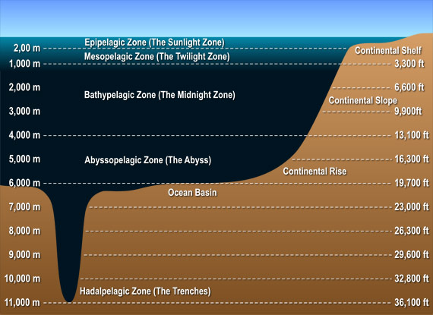
Ocean Overview
Oceanic
Neritic

Slide 6
Ocean Overview
Salinity (salts)
35 practical salinity units (psu)
1000 g sample, 35 grams are dissolved compounds
Cl⁻, Na⁺, S (as SO4⁻), Mg⁺, Ca⁺, K⁺
32 psu in Puget Sound
Why?

Slide 7
Ocean Overview
Dissolved Oxygen (D.O.)
µmol/kg
mL/L

Slide 8
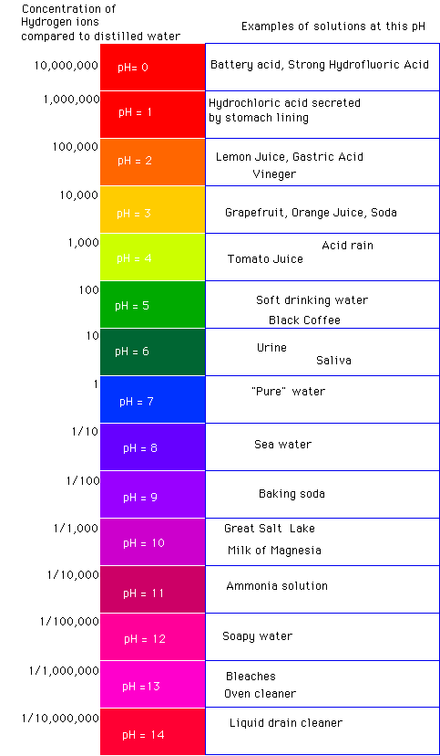
Carbon Cycle
Acid – higher concentration of H+
CO2 + H2O → H2CO3
Dissolution to
H2CO3 → H⁺ + HCO₃⁻
HCO₃⁻ → H⁺ + CO₃²⁻
Overview
Carbon → Carbonic Acid

Slide 9
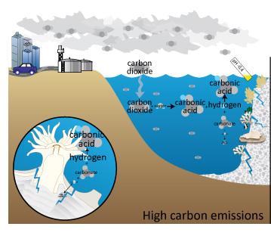
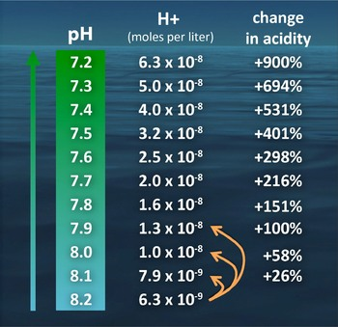
Carbon Cycle
Atmospheric carbon dioxide June 2012: 392.95ppm
Atmospheric carbon dioxide August 2013: 395.15ppm
Recommended is 350 ppm

