Slide 1
Benthic The Deep

Slide 2
Benthic Overview The Deep
Abyssalpelagic 4000-6000m (the abyss)
only found in the deep oceans
angler fish, sponges, worms
no light
Hadalpelagic 6000m-10,000m (the trenches)
fish, sponges, worms
no light

Slide 3
Benthic Overview The Deep
Average temp 2-4 ºC
Marine snow – organic matter falling
Multicellular organisms – rare
Echinoderms
Elasmobranches
Crustacean
Mollusks
Fish
Meiofauna – concentration lower than at the surface, the diversity of spp is not

Slide 4
Benthic Overview Hydrothermal Vents
Hydrothermal vents (1977)
Hot water
Hydrogen sulfide rich (rotten egg smell)
Microbial Organisms
Bacteria – the basis of life (1253:2:1)
Episymboints – living on the back (show limpit)
Endosymboints – think zoox

Slide 5
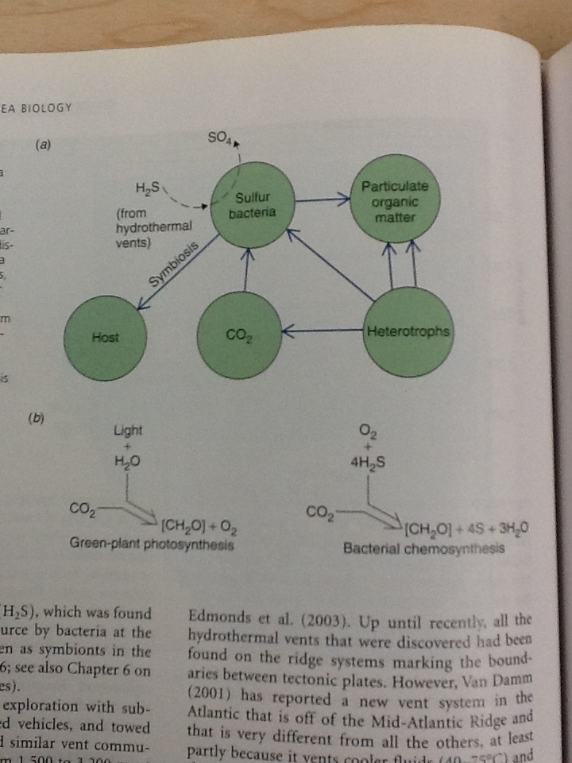
Benthic Overview Hydrothermal Vents
Hydrogen sulfide + Oxygen = Elemental sulfur + Water
Bacteria must exist on the cusp between the hydrogen sulfide and the oxygen
Hydrogen sulfide → ATP in bacteria which create complex carbons

Slide 6
Benthic Overview Hydrothermal Vents
Polychaete worms (tubeworms), crabs, shrimp, muscles, lobsters, and clams found – more yet to be discovered
Reproduction (1254:3:1 (1/2 way down))
Brooding – carry young to term
Planktonic dispersion – be free and good luck!
Carried by currents to other locations

Slide 7
Benthic Overview Cold Seeps
Cold seeps and methane hydrates
Methane CH₄
Microbial organisms
Bacteria – the basis of life
Convert methane into complex carbons
Underwater lake
Bacteria different than at the hydrothermal vents
Macrospecies similar to those found at hydrothermal vents

Slide 8
Benthic Overview Whale Falls
Whale → died → sink
Decomposition
Hagfish
Sulphophilic communities form
Microbial Organisms
Bacteria – the basis of life
Many similar species found here as well as found at hydrothermal vents

Slide 9
Benthic Overview Hood Canal
Plankton → dies → sinks makes marine snow
Eutrophication
1 High nutrient input
2 High primary productivity
3 High organic matter
4 High ‘rot’
Hood canal
We will come back to this in great depth

Slide 10
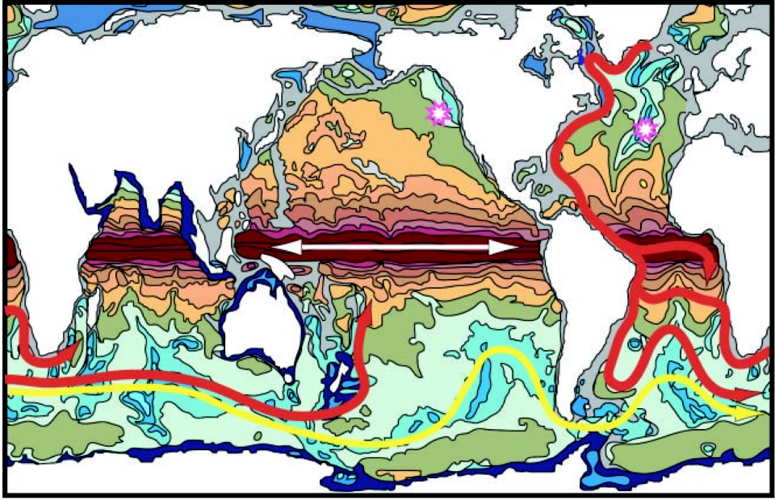
Benthic Overview Currents

Slide 11
Benthic Overview Currents

Slide 12
Benthic Overview Currents

Slide 13
Benthic Overview Currents
Read pg 11-26 → 11-32
Answer the study questions found on pg 11-26

