Slide 1
Nekton
Fish
Whales
Seals
Otters
Sharks
Squid
Octopus
Rays
Sea turtles
Dolphins
Sea lions

Slide 2
Nekton Overview
Nekton – an organism able to swim and move independently of water motion
Holoepipelagic – nektonic organism that spends the entire life in the water column
Some sharks, tunas, marlins, swordfish
Meroepipelagic - nektonic organism that spends part of the life in the water column
Herring, dolphins, salmons

Slide 3
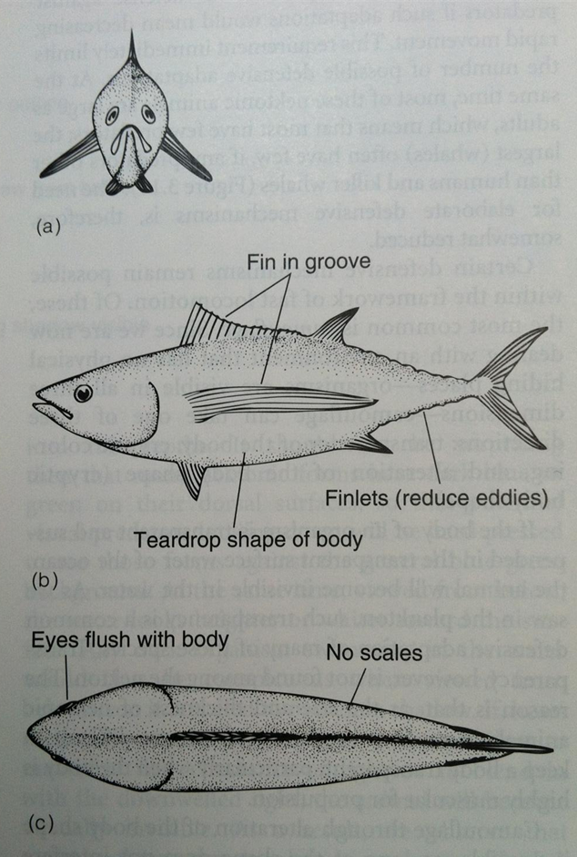
Nekton Adaptations
Buoyancy
Gas or swim bladder
Shape
Reduce drag

Slide 4
Nekton Adaptations
Predator avoidance
Cryptic coloration
Dark blue/green top
When viewed from above, the darkness fades into the darkness of the ocean
White/light color bottom
When viewed from below, the light color fades into the light color of the surface
Detection
Light (eyes): Sound (echolocation): Chemicals (olfaction)

Slide 5
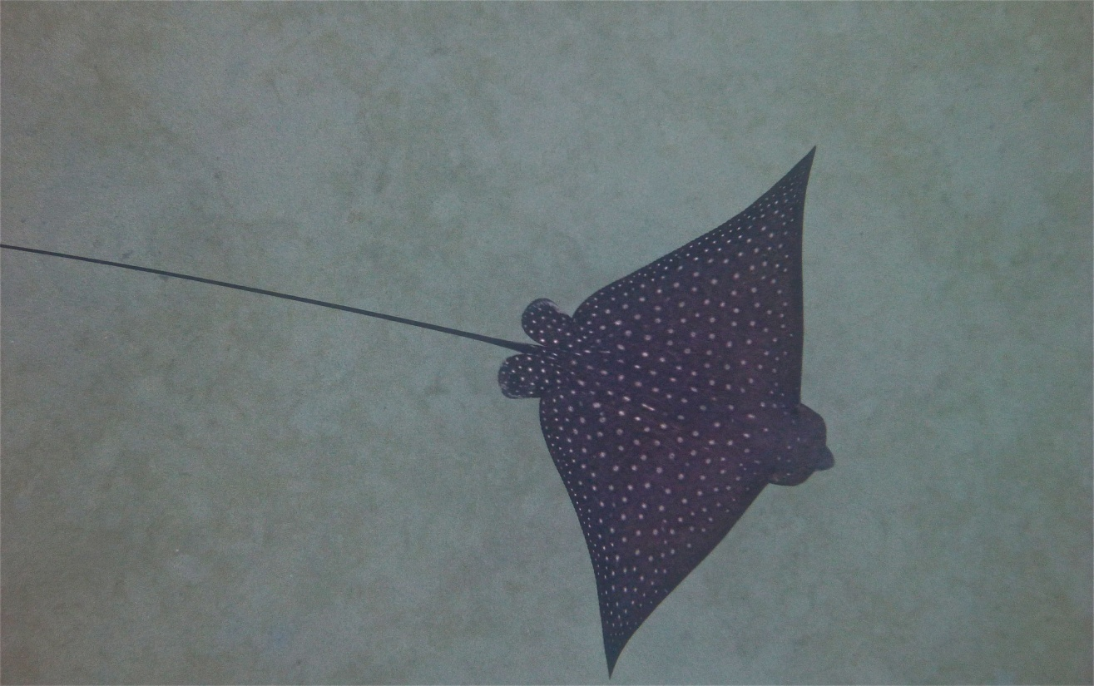
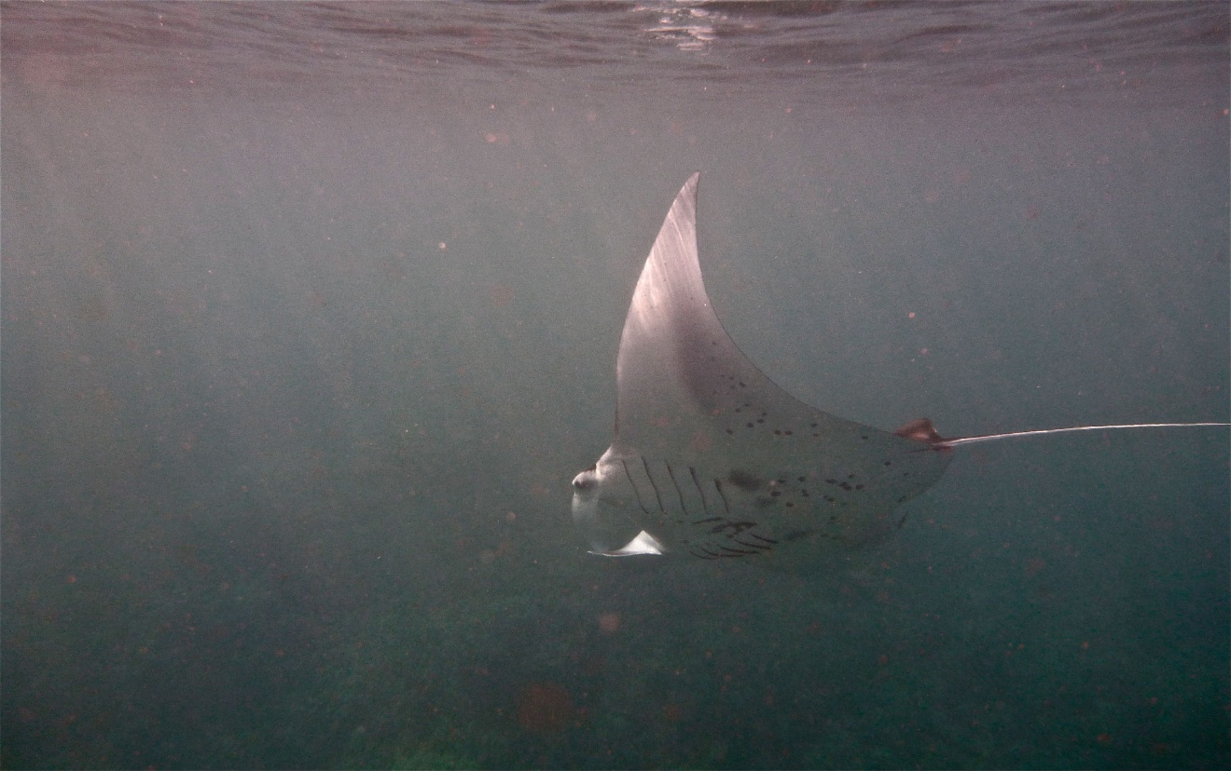
Cryptic Coloration
Top View
Photos: Emily Cohen
Bottom View

Slide 6
Nekton Adaptations
Movement to land
Resting
Procreation
Sea turtles, fur seals, sea lions, etc
Migration
Move to find food, shelter, reproduce
Fat (mammals)
Food storage
Warmth (if warm blooded)

Slide 7
Nekton Class: Elasmobranch 7-4
Sharks and Rays
Do not have bones – have cartilage
Do not have a jaw
Fins and tales provide lift
Have denticles – skin/scales that create a pocket of water to reduce friction
DIAGRAM
Tissue = to salt water
Electroreception – can detect the nervous system of prey

Slide 8
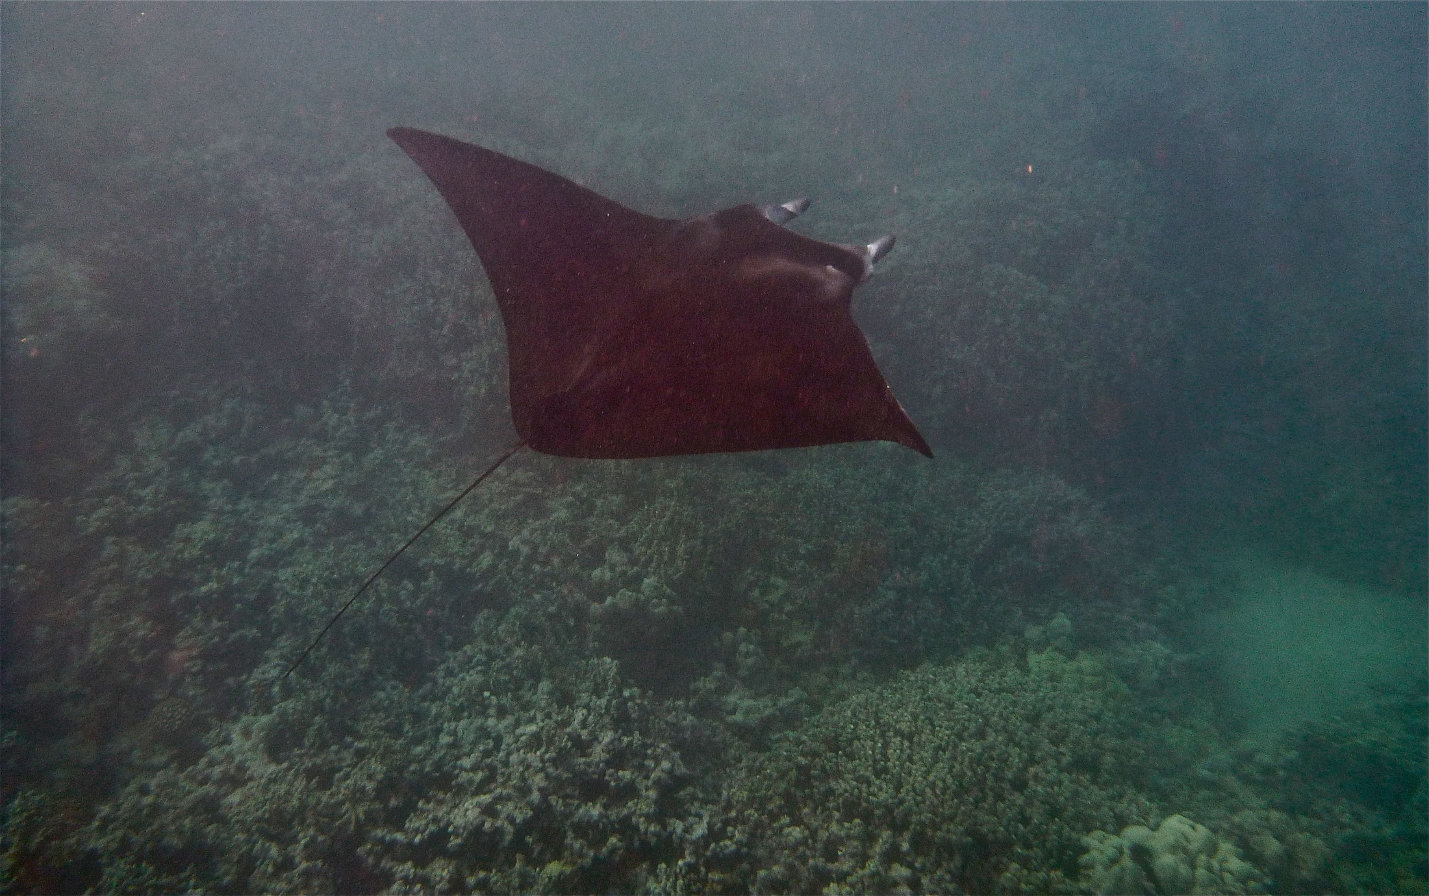
Photo by Emily Cohen

Slide 9
Nekton Class: Osteichthyes 7-11
“Bony fish”
Accounts for ½ of the world’s vertebrates
Have a jaw and bones
Order: Clupeiformes
Small fish: herring, anchovy, sardines
1972 anchovy fish population crashed
Order: Gadiformes
Cod, pollack, haddock
Atlantic cod fishing closed

Slide 10
Nekton Class: Reptilia 7-16
Order: Crocodilia – ‘fake’ marine organism
Order: Chelonia – turtles
7 species total
Lay eggs on the beach
Order: Squamata
61 species of snake
Most poisonous snakes
Amblyrhynchus cristatus – only marine lizard
herbavor

Slide 11
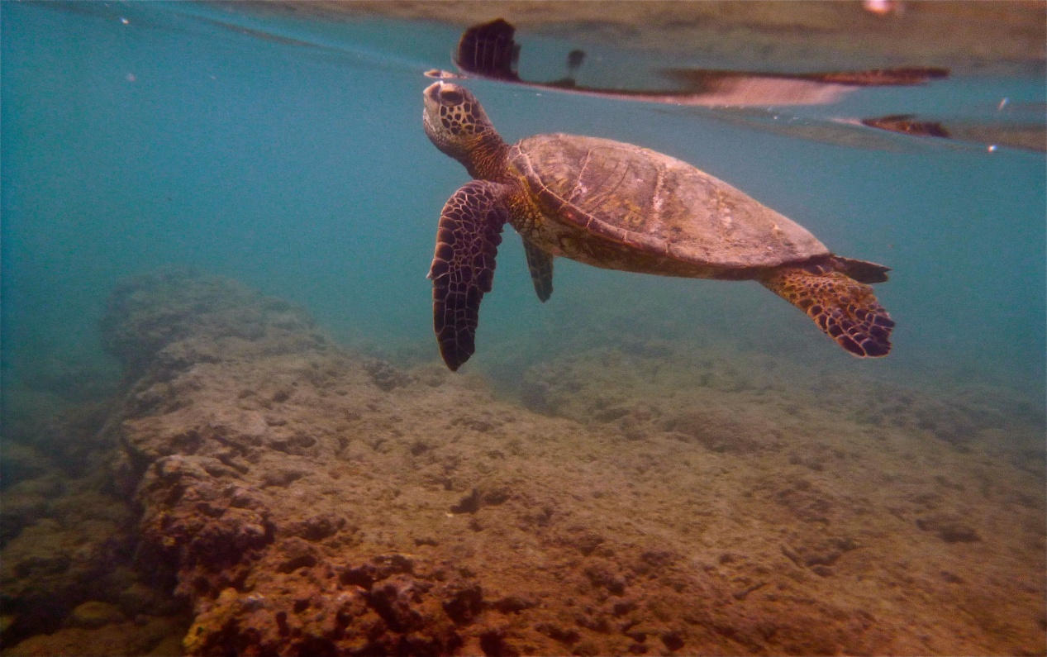
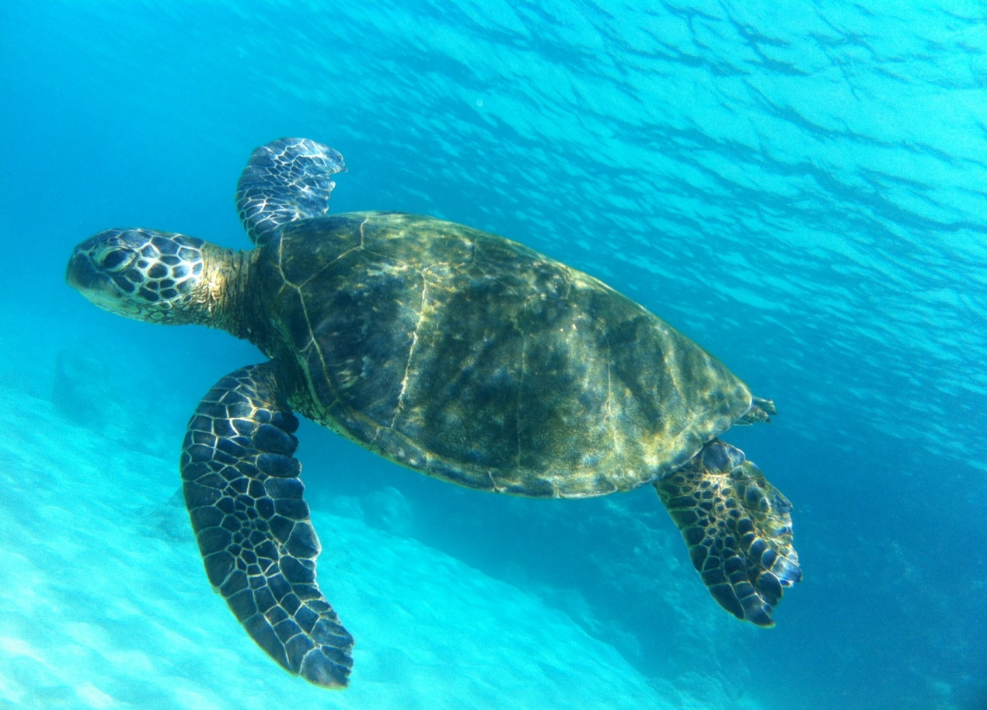
Photos by Emily Cohen

Slide 12
Nekton Class: Mammilia 7-22
Evolved on land and back to the water
Oxygen issues
Myoglobin – binds oxygen better than hemoglobin
Mammalian diving reflex – change metabolism based on depth
Water pressure – dump 95% of air in lungs
Senses – echolocation
Improved hearing/vision under water

Slide 13
Nekton Order: Pinnipedia 7-22
‘pinna’ – wing or fin
‘ped’ – foot
Seals
No ear flaps
Hind flippers point backwards
Sea lions
Has ear flaps
Hind flippers can rotate
Walrus
No ear flaps, can rotate hind flippers

Slide 14
Nekton Order: Cetacea 7-22
Dolphins, whales, porpoises
~ 90 species
Tail movement up and down
Suborder: Mysticeti
Baleen whales: Gray, Humpback, Blue
Filter feeders
Suborder: Odontoceti
Toothed whales: Orca, Sperm, Dolphin, Porpoise
predators

Slide 15
Nekton Order: Sirenia 5-22
4 species
Herbivores
Manatees migrate from fresh to salt water
Name comes from Greek sirens
Thought they were mermaids

Slide 16
Nekton Class: Cephalopoda 6-23
Greek: “head on feet”
Squids, octopus, cuttlefish, nautilus
Siphon – used as jet propulsion
Chromatophores - skin cells used for camo

Slide 17
Nekton– Human Interaction
Food
Light
Aquarium
Fur
Read 16-10 → 16-14 and answer the questions in the “Study Questions” (pg 16-10) section in your notebook.
Watch TED talk “Robert Ballard on exploring the oceans” and fill out the requirements sheet

