Slide 1
Photic Zone
Coral
Plankton
Intertidal communities

Slide 2
Ocean Overview pg 3-19
Epipelagic zone 0-200 m (sunlight zone) –
top layer of the ocean,
photosynthesis takes place
most life

Slide 3
Corals pg 14-27
Hermatypic – produce reefs
Ahermatypic – do not produce reefs
Zooxanthellae – microscopic symbiotic dinoflagellate

Slide 4
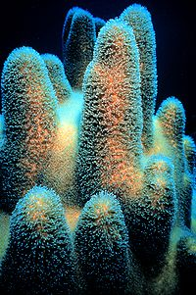
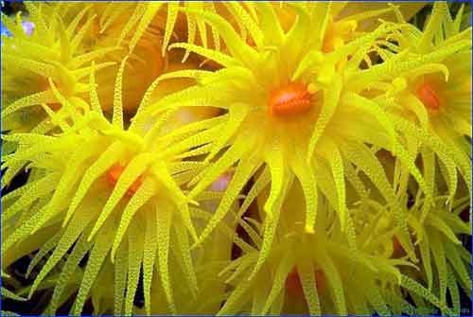
Coral structure
Colonial creatures
Small bodies

Slide 5
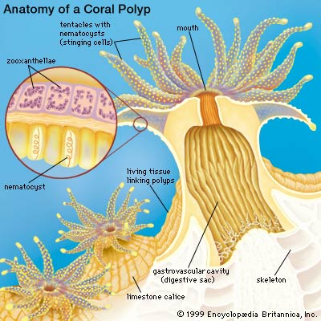
Coral Structure

Slide 6
Coral distribution and abundance
Range – equatorial region
Temperature
Mean water temperature must be above 18ºC
Optimal temperature 23-25ºC
Upwelling/currents west coast of Africa/S.A.
Light
Deepest 50-70m (1-2% surface light)
Most not below 25m
Zooxanthellae photosynthesis

Slide 7
Coral distribution and abundance
Salinity
32-35 psu
Cannot tolerate brackish water
Sedimentation
Blocks light and prevents photosynthesis by zooxanthellae
Clogs the system of the coral polyp

Slide 8
Coral distribution and abundance
Wave action
Medium
Strong waves break coral
Weak waves prevent food from entering the system
Exposure to air
Produce mucus to prevent drying
Only works for 1-2 hours

Slide 9
Coral distribution and abundance
1. Carbon dioxide and water react to form Carbonic Acid.
2. Calcium Carbonate dissociates to form calcium ions and carbonate.
3. The carbonate then joins the extra hydrogen ion to form Carbonic Acid.
Chemical reaction
Reactant →Products
Le Chatelier's Principle
Reactant ←→ Products
Acidification
CO₂ + H₂O → H₂CO₃
H₂CO₃ → H⁺ + HCO₃⁻
CaCO₃ → Ca²⁺ + CO₃²⁻

Slide 10
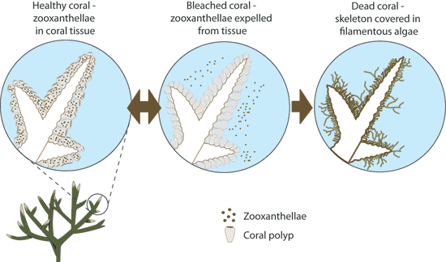
Coral bleaching
Expulsion of zooxanthellae
Polyp is left w/o nutrients and dies
Macro algae take over

Slide 11
Aussie Govt Coral Bleaching
Coral Bleaching Video

Slide 12
Intertidal Communities
Tidal area – the area exposed when the tide is out and covered when the tide is in
Found on ALL coasts
Depends on the moon
Can range from a few meters to 17 m in the Bay of Fundy

Slide 13
Intertidal Communities
Three parts
Supralittoral (splash zone)
Littoral (intertidal zone)
Upper
Middle
lower
Sublittoral (subtidal zone)

Slide 14
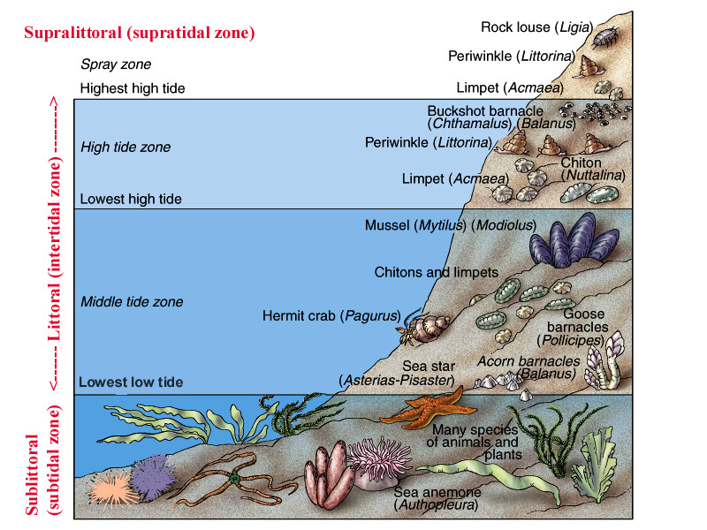
Intertidal Communities

Slide 15
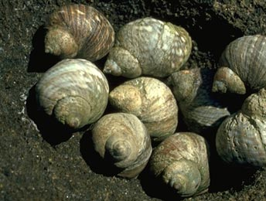
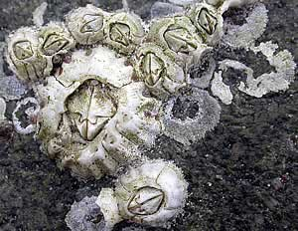
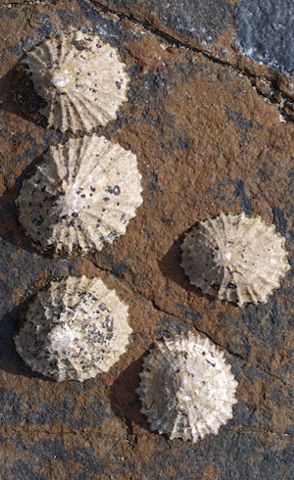
Inertial Communities – PNW
Supralittoral (splash zone)
Barnacles
Periwinkles
Limpets

