Slide 1
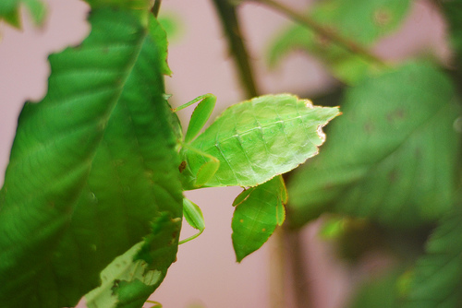
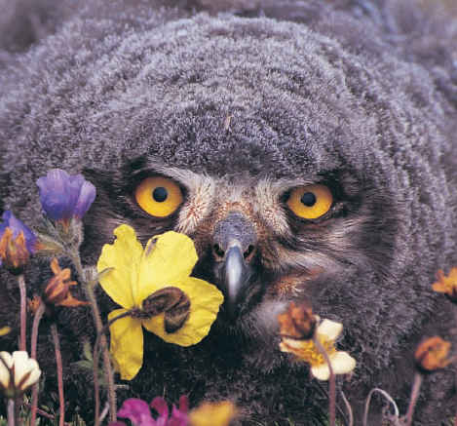
7 Themes of Biology
Also called the characteristics of life

Slide 2
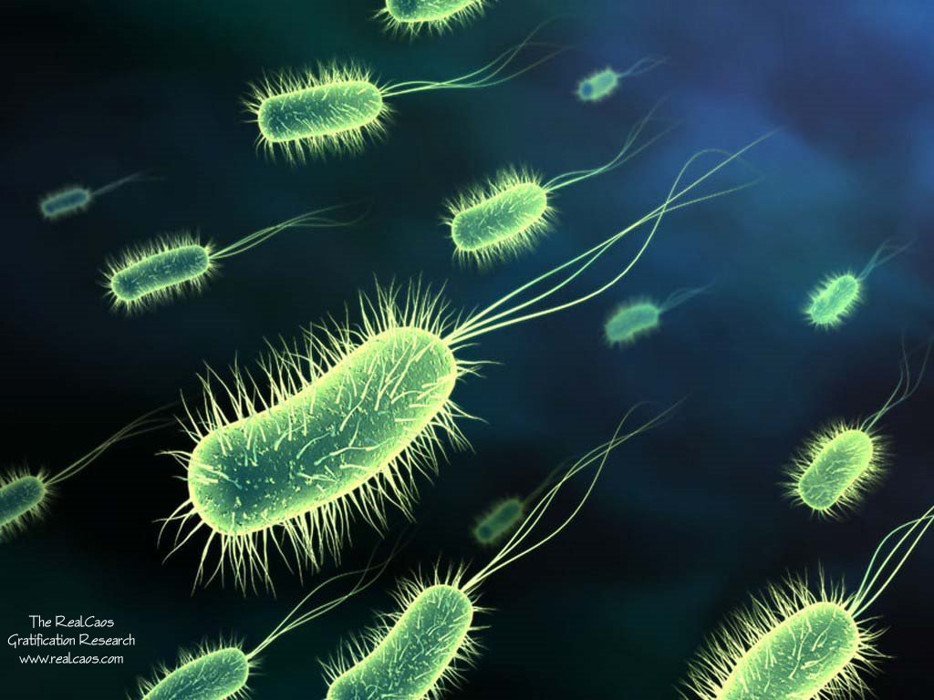
Biology – The Study of Life
Life arose more than 3.5 billion years ago
First organisms were single celled prokaryotes

Slide 3
Themes of Biology Chart (pg 7-9)
Theme | Description
1. Cell Structure and Function
Reproduction
Metabolism
Homeostasis
5. Heredity
6. Evolution
7. Interdependence

Slide 4
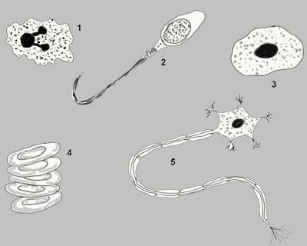
1. Cell Structure and Function

Slide 5
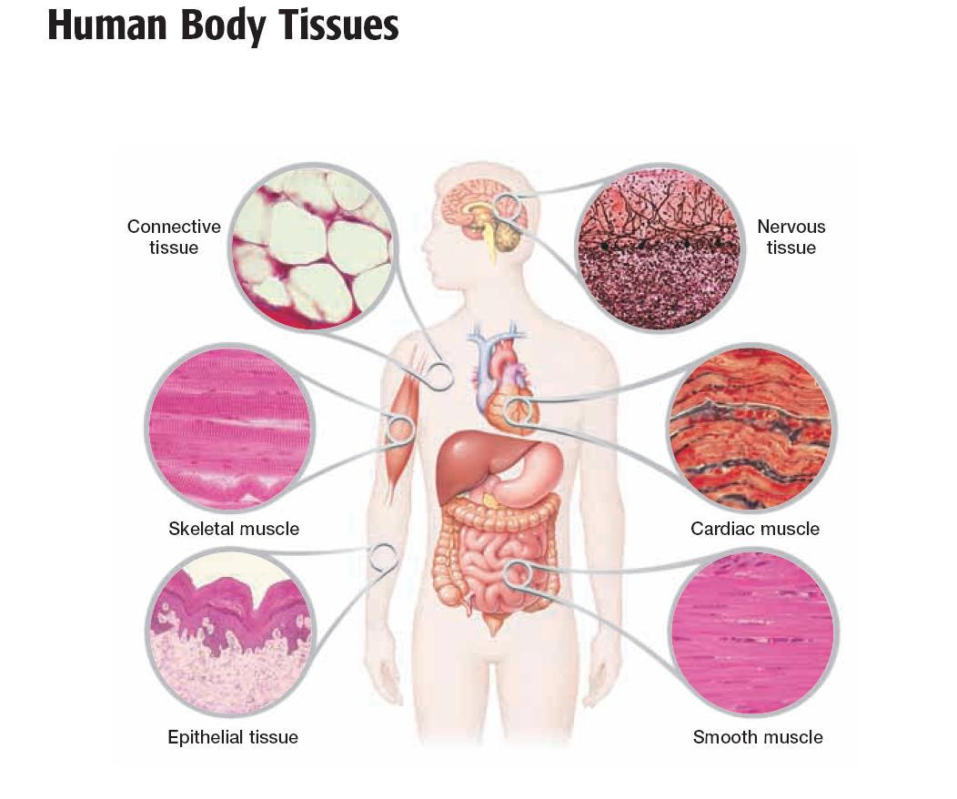
Cells lead to Organization

Slide 6
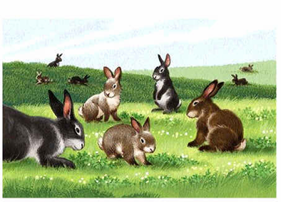
2. Reproduction

Slide 7
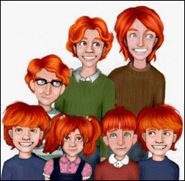
Sexual Reproduction
Involves 2 parents
Egg fertilized by sperm to make a ZYGOTE
Offspring DIFFERENT from parents
7
Notes:
7

Slide 8
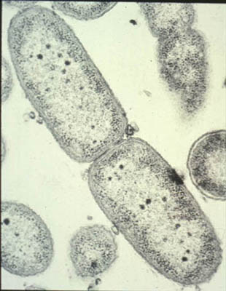
Asexual Reproduction
Involves a single organism or cell
Cell divides
Offspring IDENTICAL to parent
8
Notes:
8

Slide 9
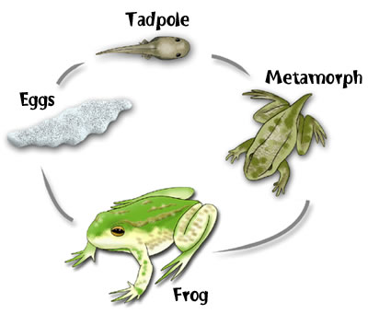
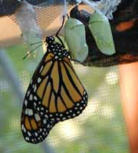
Reproduction allows for growth and development

Slide 10
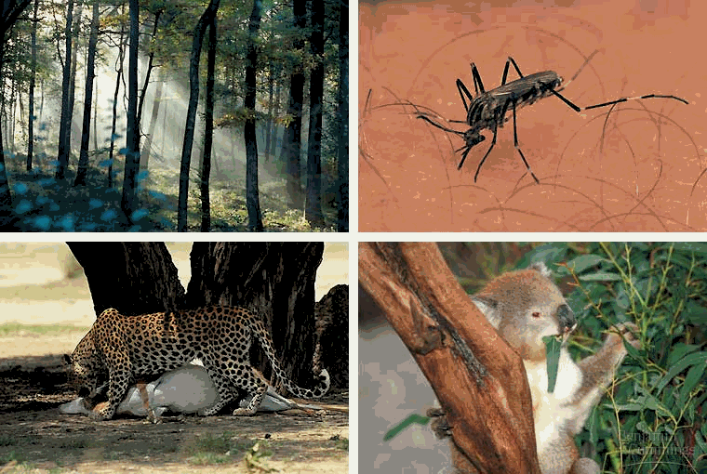
3. Metabolism
Life requires a constant supply of energy to maintain their orderly state
We use energy in a process called metabolism

Slide 11
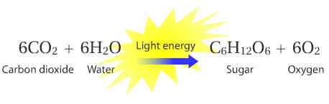
Energy
ALL energy comes from the SUN (directly or indirectly)
Photosynthesis

Slide 12
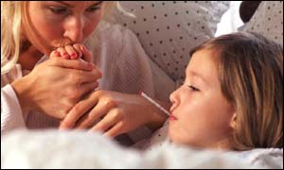
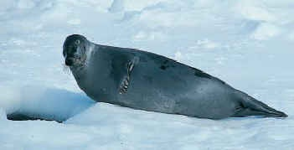
4. Homeostasis
Organisms must maintain very stable internal conditions - HOMEOSTASIS
Temperature, water content, chemical content, etc. must be maintained

Slide 13
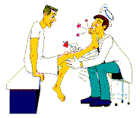
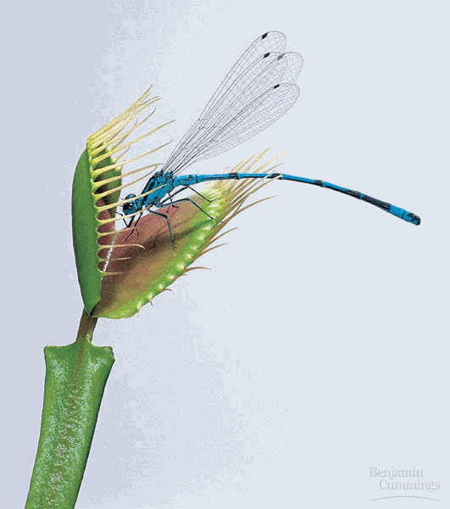
Responsiveness
The ability to respond to stimuli is essential to maintaining Homeostasis.
Common stimuli are heat, cold, light, sound, movement, touch, and of course other organisms.

Slide 14
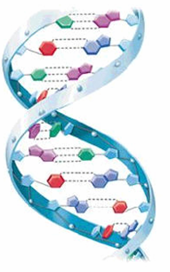
5. Heredity
Genetic Information in all cells
DNA contains instructions for traits - GENES

Slide 15
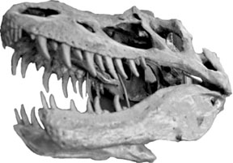
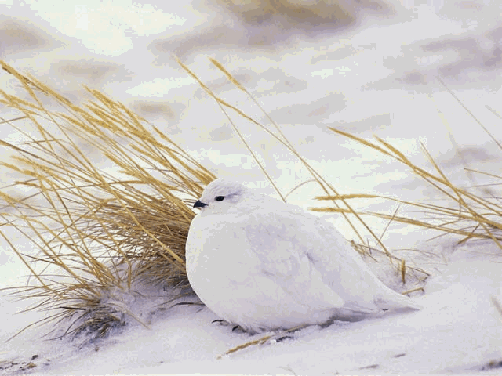
6. Evolution
Groups Of Organisms (not individuals) change over time in order to survive changing environments.
Fossil records show changes in groups of organisms

Slide 16
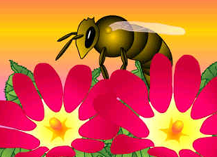
7. Interdependence
Interaction of organisms with one another and with their environment -ECOLOGY
Insects depend on flowers for food & pollination

